Slide 1

NACO Training
Prepared by
the PCC Standing Committee on Training
RDA NACO Program Training Workshop Task Group
Notes:
(Date of slide or last update given at the top of the notes for each slide)
Trainers may customize this slide.
Introduce yourself and have attendees introduce themselves. Extend a welcome to the NACO program and mention that NACO libraries are valued participants in building the LC/NACO Authority File.
Be sure to talk about: where are the bathrooms; what is the schedule for breaks and lunch; where is the food to come from; is there a close source of drinks and/or coffee; inform people of any emergency information, such as where to go in the event of a fire alarm.
Breaks are typically 20-30 minutes. Lunch is generally an hour or no longer than one hour and fifteen minutes.
Note: this training is geared toward OCLC libraries.

Slide 2
Developed by the SCT RDA NACO Program Training Workshop Task Group:
  Lori Robare, Chair
  Michael Colby
  Joanna Dyla
  Paul Frank
  Fang Gao
  Robert Maxwell
  Mark Scharff
  Adam L. Schiff
Notes:
May 1, 2013

Slide 3
NACO Foundations
Module 1
Notes:
May 1, 2013

Slide 4
Learning Objectives (1)
At the end of the course, participants will be able to:
  Consult and use MARC 21 Authority Format, LC Guidelines Supplement, and LC Descriptive Cataloging Manual, Section Z1 (DCM Z1)
  Create and revise NARs according to RDA and the LC-PCC Policy Statements
Notes:
February 24, 2014
Consult and use MARC 21 Authority Format, LC Guidelines Supplement, DCM Z1 as tools for name authority creation.
These tools can be found in Catalogers Desktop and on the PCC NACO page at http://www.loc.gov/aba/pcc/naco/doc-updates.html.
We will go over these tools in this module.
2) Create and revise NARs according to RDA & the LC-PCC Policy Statements (LC-PCC PSs).

Slide 5
Learning Objectives (2)
Apply content designation in accordance with the MARC 21 Authority Format
Evaluate, update, and modify existing name authority records
Determine if a named entity is established through NACO or SACO
Understand NACO administrative details
Notes:
March 20, 2017: updated speaker notes
“Content designation” means the tags, indicators, and subfield codes in a MARC record – the coding that makes it possible for a computer to interpret the information found in a record. RDA is a content standard that can be used with many different data formats, not just MARC, but for now we are still working in a MARC 21 environment so that is the focus of this workshop.
Module 7 of the workshop includes a set of exercises on making changes to existing authority records.
You may mention that deciding whether a named entity is established through NACO or SACO can at times be challenging. We will look at ways you can make this determination.
NACO administrative details include: NACO independence, the review process, etc. These will be discussed in the final module of the workshop.

Slide 6
Day 1: NACO Foundations
Authorities in a Shared Database
PCC NACO Principles and Parameters
Searching/BFM
Normalization
FRBR and FRAD
MARC 21 Authority Format
Notes:
May 1, 2013
Normalization: a computer edit designed to eliminate all but the essential characters of an access point for the purpose of comparison.
MARC 21 Authority Format: prepared by the Network Development & MARC Standards Office; defines the codes and convention tags (tags, indicators, subfield codes, and coded values that identify the data elements in MARC authority records)

Slide 7
Day 2: Describing Persons
RDA Chapters 8 and 9
Review LC-PCC PSs
Practicum and exercises
Notes:
Updated: March 20, 2017
Note to trainer: allow time for the creation of personal name authority records on Day 2.

Slide 8
Day 3: Describing Families
Describing Corporate Bodies
Families: RDA Chapters 8 and 10
Corporate bodies: RDA Chapters 8 and 11
Review LC-PCC PSs
Practicum and exercises
Notes:
Updated: March 20, 2017
Corporate bodies including conferences: RDA chapters 8 and 11 and corresponding LC-PCC PSs.
Other topics covered: Government and non-government bodies, direct/indirect entry, etc.
Note to trainer: practicum in the creation of NARs should be done by participants in the afternoon.

Slide 9
Day 4: Describing Places
Describing Works and Expressions
Places: RDA Chapter 16 (in conjunction with Chapter 11)
Works and Expressions: RDA Chapters 5 and 6 (in conjunction with Chapters 8-11)
Review LC-PCC PSs
Practicum and exercises
Notes:
March 27, 2017: removed reference to Chapter 12 given RDA Toolkit Restructure and Redesign project
Describing Works and Expressions: RDA Chapters 5 and 6 (in conjunction with Chapters 8-11, when constructing access points that include a personal, corporate, or family name as a creator)
Note to Trainer: practicum in the creation of NARs should be done by participants in the afternoon.

Slide 10
Day 5: Making Changes to Existing NARs and NACO Administration
Changes to NARs (DCM Z1)
Review LC-PCC PSs & DCM Z1
Practicum and exercises
NACO administrative details
Notes:
Updated: February 24, 2014
A great deal of NACO work involves access points that are already established. On the fifth day we talk about evaluating and changing NARs. It’s also the day to wrap up the training week and anticipate the next steps in the review process.
Note to trainer: practicum on the creation of new authority record in the afternoon, if necessary or time allows.

Slide 11
Day 1: NACO Foundations
This module is designed to introduce NACO participants to:
The shared database environment
PCC NACO principles and parameters
MARC 21 Authority Format
LC Guidelines Supplement to MARC 21
DCM Z1
Notes:
February 27, 2020: updated speaker notes (added URLs for documentation)
May 15, 2024: updated URL for LC Guidelines Supplement and DCM Z1
Shared database environment: Define what this means (e.g., participants from national and international libraries working together to create NARs for the common good of all users).
PCC NACO parameters: The underlying principle of the LC/NACO Authority File is that participants agree to follow a common set of standards and guidelines when creating or changing authority records in order to maintain the integrity of a large shared authority file. These guidelines will be discussed later. There is a need to streamline efforts while building a consistent and predictable file that will reduce the efforts of the global library community and maximize its resources.
MARC 21 Authority Format: show if available. https://www.loc.gov/marc/authority/
LC Guidelines Supplement to the MARC 21 Authority Format: available in ClassWeb Plus (linked from MARC 21 Authority Format and separately) and linked from NACO Documentation & Updates page (https://www.loc.gov/aba/pcc/naco/doc-updates.html). https://www.loc.gov/aba/publications/FreeDCM/DCM/ZAU.pdf
DCM Z1: available in ClassWeb Plus (linked from MARC 21 Authority Format and separately) and linked from NACO Documentation & Updates page (https://www.loc.gov/aba/pcc/naco/doc-updates.html). https://www.loc.gov/aba/publications/FreeDCM/DCM/Z01.pdf

Slide 12
NACO Principles:
Authorities in a Shared Database
Notes:
May 1, 2013

Slide 13
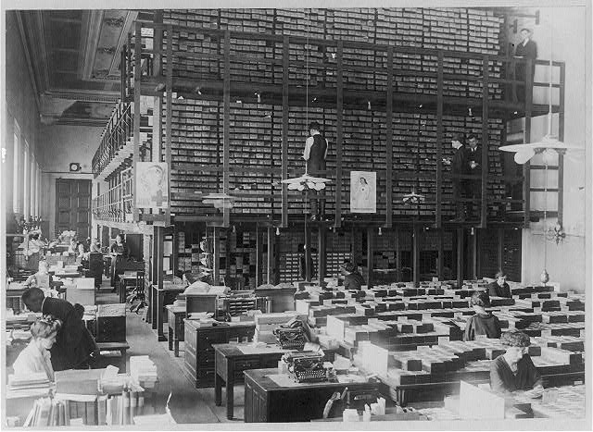
Standards in Card Catalogs
“The Card Division” in the early 1900s
Notes:
December 12, 2016: updated speaker notes
Library of Congress sold card sets to libraries roughly from 1900 to 1982. Other vendors also sold cards.

Slide 14

Standards Today
We have moved away from limitations of card catalogs
LC is a member of PCC and must meet the same standards as any NACO library
Notes:
May 1, 2013
The Library of Congress, early on, set the standards among library catalogs around the world. Many of the standards that we work from today, especially for bib records, still reach back into the paper format of a 3x5” card that was used for so long. But we are slowly but steadily moving away from those limitations.
LC continues to be a major contributor to library standards followed around the world.

Slide 15
PCC Program Overview
NACO
BIBCO
CONSER
SACO
Notes:
Updated August 6, 2019
The Program for Cooperative Cataloging was initiated in February 1995.
The PCC is made up of four programs: NACO (Name Authority Cooperative Program), BIBCO (Monographic Bibliographic Record Program), CONSER (Cooperative Serials Program), and SACO (Subject Authority Cooperative Program).
There are over 950 PCC member libraries (957 as of September 30, 2016), including full-level NACO members, NACO funnel projects, and SACO-only members (21)
The Library of Congress (LC) is one of the PCC partner institutions.
The PCC is an international cooperative effort. Other PCC institutional members include: University of Toronto; the British Library; Trinity College, Dublin; National Library of South Africa; National Library of Wales; National Library of Israel; National Library of New Zealand; Singapore Integrated Library Automation Services; Hong Kong University of Science & Technology; and various international funnel projects, for example: Canada Project, NACO Chile, NACO Mexico; NACO Peru, GAELIC South Africa Project, Caribbean Project.
Membership in NACO is a prerequisite for participating in BIBCO and CONSER.
It is possible to participate in SACO without membership in NACO.
Trainers note: you can check with the Cooperative Programs section for updates on membership numbers before giving the workshop.

Slide 16
Name Authority Cooperative Program
(NACO)
Over 950 NACO members
  Full-level members
  NACO funnel projects
Funnels may be based on geography, specialization (art, music), or language
NACO partners contribute name authority records to LC database via utilities
Notes:
December 12, 2016: updated statistics
NACO began in 1977 as a joint project between LC and the Government Publications Office (GPO) to use and maintain a common authority file which would reduce the cost of authority work, the most expensive aspect of cataloging.
At the end of fiscal 2016, there were 957 institutions participating as either full-level NACO members or in NACO funnel projects. [Note: This figure comes from adding the NACO-only institution number with the institutions in BIBCO and CONSER in the PCC statistics document]
NACO funnel projects are formed to pool resources, expertise and contributions.
NACO-contributed records account for well over half of all new name and series records in the authority file. In fiscal 2012, PCC contributions exceeded LC contributions by 127.8%.
The NAF contains about 9.7 million records (2016).

Slide 17

Exchanging Records
More standardization required
Local systems/utilities are different
Earlier MARC formats were diverse (US MARC, CanMARC, UK MARC)
MARC 21 is more universal
Notes:
May 1, 2013
1) As the library becomes more globalized, we are making more and more efforts to harmonize the rules and standards we work under, not just in MARC formats, but also in how to establish a unique identifier.
2) There is still a great deal of work to be done, but international harmonization efforts continue to grow, and you are now going to be a part of that.

Slide 18
MARC 21 to BIBFRAME
Efforts are underway to transition from MARC 21 to a new bibliographic framework
Collaborative process
Focus: translate the MARC 21 format to a linked data model
  While retaining as much as possible the robust and beneficial aspects of MARC
Proposed model: BIBFRAME
  http://bibframe.org/
Notes:
May 1, 2013
Libraries have used the MARC format for exchanging information since the 1960s. Efforts are now underway to transition to a new bibliographic framework that will better accommodate the future needs of the library community.
The Library of Congress is leading the Bibliographic Framework Transition Initiative as a collaborative process. LC contracted with Zepheira to provide a model as a starting point of discussion.
The proposed model is called BIBFRAME. Early experiments are underway, but it will take time for the model to be fully developed and implemented. We are still working in MARC 21 for now.

Slide 19



Authority Record Creation and Distribution
Utilities (such as OCLC and SkyRiver) and the British Library contribute authority records, which are then sent to LC.
British Library
Utilities
LC/NACO AUTHORITY FILE (NAF)
Each morning all contributed authority records, including LC’s, are redistributed to the BL, the utilities, and all CDS customers.
19
Notes:
May 1, 2013
Utilities such as OCLC and SkyRiver along with catalogers at the British Library and NLM contribute authority records to the NAF. Records are now transferred on a daily basis.
Today most libraries contribute to the master file in the LC database via OCLC, creating an authority file that is international in scope.
Copies of all new and changed records are re-distributed by LC on a daily basis to its bibliographic partners in order to synchronize the three files.
(CDS – Cataloging Distribution Service)

Slide 20
High Value – Low Effort
NACO’s goal:
To build a name authority file
For the greatest good of all
With the least amount of effort by participants
Notes:
May 1, 2013

Slide 21
Dynamic File
The LC/NACO Authority File is a dynamic file, changing every 24 hours
Any record may be changed by another NACO participant for appropriate reasons
Notes:
Updated: February 24, 2014
1) The LC NACO Authority File is in constant flux, changing every 24 hours.
2) NACO members modify authority records frequently. In recent years, nearly half of NACO activity involved changes to existing records. As we transition to RDA, there are likely many more modifications than new records.
a) New information is constantly coming in through regular cataloging, so we can expect constant change. Even though this does cause a need for maintenance, it is nonetheless a good thing in the long run.
b) Remember that one of the most important rules of a shared database is to respect your colleagues. Everybody makes mistakes, and you are certainly free to modify an authority record if you discover an error in fact or form, or have new information to add.
c) But a difference of opinion is not an acceptable reason to make changes to the authorized access point. Reasons for making changes to an authorized access point include: conflict, author preference, record created in error, etc.
d) any other aspect of the record can be changed or added to, e.g., adding new RDA elements, new variant access points, etc.

Slide 22
The Catalog Serves the Users
According to the Statement of International Cataloging Principles:
Controlled access points should be provided for the authorized and variant forms of names
Controlled access points provide the consistency needed for collocating the bibliographic records for sets of resources
Notes:
May 1, 2013
1) This comes from the Statement of International Cataloging Principles developed by the International Federation of Library Associations (IFLA): http://www.ifla.org/files/assets/cataloguing/icp/icp_2009-en.pdf
2) Remember that this basic idea applies to all names, not just people. In fact, that is what we are covering in this entire course, all the different entities that have names or titles and therefore need unique identifiers.

Slide 23
NARs and the NAF
Name authority record (NAR) shows authorized access point and variant access points, and describes the entity using RDA elements
LC/NACO Authority File (NAF) includes all NARs
Libraries choose levels of authority control
DCM Z1 Introduction describes LC’s policies for when to create a name authority record
Notes:
December 12, 2016: updated first bullet point to more fully describe the function of the NAR
3rd bullet: Libraries in NACO may decide which areas of their collection will require name authority records. They may choose to contribute NARs to NACO for only certain parts of their collections. They may use slightly different practices for their local authority files. For example, a local author who has only a vanity press publication in your file may not need a national-level authority record. Or maybe that person is the one you need to make sure gets into the NAF. It’s up to your institution to decide on these policies.
4th bullet: DCM Z1 Introduction describes LC’s policies for when to create a name authority record.

Slide 24
Cataloger’s Judgment
Use judgment when applying many instructions
A different choice isn’t always an error, so respect the judgment of your colleagues
Leave a correct, unique authorized access point alone
Notes:
May 1, 2013
1) Over time, each cataloger will find their judgment developing with their own area of specialty (e.g. public libraries vs. the needs of academic libraries). Learn to trust your judgment. Sometimes there is no right or wrong answer, just what is appropriate to the needs of your library.
2) As much as possible, leave a correct, unique authorized access point alone.

Slide 25
Specific Practices
A practice may not apply equally to all parts of NACO work
  e.g., Geographic names always require research, but personal names seldom do
Notes:
May 1, 2013
As we go through the instructions, we will show where there are practices specific to an area, and what exceptions exist to general policies.

Slide 26
Focus on Work in Hand
Focus on records related to an item being cataloged
NACO (including LC) catalogers are discouraged from cruising the database to find errors
Notes:
February 24, 2014

Slide 27
Go To the Source
Ask the other library’s NACO contact if you notice problems in an authority record
NACO liaisons:
http://www.loc.gov/aba/pcc/naco/pccliaisons.html
Notes:
May 1, 2013
The NACO liaisons or contacts’ email addresses and phone numbers for the various PCC NACO institutions are on the NACO web page.
If you spot a continuing pattern of suspicious cataloging practices, you could mention it to naco@loc.gov and let them investigate it. This is generally a better procedure than pointing out mistakes on public discussion lists.

Slide 28
NACO Parameters
Documentation
Contribution guidelines—PCC
Changes to existing NARs
Cancellation of NARs
Bibliographic File Maintenance (BFM)
Searching (why, how, and when)
Normalization rules
Notes:
May 1, 2013
1. Participants agree to a common set of standards when creating or changing records.
2. This maintains the integrity of the LC/NACO Authority File (which will sometimes be call “NAF” in the following slides).
3. The primary purpose of this workshop is to teach you the standards that underlie our work.
4. The goal is to follow a common set of standards and guidelines when creating or changing authority records in order to maintain the integrity of a large shared authority file

Slide 29
NACO Parameter:
Documentation
RDA Toolkit
LC-PCC PSs
MARC 21 Authority Format
LC Guidelines Supplement to the MARC 21 Authority Format
Descriptive Cataloging Manual (DCM Z1)
Notes:
October 14, 2024: revised notes
November 12, 2019: revised second bullet (current text of the old RDA in RDA Toolkit is no longer updated frequently)
All new authority record contributions are to be formulated using the following documentation:
RDA – Resource Description and Access. These instructions must be applied by NACO participants in conjunction with the LC-PCC PSs. Participants must have access to the RDA Toolkit.
LC-PCC PSs – Library of Congress/Program for Cooperative Cataloging Policy Statements. These guidelines provide the PCC and LC policies related to RDA, with clear labels indicating any differences in application. They identify core elements, explain practices for alternative instructions and options, and provide explanation and expansion of certain instructions in an attempt to assure uniformity which will facilitate retrieval, and increase the predictability of data elements in the NAF. NACO participants must follow the LC-PCC PSs and they trump RDA instructions.
MARC 21 Authority Format – describes and illustrates the structural elements (content designation) of authority records, such as leader, fixed fields, variable fields, subfields and all codes which are defined for these fields. These fields will be discussed later in Day 1. Note: LC does not implement all of the MARC 21 elements described, and since the PCC program records follow LC guidelines, participants must refer to the LC Guidelines Supplement.
LC Guidelines Supplement – use when applying content designation
DCM Z1 – Descriptive Cataloging Manual Z1
Note: LC-PCC PSs are freely available as part of the RDA Toolkit (on the Resources tab). The MARC 21 formats, LC Guidelines Supplement, and DCM Z1 are available through ClassWeb Plus. MARC 21 Authority is also freely available on the MARC standards website (https://www.loc.gov/marc/authority/). The LC Guidelines Supplement and DCM Z1 are also freely available as PDF files on the LC PTCP website (https://www.loc.gov/catdir/cpso/z1andlcguidelines.html), which is linked from the NACO Documentation & Updates page (http://www.loc.gov/aba/pcc/naco/doc-updates.html). Individual quarterly updates to DCM are also linked to from the same NACO page.
Note: In the past, MARC 21 Authority Format was sometimes called the “white pages,” LC Guidelines were called “blue pages,” and DCM Z1 was called “yellow pages” because of the colors used for printing and interfiling. This terminology is no longer used as online documentation has become the norm.

Slide 30
Use Both RDA and LC-PCC PSs
RDA gives the basic instructions
LC-PCC PSs give further explanations, additional applications, and examples
LC-PCC PSs tell which RDA options and alternatives to apply
  LC-PCC PSs take precedence over RDA
Notes:
May 1, 2013

Slide 31
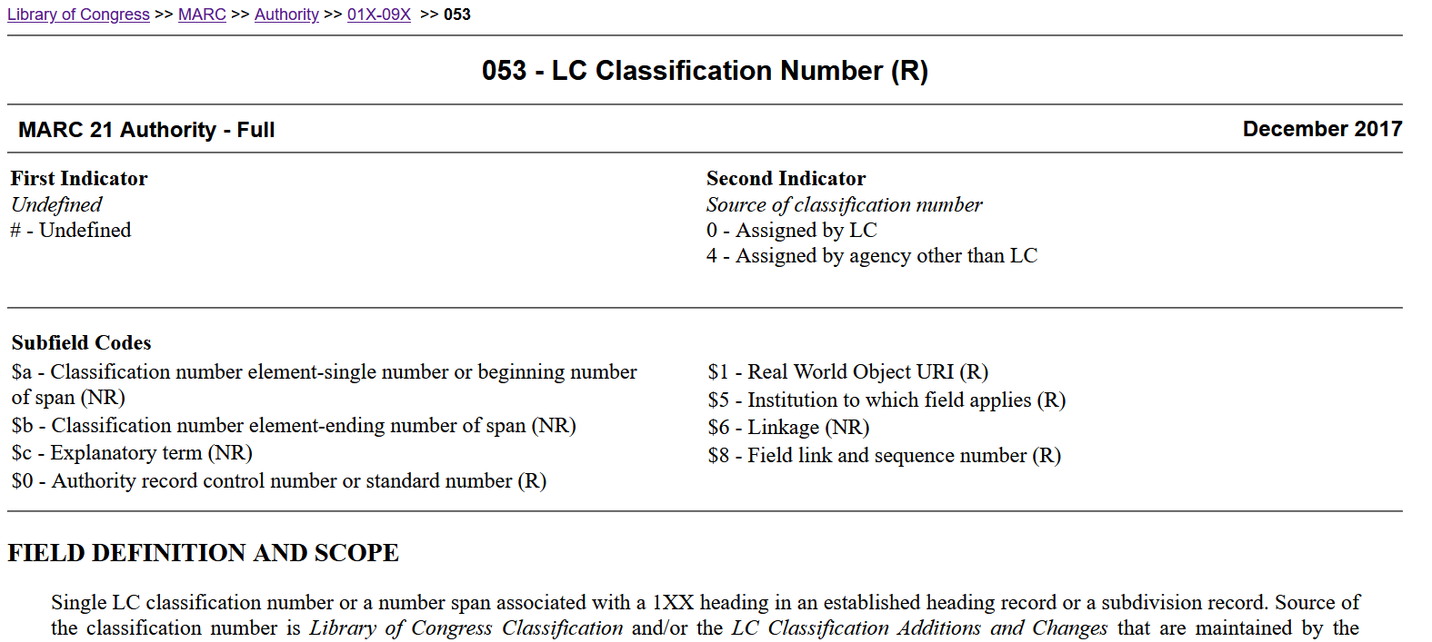
MARC 21 Format : www.loc.gov/marc
31
Notes:
May 15, 2024: updated the image and info about ClassWeb Plus
Note to Trainer: If possible, demonstrate ClassWeb Plus https://classweb.org/Menu/docs.html (or start at https://classweb.org/Menu/ - Cataloging Policy Documentation) in a browser.
This is a representation of the format of fields described in MARC 21 Format for Authority Data—in this case the 053 field is demonstrated.
MARC 21 Format for Authority Format – The basic pages that describe and illustrate the structural elements (content designation) of authority records, such as the leader, fixed fields, variable fields, subfields, and codes defined for these fields.
LC does not implement all elements described in the MARC 21 Authority Format, and since the PCC program records follow LC guidelines, participants must refer to the supplements known as the “LC Guidelines” when applying the content designation to authority records.
A MARC record is composed of three elements: the record structure, the content designation, and the data content of the record.

Slide 32
LC Guidelines Supplement to MARC 21 Authority Format
Instructions for LC, NACO, SACO, series, subjects practices
Many have the statement “Do not use this field/subfield”
Notes:
May 1, 2013
LC Guidelines are prepared by the MARC Standards Office at LC.
Libraries using the MARC record structure do not always implement every part of the MARC coding.
Since the PCC name and subject authority files are essentially LC local authority files, they follow LC’s implementation patterns.

Slide 33
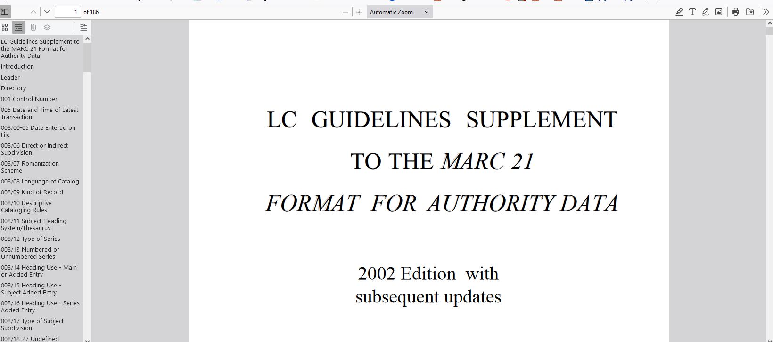
LC Guidelines Supplement
Notes:
December 12, 2016: updated image
LC Guidelines Supplement to MARC 21 Authority Format is issued by the Network Development and MARC Standards Office at LC to state which MARC 21 elements in the MARC 21 Authority Format are not implemented by LC and/or the PCC.
Note: This is now found through ClassWeb Plus or https://www.loc.gov/aba/publications/FreeDCM/DCM/ZAU.pdf.

Slide 34
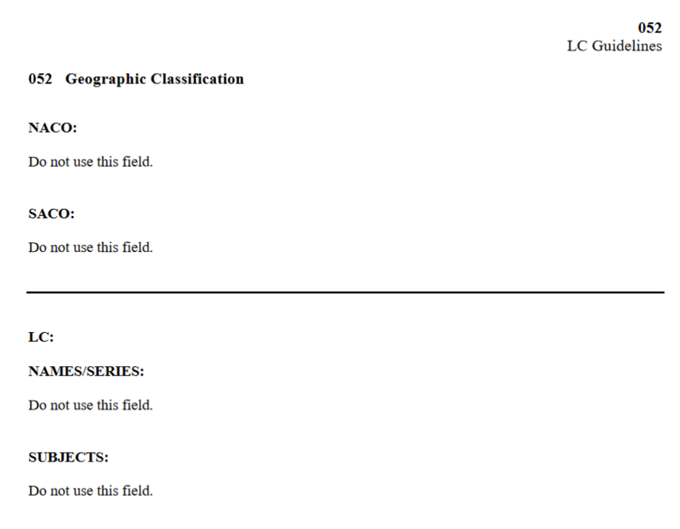
Notes:
October 14, 2024: new slide
An example of an authority field that isn’t used in NACO. “Do not use this field.”

Slide 35
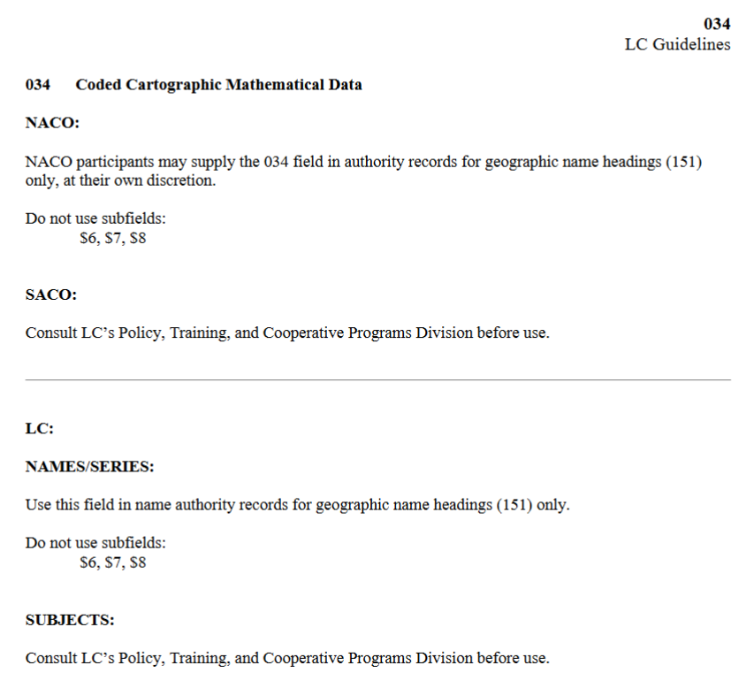
Notes:
October 14, 2024: new slide
An example of an authority field that may be used, but certain subfields are not.

Slide 36
Descriptive Cataloging Manual
(DCM Z1):
Name and Series Authority Records
Instructions on handling NAR and SAR practices
LC & PCC practices where they differ
NACO normalization
Examples
Notes:
May 1, 2013
LC’s Policy and Standards Division maintains DCM Z1, reflecting the program practices for the content of name and series authority records.
DCM Z1 also includes:
1. Conversion tables for fixed field names and tags in OCLC
2. Suggested wording for notes fields
3. Instructions for using records from other sources
4. Appendix 1 – Alphabetic List of Ambiguous Entities
Trainer note: As of June 1, 2006, LC does not create or update SARs

Slide 37
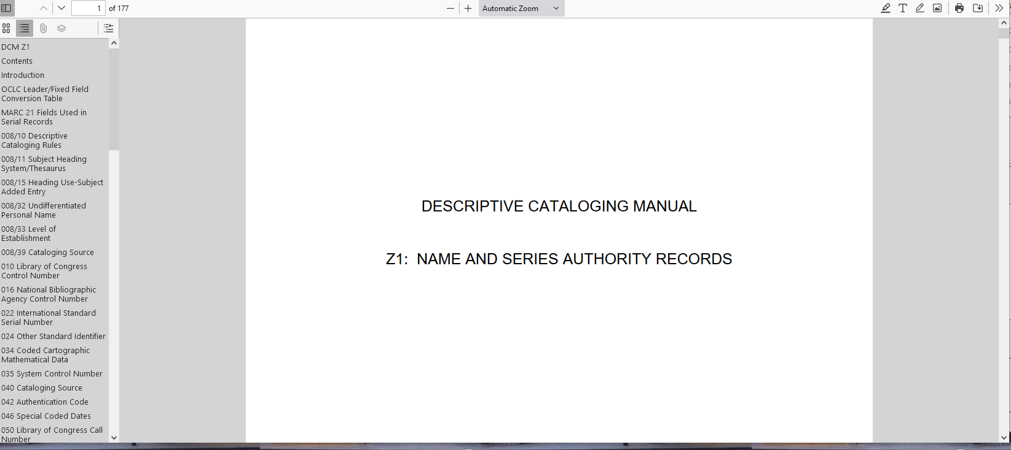
DCM Z1
Notes:
May 14, 2024: updated to delete Cataloger’s Desktop information.
ALSO: removed next three slides (36-38) which showed links in Cataloger’s Desktop that no longer exist.
December 12, 2016: updated image
DCM Z1:
Note: This is now found through ClassWeb Plus or https://www.loc.gov/aba/publications/FreeDCM/DCM/Z01.pdf

Slide 38
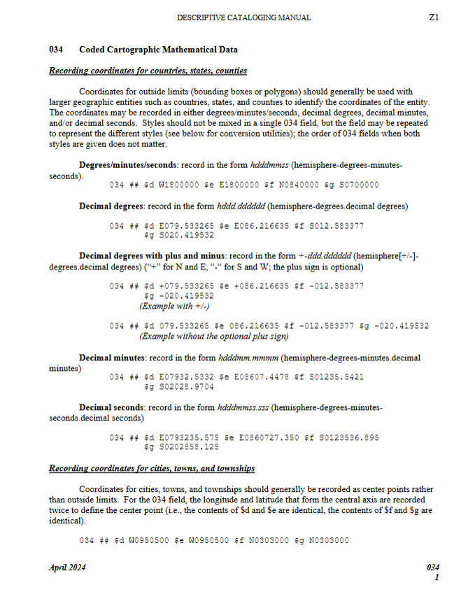
Notes:
October 14, 2024: new slide
Example of instructions on how to use the 034 in authority records. Compare with what we saw in the LC Guidelines Supplement for the same field.

Slide 39
Other Documentation
Alphabetic List of Ambiguous Entities
  DCM Z1: Headings for Ambiguous Entities
  Subject Headings Manual (SHM) H 405
ALA-LC Romanization Tables
Policy announcements, FAQs, guidelines, etc. from PCC/NACO and LC
Notes:
May 15, 2024: added new locations for Z1 and SHM
August 5, 2019: revised third bullet, which didn’t match the content shown later in slides 45-47
We will discuss each of the bullets in the following slides.
DCM Z1 is now at https://www.loc.gov/aba/publications/FreeDCM/DCM/Z01.pdf. Ambiguous entities is in Appendix 1.
SHM H 405 is now at https://www.loc.gov/aba/publications/FreeSHM/H0405.pdf.
See https://www.loc.gov/aba/pcc/naco/doc-updates.html

Slide 40
Division of the World:
Name vs. Subject file
Is the entity a name or a subject?
Name
Authority
File
Subject
Authority
File
Ambiguous Entities
SHM H 405
Notes:
May 1, 2013
These two indexes are separate files, and this can be confusing.
Generally, most entities are not ambiguous and are simple to categorize -- it is not a problem to determine in which file they should reside. But some are less clear, and you must make that determination before you can create an authority record. These lists have changed over time, so what was once a name authority may now be a subject authority record, and vice versa.
Guidelines for the problematic entities were developed at LC in the early 1980s and revised in 1995 with respect to: the file in which the authority records will reside; the conventions to be used in formulating the access points; the tags to be used for content designation; and the responsibility for establishing access points.
These guidelines have been named the “Division of the World” although another way to think of them is the “Division of the Work.”
In some cases the decision of whether it's a name or a subject is arbitrary; a decision was needed simply to avoid duplication. Also, these decisions can change over time, in which cases the files are revised.

Slide 41
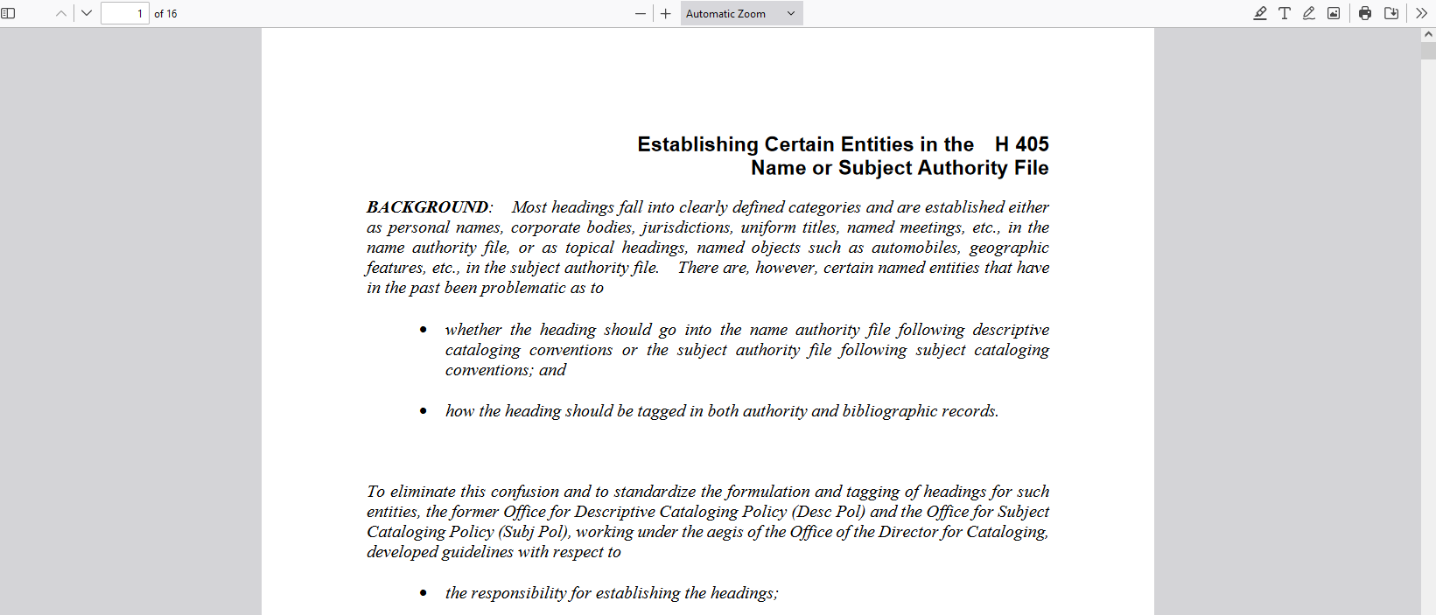
Name or Subject? SHM H 405
Notes:
October 14, 2024: changed reference to Cataloger’s Desktop in notes to ClassWeb Plus
May 15, 2024: changed image
March 4, 2020: updated notes
Subject Headings Manual instruction sheet H 405 – Establishing Certain Entities in the Name or Subject Authority File. Provides guidance on some kinds of named entities that have been problematic as to whether they should go into the name authority file or the subject authority file and what MARC tag to use.
The SHM is available as free, print-ready PDF files (https://www.loc.gov/aba/publications/FreeSHM/freeshm.html) and is also in ClassWeb Plus. Direct link to the PDF of SHM H 405: https://www.loc.gov/aba/publications/FreeSHM/H0405.pdf
The next two slides illustrate the two groups of headings and some of the entities in each.
Note: If possible, show participants SHM H 405 to see how it is divided up and what kinds of entities are established as names vs. subjects.

Slide 42
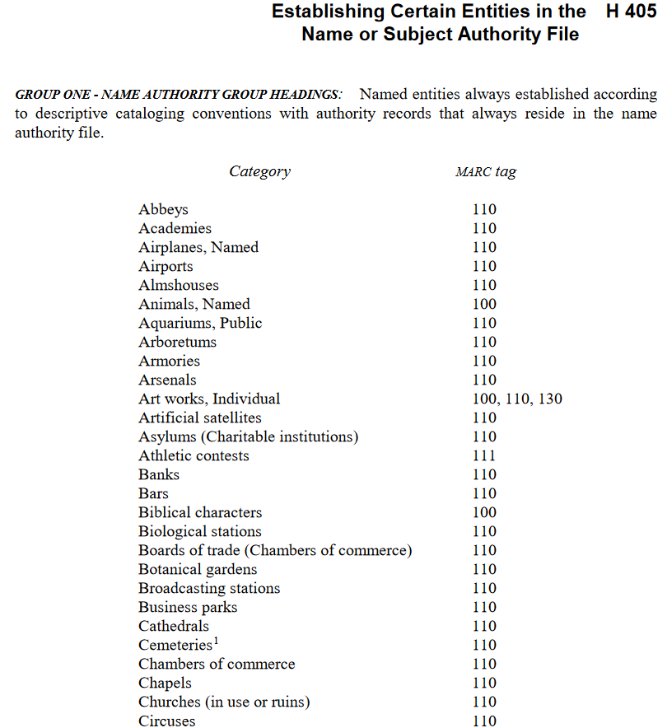
Notes:
March 4, 2020: new slide
Group one headings are entities that are always established according to RDA with authority records that reside in the NAF.
Note: If possible, show participants SHM H 405 to see how it is divided up and what kinds of entities are established as names vs. subjects.

Slide 43
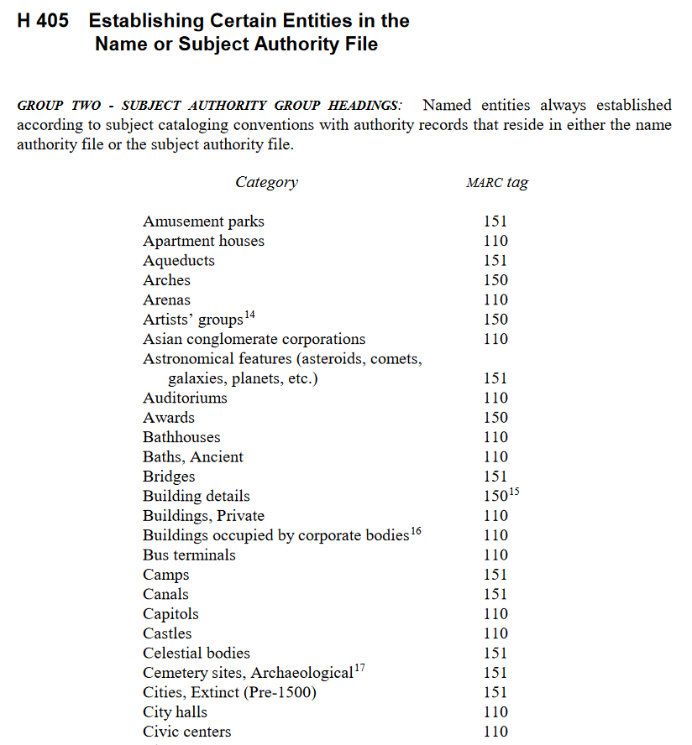
Notes:
March 4, 2020: new slide
Group two headings are always established according to subject cataloging conventions as found in the SHM with authority records that reside in either the NAF or the LCSH subject authority file. The choice between residing in the NAF or subject authority file is explained in detail in the instruction sheet, and depends on whether the heading is needed as a subject or as a descriptive access point.

Slide 44
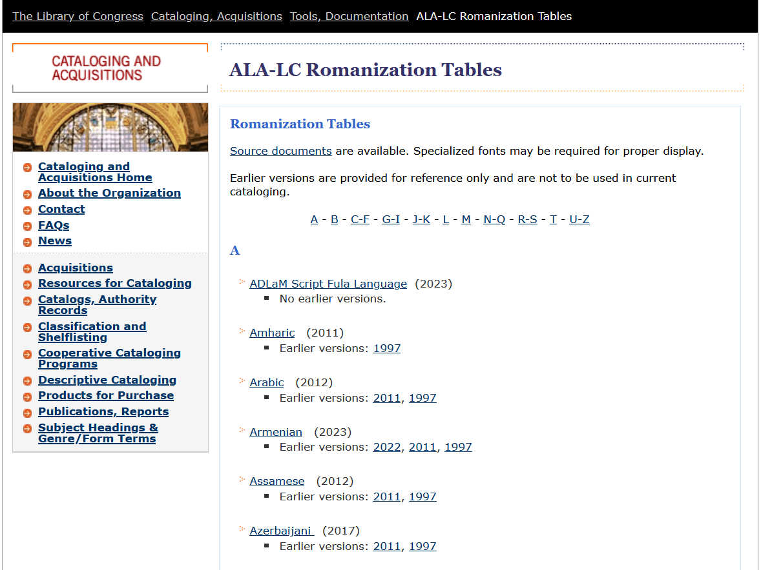
Romanization Tables
http://www.loc.gov/catdir/cpso/roman.html
44
Notes:
October 14, 2024: updated image
February 26, 2019: updated image
1) ALA-LC Romanization Tables are available at http://www.loc.gov/catdir/cpso/roman.html. There is a link from the NACO Documentation & Updates page.
2) The 1997 edition of the tables is available for purchase in book form from the Cataloging Distribution Service (while supplies last).
Not all alphabets have romanization tables and new tables are being developed all the time. If a new participant has a particular expertise in a particular writing system not already represented, he/she is encouraged to volunteer to work on a table in cooperation with ALA/LC.

Slide 45
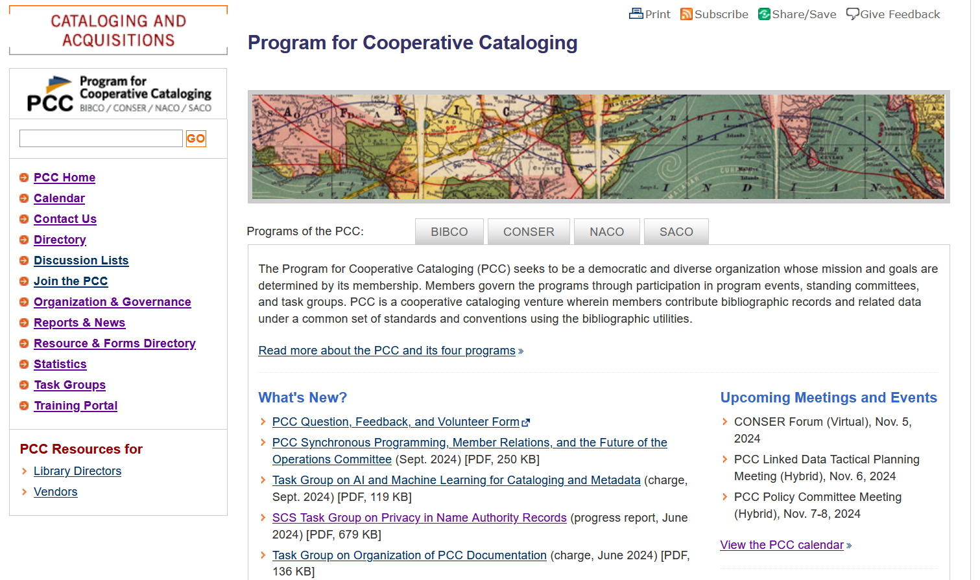
PCC Home Page
http://www.loc.gov/aba/pcc/
Notes:
October 14, 2024: updated image
February 26, 2019: updated image
The PCC home page is an important source of information for NACO participants. It includes information about all PCC programs; decisions, policies, and tasks; and information about the PCC’s implementation of RDA.

Slide 46
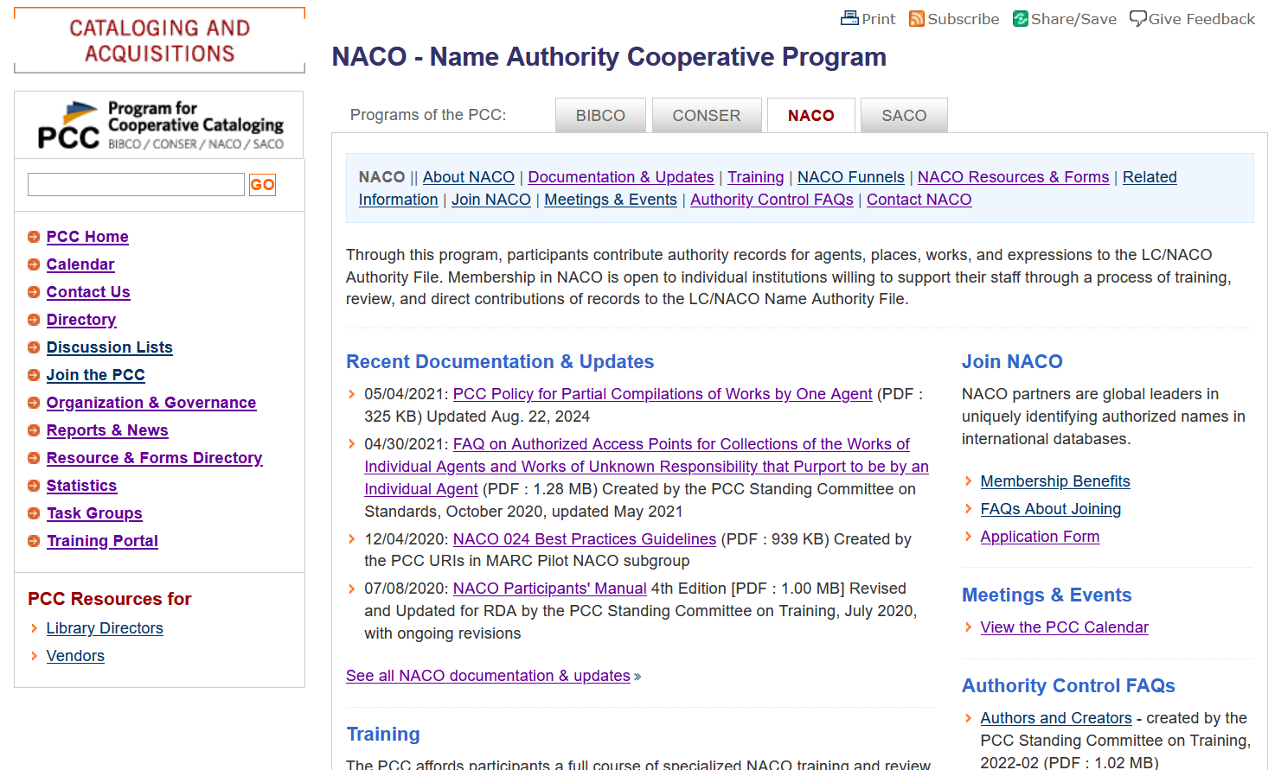
NACO Home Page
http://www.loc.gov/aba/pcc/naco/
Notes:
October 14, 2024: updated image
February 26, 2019: updated image
The NACO home page includes information about the NACO program as well as extensive documentation and resources specific to NACO.
Some relevant material may be linked from the PCC home page and not necessarily the NACO page. One example: Changes to the LC/NACO Authority File.

Slide 47
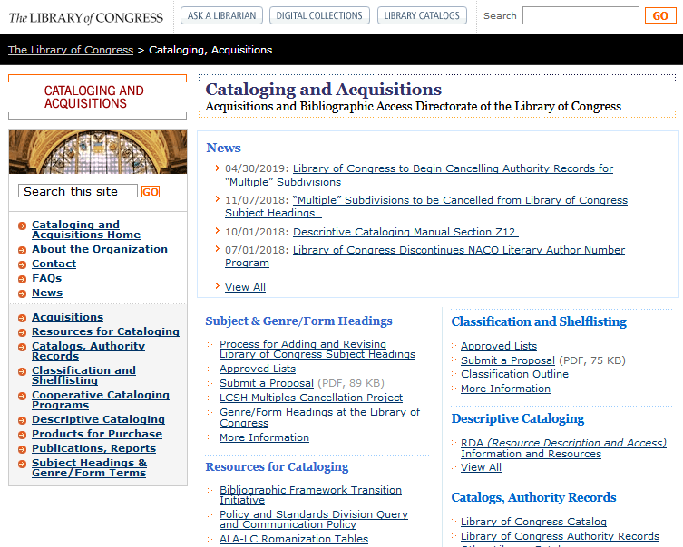
Source of Latest Changes
PCC Discussion List: see instructions at http://www.loc.gov/aba/pcc/discussion.html
LC Cataloging & Acquisitions Home http://www.loc. gov/aba/
Notes:
October 14, 2024: updated first bullet and added to speaker notes
August 7, 2019: updated image
PCC Discussion List: NACO funnel coordinators and NACO institutional liaisons must be subscribed. Other PCC participants are welcome to subscribe. To subscribe:
Send a message to coop@loc.gov with the subject line: "Subscribe PCCLIST".
Include your email address and name in the body of the message in a single line. Institutional email addresses are strongly preferred.
Example:
To: coop@loc.gov
From: email@institution.edu
Subject: Subscribe PCCLIST
email@institution.edu Forename Surname
LC’s Cataloging and Acquisitions home page has announcements and proposals and should be checked regularly.

Slide 48
NACO Parameter :
Contribution Guidelines for PCC
NACO libraries decide which NARs to contribute
Series and music work or expression NARs may be contributed only after completing additional training
When creating certain types of NARs, other related NARs must be established
Notes:
May 1, 2013
NACO libraries ARE NOT obligated to contribute all authorities generated by their cataloging or any one individual heading
NACO libraries may contribute series authority records and music work or expression records only after completing additional training. Information on series training and on joining the NACO-Music funnel project is available from the Cooperative Programs Section.
When creating certain types of NARs, other related NARs MUST be created, if not already established, and contributed to the NAF. The next slides illustrate situations in which related NARs must be established.

Slide 49
1. Parent-Subordinate Hierarchies
  For this NAR:
  1XX Parent body. $b Subordinate body
  Another NAR is needed for:
  1XX Parent body
Notes:
May 1, 2013
Body entered subordinate to parent body:
All bodies that are part of an established hierarchy; e.g., when establishing a body that is entered subordinately to its parent body, if an NAR for the parent body is not present in the NAF, it must be established and contributed as well.

Slide 50
1b. Parent-Subordinate Hierarchies
For this NAR:
110 2 _ Universidad Complutense de Madrid. $b Biblioteca
Another NAR is needed for:
110 2 _ Universidad Complutense de Madrid
Notes:
May 1, 2013
Example: Body entered subordinate to parent body
Subordinate body: Biblioteca (entered subordinately under parent body)
Must create another NAR for parent body, if not established, and submit to NAF (e.g.: parent body: Universidad Complutense de Madrid
Trainer note: Remind participants that we are not showing subfield $a in examples.

Slide 51
1c. Parent-Subordinate Hierarchies
  For this NAR:
  1XX Parent body. $b Subordinate body. $b Subordinate body
  NARs are needed for:
  1XX Parent body
  1XX Parent body. $b Subordinate body
Notes:
May 1, 2013
1XX Parent body. $b Subordinate body. $b Subordinate body
If the parent body is not established: a NAR is needed
If the immediate subordinate body is not established: a NAR is needed

Slide 52
1d. Parent-Subordinate Hierarchies
For this NAR:
110 2 _ Universidad Complutense de Madrid. $b Colegio Mayor de San Pablo. $b Centro de Estudios Universitarios
NARs are needed for:
110 2 _ Universidad Complutense de Madrid
110 2 _ Universidad Complutense de Madrid. $b Colegio Mayor de San Pablo
Notes:
May 1, 2013
Example: Parent body. $b Subordinate body. $b Subordinate body

Slide 53
1e. Parent-Subordinate Hierarchies in Variant Access Points
For this NAR:
1XX Subordinate body
4XX Parent body. $b Subordinate body
Another NAR is needed for:
1XX Parent body
Notes:
October 29, 2018: new slide
Applies also to variant access points!
If a variant access point has a body entered subordinate to its parent body, must create another NAR for parent body, if not established, and submit to NAF.

Slide 54
1f. Parent-Subordinate Hierarchies in Variant Access Points
For this NAR:
110 2 _ Apple Industrial Design Group
410 2 _ Apple Computer, Inc. $b Apple Industrial Design Group
Another NAR is needed for:
110 2 _ Apple Computer, Inc.
Notes:
October 29, 2018: new slide
Example: Variant access point has body entered subordinate to parent body: 4XX Parent body. $b Subordinate body
Must create another NAR for parent body, if not established, and submit to NAF (e.g.: parent body: Apple Computer, Inc.)

Slide 55
2. Bodies in Variant Access Points
For this NAR:
  1XX Government agency
  4XX Jurisdiction. $b Government agency
Another NAR is needed:
  1XX Jurisdiction
Notes:
February 26, 2019: removed qualifier from 1XX to clarify difference between this slide and slide 73
All bodies referred through in variant access points:
When an authorized access point is entered independently but a variant access point is given through a higher body
The higher body needs to be represented in the authority file. If the higher body is not represented in the authority file the library needs to create an additional name authority record.

Slide 56
2b. Bodies in Variant Access Points
For this NAR:
110 2 _ Seattle Municipal Archives
410 1 _ Seattle (Wash.). $b Municipal Archives
Another NAR is needed:
  151 _ _ Seattle (Wash.)
Notes:
February 26, 2019: changed example to clarify difference between this example and slide 73
So, for the jurisdictional cross-reference to be given, the place name must exist already, or it must be contributed to the NAR at the same time.
NOTE: The 151 to 410 MARC change is reflective of the use of a place as a jurisdiction. This will be covered in more detail later in the Describing Corporate Bodies and Describing Places presentations. Don’t worry about it here.

Slide 57
2c. Bodies in Variant Access Points
For this NAR:
110 1 _ British Columbia. $b School Facilities Planning
410 1 _ British Columbia. $b Ministry of Education. $b School Facilities Planning
Another NAR is needed:
110 1 _ British Columbia. $b Ministry of Education
Notes:
May 1, 2013
Example: Variant access point on NAR for body entered subordinately (applying RDA 11.2.2.20: direct or indirect subdivision)

Slide 58
2d. Bodies in Variant Access Points
For this NAR:
1XX Place within city (City)
4XX City. $b Place within city
Another NAR is needed:
1XX City
Notes:
August 7, 2019
For places within a city, etc., the authorized access point is formed by combining the preferred name for the place within the city with a qualifier containing the name of the city and the larger place the city is located in. A variant access point may be formed by recording the name of the place within the city as a subordinate body of the authorized access point for the city (RDA 16.2.3.8 and LC-PCC PS for 16.2.2.14). If the city is not already established, an authority record for it must also be created.

Slide 59
2e. Bodies in Variant Access Points
For this NAR:
151 _ _ Koreatown (Los Angeles, Calif.)
410 1 _ Los Angeles (Calif.). $b Koreatown
Another NAR is needed:
  151 _ _ Los Angeles (Calif.)
Notes:
August 7, 2019
For a variant access point constructed for a place within a city as a subordinate body of that city, there must already be an authority record for the city, or it must be created at the same time as the authority record for the place within the city.
NOTE: The 151 to 410 MARC change is reflective of the use of a place as a jurisdiction. This will be covered in more detail later in the Describing Corporate Bodies and Describing Places presentations. Don’t worry about it here.

Slide 60
3. Related Entities (5XX)
In many cases, it is useful to create access points for related entities (5XX)
Every entity in a 5XX must be established
Reciprocal access points for related entities are not generally required, but are required in four situations:
  Persons with different identities (pseudonyms)
  Earlier and later forms of a corporate name, place, or family
  Sequential relationships between series or serials
  Government and religious officials
Notes:
October 14, 2024: updated second sub-bullet of third bullet to add places; added most recent revision of the guidelines and updated speaker notes to add places
March 6, 2019: revised to reflect PCC Guidelines for Relationship Designators in Authority Records, 2018 version
The PCC Guidelines for the Application of Relationship Designators in NACO Authority Records (November 2018, rev. May 2024 - at https://www.loc.gov/aba/pcc/rda/guidelines/authority-relationships.pdf) require reciprocal access points to be explicitly made in corresponding authority records:
Between real and alternate identities (Guideline 10)
Between sequential forms of Corporate Bodies that have changed name (including mergers) (Guideline 11), sequential forms of Places that have changed name (Guideline 13a), and sequential forms of Families that have changed name (Guideline 14)
Between earlier and later titles of series and serials that have changed title (Guideline 15b, see also LC-PCC PS 25.1, 25.1.1.3 and 26.1)
Between the corporate body form of a government or religious official and the personal form of the name (Guideline 11)

Slide 61
3b. Related Entities (5XX)
1XX Current name of entity
5XX $w r $i Predecessor: $a Earlier name of entity
1XX Earlier name of entity
5XX $w r $i Successor: $a Current name of entity
Notes:
September 17, 2018: moved $w to beginning of 5XX fields
ANIMATED SLIDE: arrows come in on click
This is an example of a situation in which reciprocal access points are required; in this case, the entity would be a corporate body. In order to avoid blind references – an access point that does not point to an actual record – the participant needs to make sure that the corresponding authorized access point is also established.
From DCM Z1: LC/NACO catalogers should use subfield $i with subfield $w coded “r” when providing relationship links between corporate entities and the names of other persons, families or corporate bodies, if appropriate. In subfield $i use a capital letter for the first letter of the term and follow the term with a colon. NARs that contain the $w “a” (earlier) or “b” (later) values should be converted when otherwise being modified.

Slide 62
3c. Related Entities (5XX)
110 2 _ International Business Machines Corporation
510 2_ $w r $i Predecessor: $a Computing-Tabulating-Recording Company
110 2 _ Computing-Tabulating-Recording Company
510 2_ $w r $i Successor: $a International Business Machines Corporation
Notes:
September 17, 2018: moved $w to beginning of 510 fields
ANIMATED SLIDE: arrows come in on click
Here’s the same example but with the name(s) of an actual corporate body.
All corporate bodies used in access points for related entities (5XXs) must be established and have their own NAR.

Slide 63
3d. Related Entities (5XX):
Previous coding practice
1XX Current name of entity
5XX $w a $a Earlier name of entity
1XX Earlier name of entity
5XX $w b $a Current name of entity
Notes:
October 14, 2024: updated speaker notes to differentiate current practice with places and families; family practice was incorrectly stated in earlier notes; OCLC never validated the use of $w a/b in family NARs
November 12, 2019: updated speaker notes
February 26, 2019: added clarification to speaker note that this practice still applies to jurisdictional bodies (place names) and families
There are different ways to show the relationship through coding.
The practice shown here was used for many years, in AACR2 records and many RDA records. Subfield $w here is coded “a” for earlier name and “b” for later name. However, these codes cover a variety of sequential relationships that have their own more specific designators in RDA (e.g., $w “a” would have been used for a predecessor as well as for a predecessor of split and also for a component of merger).
Until early 2013, LC catalogers were instructed to use this coding when providing relationship links between corporate entities and the names of other persons, families or corporate bodies, so you will see this practice in many authority records. The same coding was also used until recently to related sequential names of places. DCM Z1 now says that records containing this coding should be converted when otherwise being modified.
Note 1: This practice (using $w a and $w b) is no longer used for sequential place name relationships. Catalogers may now use appropriate relationship designators from Appendix K for corporate bodies (e.g., “predecessor”, “successor”, “product of merger”) in authority records for places (see May 2024 revision of PCC Guidelines for the Application of Relationship Designators in NACO Authority Records Guideline 13a).
Note 2: $w a and $w b cannot be used for sequential family names. OCLC will not validate these codes in family name authorities. In addition, because appropriate relationship designators for sequential family relationship are not available in original RDA, catalogers cannot use $w r and $i. For now, use simple see also relationships between families for sequential relationships (earlier/later family names). (Note, however, that in Official RDA, which has yet to be implemented by PCC, there are relationship elements for predecessor of family and for successor of family. The Metadata Guidance Documentation for relationship labels says to use “predecessor” and “successor” when recording these relationship elements in $i, but we cannot use them until PCC implements Official RDA.)

Slide 64
3e. Related Entities (5XX)
It is not always useful to make reciprocal access points for related entities
100 1_ Kimball, Edward L., $d 1930-2016
510 2_ $w r $i Employer: $a University of Wisconsin
Notes:
September 17, 2018: moved $w to beginning of 510 field
There are cases in which it is not useful to make reciprocal access points for related entities. For example, we would not want to have every employee of an organization listed on the authority record for that organization.
Use judgment! If recording the reciprocal relationships in the other authority record could cause an unwieldy number of 5XXs in that authority record (perhaps more than 5-10), it may be best not to make the reciprocal access points.
Keep in mind that in most cases, systems can automatically generate reciprocals.

Slide 65
3f. Related Entities (5XX)
100 1_ Lennon, John, $d 1940-1980
510 2_ $w r $i Corporate body: $a Beatles
Notes:
September 17, 2018: moved $w to beginning of 510 field
The authority record for John Lennon indicates that he was a member of the Beatles.

Slide 66
3g. Related Entities (5XX)
When not required, use judgment! When are reciprocal access points useful?
110 2_ Beatles
500 1_ $w r $i Member: $a Lennon, John, $d 1940-1980
500 1_ $w r $i Member: $a McCartney, Paul
500 1_ $w r $i Member: $a Harrison, George, $d 1943-2001
500 1_ $w r $i Member: $a Starr, Ringo
500 1_ $w r $i Member: $a Best, Pete, $d 1941-
500 1_ $w r $i Member: $a Sutcliffe, Stuart, $d 1940-1962
Notes:
March 4, 2020: added the other two members that are found on this NAR
On the previous slide we saw the relationship of John Lennon to the Beatles expressed in a 510 field. Should we also add a 500 for each group member to the record for the Beatles, as is shown in the slide? What are the pros and cons of making reciprocal references such as these, between a musical group and members of that group?

Slide 67
Mandatory Match 5XX-1XX
110 2 _ Dallas/Fort Worth
International Airport
510 2 _ $w r $i Predecessor: $a Dallas/Fort Worth Regional Airport
110 2 _ Dallas/Fort Worth Regional Airport
510 2 _ $w r $i Successor: $a Dallas/Fort Worth International Airport
5XX MUST match 1XX on another NAR in the same authority file
Notes:
September 17, 2018: moved $w to beginning of 510 fields
Remember that every entity in a 5XX must be established.
If you create a reciprocal relationship in both records, the 5XX must match its corresponding 1XX exactly.

Slide 68
4. Creator/Work Access Points
For this NAR:
1XX Creator. $t Work
This NAR is needed:
  1XX Creator
Notes:
May 1, 2013
For creator/work access points, there must also be a name authority record for the creator.

Slide 69
4b. Creator/Work Access Points
For this NAR:
1XX Creator. $t Work. $l Language …
This NAR is needed:
  1XX Creator
Notes:
November 12, 2019: revised speaker notes
If you are creating a NAR for a language expression (i.e., a translation), a NAR for the creator must also be created, if it is not already established.
Optionally, libraries may also create a NAR for the work (1XX Creator. $t Work), but this is not a NACO requirement.

Slide 70
4c. Creator/Work Access Points
For this NAR:
  100 1_ Le Guin, Ursula, $d 1929-2018. $t
  Earthsea. $l Chinese
This NAR is needed:
  100 1_ Le Guin, Ursula, $d 1929-2018
Notes:
November 12, 2019: added to speaker notes
February 26, 2019: added death date
So, in order to establish the authorized access point for the Chinese translation of Ursula Le Guin’s Earthsea, Le Guin’s name must be established.
Optionally, libraries may also create a NAR for the work (100 1_ Le Guin, Ursula, $d 1929-2018. $t Earthsea), but this is not a NACO requirement.

Slide 71
4d. Creator/Work Access Points
For this NAR:
1XX Creator. $t Work. $k Selections
This NAR is needed:
  1XX Creator
Notes:
June 6, 2014
Similarly, if you are creating a NAR for a part of a larger work (e.g., Selections), a NAR for the creator must also be created, if it is not already established. Optionally, libraries may create a NAR for the Work (1XX Creator. $t Work), but this is not a NACO requirement.

Slide 72
4e. Creator/Work Access Points
For this NAR:
  100 1_ McDougall, Christopher, $d 1962- $t Born to run. $k Selections
This NAR is needed:
  100 1_ McDougall, Christopher, $d 1962-
Notes:
November 12, 2019: added to speaker notes
March 20, 2017: corrected spacing in first 1XX
So, in order to establish the authorized access point for Born to run. Selections, McDougall’s name must already be established. Optionally, you may also create an NAR for the whole work (100 1_ McDougall, Christopher, $d 1962- $t Born to run) if it is not already established.

Slide 73
Place name in qualifier
If a place name is used in a qualifier, it must be established
110 2_ Galleria d'arte contemporanea (Turin, Italy)
151 Turin (Italy)
130 _0 Financial chronicle (Hyderabad, India)
151 Hyderabad (India)
151 __ Wrigleyville (Chicago, Ill.)
151 Chicago (Ill.)
Must be established!
Notes:
August 7, 2019: added third example showing a place within a city
March 29, 2017: removed indication that a corporate body must be established to be used as a qualifier. The Introduction to DCM Z1 only indicates places must be established; added second place example.
In the first example, Turin, Italy is used as a qualifier for a corporate body. If there is not yet an authority record for Turin (Italy), it must be created.
In the second example, Hyderabad, India is used as a qualifier for a work. If there is not yet an authority record for Hyderabad (India), it must be created.
In the third example, Chicago, Ill. is used as part of the access point for a neighborhood within Chicago. If there is not yet an authority record for Chicago (Ill.), it must be created.

Slide 74
NACO Parameter :
Changes to existing NARs
All authorized access points in the NAF are eligible to be changed
by all NACO participants
Notes:
May 1, 2013
NACO parameter: Changes to existing NARs:
This parameter applies only to changes to the authorized access point; not additions of 046, 3XX, 4XX, 5XX or 670’s.
Additions and changes to authority records:
Almost as common as the need for a new authority record is the need to alter an existing record. New information can be received in various ways (e.g., new cataloging, investigation in response to a query) and may be significant enough to add to the authority record.
Normally a new variant access point or a change in authorized access point must be justified by the addition of new information to the authority record. Many other types of data can be added to the authority record when judged useful for proper identification. In order to minimize the impact of database maintenance with associated bibliographic records and/or name/title authority records, catalogers are urged to refrain from making unnecessary changes to authorized access points.
Although there are guidelines in the instructions and/or LC-PCC PSs that indicate when changes are or are not necessary, the necessity for other changes may be evident only to the agency making the change (for example, to break a conflict when the searching universe for the changing agency and the agency observing the change are different); assume that such changes are valid.
When the published work for an item cataloged through the CIP program shows a change in the form of name of a person, family, corporate body, work, expression, or series, change the authority record; add the published source after the CIP source in the 670 field to document the change. Changes in the imprint date, choice of main entry, and changes in title proper do not require changes to authority records created for CIP items.
More details about authorized changes to AAPs will be found in the "Changes" module on Day 5.

Slide 75
NACO Parameter :
Deletion of NARs
  Only LC catalogers can delete NARs in the NAF
  NACO libraries notify LC to delete NARs
  LC/NACO database is redistributed daily to the utilities
Notes:
May 1, 2013
LC does not allow for online deletion by NACO participants. This is because of database maintenance issues, which apparently cannot handle multiple sources of deletion. It is NOT a lack of trust. The NAF is LC’s local authority file, and for system and security reasons, delete capability needs to be limited to LC catalogers.
NACO participants notify LC about deletion requests via naco@loc.gov.
Deletions are most often made because of duplicate authorized access points for the same entity. There will be more details about this in a later session.

Slide 76
NACO Parameter :
Bibliographic File Maintenance
(BFM)
LC bibliographic records (as distributed by CDS) must remain in synch with the NAF
http://www.loc.gov/aba/pcc/naco/bfmguide.html
NACO partners must notify LC when certain types of changes to NARs affect authorized access points used on LC bibliographic records
Notes:
November 12, 2019: revised notes: changed Cooperative Programs Section to Policy, Training, and Cooperative Programs Division; added 5th bullet
1) Reporting records that need changes to authorized access points (BFM = Bibliographic File Maintenance)
2) NACO participants must notify the Policy, Training, and Cooperative Programs Division via naco@loc.gov to perform BFM for certain types of changes to NARs that affect records at LC.
3) The link in the record leads to Guidelines for Reporting NACO BFM.
4) Reporting BFM to OCLC is not required, but it could be helpful to either correct affected records in the WorldCat database (if few in number) or report the need for change to OCLC.
5) And don’t forget that records in your own catalog may need to be revised!

Slide 77
BFM : Examples
BFM NOT required: changes to authorized access points
  e.g., revised authorized access point including a death date
  Reports are generated by bibliographic utilities
BFM required: new NAR is created for a person previously on an undifferentiated NAR (and LC bib records are affected)
Notes:
May 1, 2013
Here are a couple of examples of situations in which changes may or may not need to be reported for BFM.

Slide 78
NACO Parameter :
Searching
Catalogers keep the database clean by searching for related records before contributing an authority record to the LC/NACO Authority File
Notes:
May 1, 2013

Slide 79
Why Search? (1)
To prevent duplicate NARs
  Authorized access point for entity already established?
  OCLC de-dupe detection and validation programs need to be run
  Report deletions to Policy, Training, and Cooperative Programs Division (naco@loc.gov)
Notes:
November 12, 2019: changed name in slide from Cooperative Programs Section to Policy, Training, and Cooperative Programs Division
Why search? (1):
Duplicates are normally created by inefficient searching and the 24-hour upload gap in the Name authority file.
Before creating a name authority record:
Search the OCLC authority file for the authorized access point, including variant forms of the access point.
In addition, search WorldCat for bibliographic records that contain the authorized access point or variant forms.
Remember to search again every 24 hours for new NAR’s.

Slide 80
Why Search? (2)
To avoid conflict in authorized access points and variant access points
  Information on normalization rules coming up
To gather information from existing bibliographic records
Notes:
May 1, 2013
NOTE for 2nd bullet: To gather information from existing bib records to assure proper choice and form of authorized access points and variant access points

Slide 81
Why Search? (3)
To identify existing records that may need to be evaluated and re-coded for RDA
  Presence of 667 note:
THIS 1XX FIELD CANNOT BE USED UNDER RDA UNTIL THIS RECORD HAS BEEN REVIEWED AND/OR UPDATED
To identify and re-code an existing RDA-acceptable AACR2 NAR to RDA
More information on changes to the LC/NAF:
  Summary of Programmatic Changes to the LC/NACO Authority File (Phases 1 and 2) http://www.loc.gov/aba/rda/pdf/lcnaf_rdaphase.pdf
  Report of the Phase 3 Task Group http://www.loc.gov/aba/pcc/rda/RDA%20Task%20Groups.html
Notes:
December 12, 2016
The presence of this 667 is a clear indication that the 1XX field and the other fields in the existing record must be evaluated. During Phase 1 of the authority file conversion from AACR2 to RDA, authorized access points that were not good candidates for a global, mechanical change were identified with this note. More information is available in the document Summary of Programmatic Changes to the LC/NACO Authority File.
If the review indicates that the 1XX can be used under RDA as given, the cataloger should remove the 667 note, add any additional elements needed, and re-code the record to RDA.
If the existing 1XX needs to be updated to be made acceptable for use under RDA, the cataloger should revise the authorized access point, make a reference from the former 1XX when applicable, remove the 667, add any additional elements needed, and re-code the record to RDA. Revising existing authority records is covered in more detail in the Authority Workflow module.
It is also important to be alert to changes that might be needed in records NOT flagged as needing review. Some examples are: persons with numerals at the end of the name, or terms like Jr., Sr., père.
For a summary of LC announcements about the various phases, see http://www.loc.gov/cds/notices/3A-141201a.pdf.

Slide 82
Why search? (4)
To identify bibliographic records that will need BFM
To revise an existing NAR
  Personal name changes
  Corporate earlier-later
  Other revisions
Notes:
May 1, 2013
When you are revising an existing NAR, it is helpful to search again to see what additional information you may be able to find.
Remember: Search WorldCat for bibliographic records that contain the authorized access point or variant forms of the authorized access point.

Slide 83
Searching : How?
Search bibliographic and authority files
Maybe even subject headings in bibliographic and authority records
Search more than one form, e.g.:
  Fowler, Esther Miller
  Fowler, E.
  Miller, E.
  Miller, Esther
  Miller, E. Anne
Search both the authorized access point and the variant access points
Notes:
May 1, 2013
1) Be sure to search possible alternative forms of a person’s name to find any authorized access points that may been entered under those forms. You’re trying to find all the works by (and about) a person. This is even more necessary in languages with multiple surnames, etc.
2) Be sure to emphasize that the search strategies differ from program to program and person to person.
3) Places to search:
a) LC/NACO Authority File (NAF via OCLC)
b) OCLC bibliographic records
c) Your local files
d) Optionally: LC’s OPAC
f) Occasionally: other reference sources, databases, WWW, etc.

Slide 84
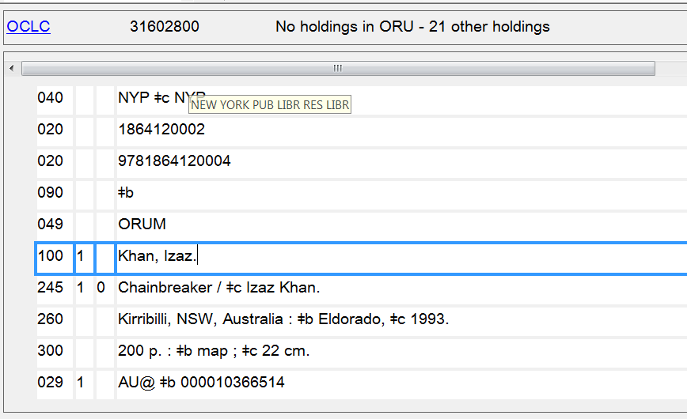
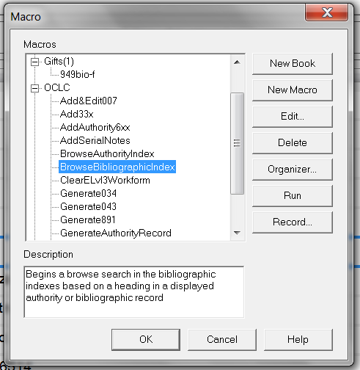
Notes:
May 1, 2013
ANIMATED SLIDE
You can use OCLC macros to easily search bibliographic and authority files from an access point in a record.
Here we are starting with a bibliographic record. With the cursor in an access point (here the 1XX for Khan, Izaz):
(CLICK to bring in box with list of macros)
…run the “Browse Bibliographic Index” macro to search that access point in other bibliographic records. (You can assign the macro to a keystroke to make this very quick)

Slide 85
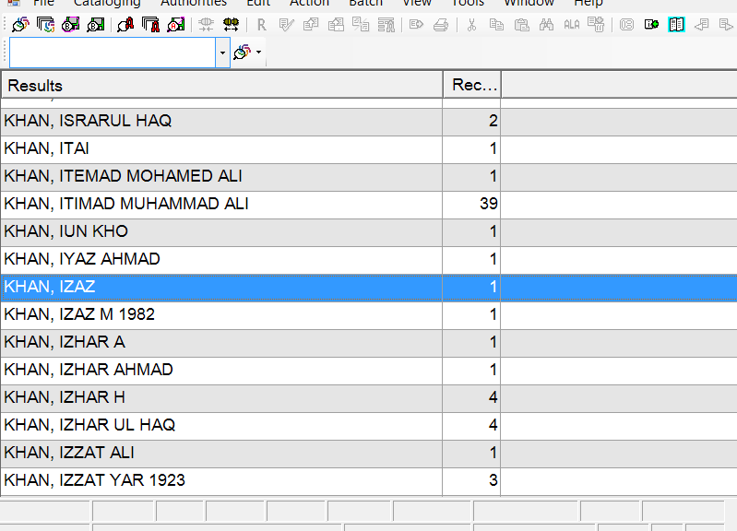
Notes:
May 1, 2013
Here are the results of the search in the bibliographic index. There is another macro that performs the same type of search in the authority indexes.

Slide 86
Searching : When?
Don’t leave authority records in the save file too long
Search again if 24 hours pass to:
  Avoid conflicts
  Avoid duplicates
Remember:
24 Hour Rule to Avoid Duplicate Access Points
Notes:
May 1, 2013
Searching– When?:
Trainer note: Remind participants that they MUST search authorized access points and variant access points again before contributing to the NAF to ensure that the same has not been contributed by another library.

Slide 87
NACO Normalization
Normalization is the conversion of a text string to a normalized form
Text strings that normalize to the same form are considered to be duplicates and must be differentiated from each other
The goal of normalization is to ensure that each authorized access point is unique
Notes:
May 1, 2013
All contributors to the NAF have agreed to a common set of normalization rules.

Slide 88
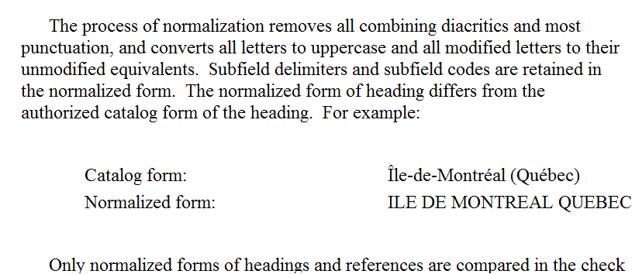
Normalization: Documentation
DCM Z1: Introduction
Notes:
February 24, 2014

Slide 89
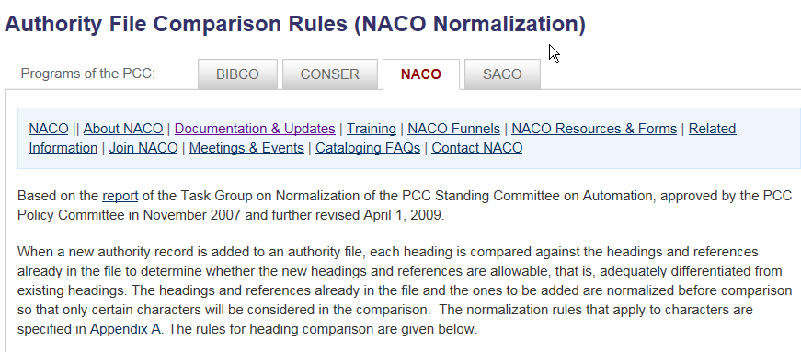
Normalization: Documentation
Linked from NACO Documentation & Updates
Notes:
January 25, 2017: replaced screenshot
December 12, 2016: URL added to speaker notes
http://www.loc.gov/aba/pcc/naco/normrule-2.html

Slide 90
Impact of Normalization
Until early in 2013, “non-unique” or “undifferentiated” personal name NARs were sometimes created due to normalization. Examples:
  Martínez, José Nguyễn, Khôi
  Martinez, Jose Nguyễn, Khởi
Beginning in January 2013, NACO catalogers were asked to avoid creating new undifferentiated personal name authority records (or adding to existing ones)
Notes:
February 27, 2020: added examples to first bullet; revised speaker notes to include examples and explanations
Normalization may affect how certain authorized access points and variant access points are formulated.
Until January 2013, NACO contributors sometimes created “undifferentiated” personal name authority records in order to avoid duplicates due to normalization. For example, consider these names for different persons:
Martínez, José
Martinez, Jose
Because both names would normalize to the same form, both persons might have had to be included on an undifferentiated record even though one uses diacritics and the other doesn’t.
Nguyễn, Khôi
Nguyễn, Khối
Nguyễn, Khởi
Because all three of these names would normalize to the same form, they all might have had to be included on an undifferentiated record even though each one uses different diacritics or special characters (hooked ơ vs. o).
Catalogers are now asked to avoid creating new undifferentiated personal name authority records (or adding to existing ones) but there may still be some cases where it is unavoidable.

Slide 91
NACO Normalization
OCLC and SkyRiver run databases against a computer program using NACO Normalization rules
Error reports on duplicates and conflicts come to LC
  PTCP Division catalogers handle them
Notes:
November 12, 2019: changed Coop on slide and in notes to PTCP
LC Policy, Training, and Cooperative Programs Division (PTCP) catalogers may resolve any duplicate or conflict situations uncovered by the NACO Normalization check, but sometimes PTCP catalogers will ask for PCC assistance to resolve these issues.

Slide 92
What happens in the Normalization process?
All letters are converted to upper case
Modified letters are converted to unmodified letters
All diacritics are removed
Notes:
May 1, 2013
So differing capitalization is not enough to differentiate otherwise identical forms; and the presence or absence of diacritics is not enough.
2nd bullet: an example of a modified letter is the Polish “l” (Ł (upper case) ł (lower case)), or the Turkish “i” (ı).

Slide 93
What happens in the Normalization process?
Most punctuation is removed.
  Exceptions: first comma in subfield a
Subfield delimiters and subfield codes are retained and considered
The contents of 1XX, 4XX, and 5XX fields are compared
Notes:
March 20, 2017: updated speaker notes about normalization of hyphens in birth and death dates
Updated Jan. 25, 2017: removed incorrect info about normalization of hyphens in birth and death dates under first bullet
1st bullet: The only mark of punctuation that is retained during normalization is the first comma in subfield $a. This exception means that the following two authorized access points normalize to different forms:
Catalog form: Chung, Hui
Normalized form: CHUNG, HUI
Catalog form: Chung-hui
Normalized form: CHUNG HUI
Hyphens in birth and death dates are removed, so “Smith, John, -1790" will normalize to the same string as "Smith, John, 1790-"
3rd bullet: the 7XX fields are not compared

Slide 94
Tags Are Not Compared
MARC 21 tags are NOT considered when the computer compares access points for uniqueness
  Subfield codes ARE considered
Different MARC tags (100, 110, 111, 151, 130) do not make an authorized access point unique
Notes:
February 26, 2019: revised last paragraph to clarify that subject and genre/form are in separate files
MARC 21 tags are NOT considered by the computer when comparing the authorized access point string for uniqueness.
Subfield codes ARE considered as part of the comparison. This allows the same term in a 150 $a and 180 $x to occur without conflict because the subfield codes ‘a’ and ‘x’ will make the strings unique.
An authorized access point (1XX) must be the same as any other authorized access point, EXCEPT an established topical heading (150 field) in the subject authority file (LCSH) may be the same as an established form/genre heading (155 field) in the genre/form authority file (LCGFT).

Slide 95
What happens to the symbols?
Deleted with no space remaining:
[ ] ′
Replaced by a blank space:
@ ? / \ () = “ , -
Unchanged:
& + ♯ ♭
apostrophe
Comma after first one
hyphen
quotation mark
musical flat
musical sharp
Notes:
January 25, 2017: removed hyphen in birth and death dates from Unchanged bullet; removed incorrect info about hyphen being retained in birth and death dates from speaker’s notes
January 19, 2017: replaced hash tag and italic b with musical sharp and flat symbols
January 13, 2017: removed exception for hyphen in birth and death dates
Many more symbols may be changed in normalization. Please check the actual “NACO Normalization rules”
The first comma in the $a subfield (unless it is a terminal comma) is taken into account. In all other cases commas are converted to blank.

Slide 96
What is Compared?
Line of characters that are part of the tagged field (character “string”)
100 1 _ Le Bret, $c Monsieur $q (Alexis-Jean), $d 1693-1772?
NORMALIZES AS: LE BRET, $c MONSIEUR $q ALEXIS JEAN $d 1693 1772
Notes:
January 25, 2017: removed hyphen from $d and replaced with space; removed mention of hyphen from speaker’s notes
DCM Z1 also give guidance on rules for normalization:
1) The process of normalization removes all diacritics and most punctuation, and converts all letters to uppercase and all modified letters to their unmodified equivalents.
2) Subfield delimiters and subfield codes are NOW considered as part of the comparison: http://www.loc.gov/catdir/pcc/naco/normrule-2.html
3) The only marks of punctuations that are retained during normalization are the first comma in subfield $a
4) The normalized access point is illustrated in red on the slide.

Slide 97
Normalized Authorized Access Point
Catalog form:
  151 _ _ Île-de-Montréal (Québec)
Normalized form:
  151 _ _ ILE DE MONTREAL QUEBEC
Notes:
December 12, 2016: reversed bullet points

Slide 98


Conflicts and Duplicates
Notes:
May 1, 2013
To prevent conflicts and duplicates, a cataloger needs to know the rules that have been programmed into the computer’s normalization software.
Catalogers must also understand the difference between a conflict and a duplicate.

Slide 99
What is a conflict?
Normalized match between
  1XX vs. 1XXs
  4XX vs. 1XXs & 5XXs
  4XX vs. 4XX in same record
But
  5XX must normalize to 1XXs
  4XX to 4XX is fine in different records
Notes:
May 1, 2013
Trainer note: Don’t spend much time here: examples that follow demonstrate these conflicts.
Conflict situations: These will all be discussed in upcoming slides
1) If a 1xx in one authority record normalizes to the same form as a 1xx in another authority record, there is a conflict.
2) If a 1xx in one authority record normalizes to the same form as a 4xx in another authority record, there is a conflict.
3) A 5xx in one authority record must correspond to a 1xx in another authority record. This is because the 5xx is referring to the 1xx in the other authority record, and the 5xx and the 1xx represent the same entity!
4) If a 4xx in one authority record normalizes to the same form as a 4xx in another authority record, there is no conflict. 4xx’s in different authority records may conflict with each other.

Slide 100
1XX Duplicates
A 1XX may NOT normalize to the same string as another 1XX
100 1 _ Smith-Jones, Barb
100 1 _ Smith Jones, Barb
(This is a duplicate)
Notes:
May 1, 2013
ANIMATION: arrows fly in separately to show differences in punctuation; phrase “This is a duplicate” dissolves in last.
The hyphen in one of the names becomes a blank space under normalization rules.
Note: If personal names normalize to the same string, catalogers use specific RDA instructions to add information in order to create a unique authorized access point (more on this in Describing Persons).

Slide 101
1XX-4XX Conflict
A 4XX may NOT normalize to the same string as a 1XX or 5XX
100 1 _ O’Brien, John
400 1 _ O’Brien, Jack
100 1 _ O’Brien, Jack
400 1 _ O’Brien, J. (Jack)
(This is a conflict)
Notes:
May 1, 2013
ANIMATION: “This is a conflict” dissolves in.
Items in red conflict with one another. The apostrophe is deleted.
Do not trace a 4XX variant access point that normalizes to the same character string as an existing authorized access point (1XX) in the national authority file, including the authorized access point in the same authority record.

Slide 102
Conflict Within a Record
A 4XX may NOT normalize to the same string as another string in the same NAR
110 2 _ Winston-Salem Sunrise Hiking Club
410 2 _ Winston-Salem Hiking Club
410 2 _ Winston/Salem Hiking Club
(This is a conflict)
Notes:
May 1, 2013
ANIMATION: arrows fly in separately to show differences in punctuation; phrase “This is a duplicate” dissolves in last.
1) The HYPHEN and the SLASH becomes blank space.
2) Watch out for visually misleading presentations that normalize the same.

Slide 103
No Conflict Between Records
A 4XX MAY normalize to the same string as a 4XX in another NAR
100 1 _ Potter, Harold
400 1 _ Potter, Harry
100 1 _ Potter, Henry
400 1 _ Potter, Harry
(No conflicts here!)
Notes:
May 1, 2013
However, a 4XX may normalize to another 4XX in another NAR in the catalog.

Slide 104
Normalization Exercises
Look at each record and decide if any of the variant access points would normalize to the authorized access point
Notes:
March 4, 2020: added final sentence to notes
Normalization Exercises:
In the following exercises, which 4XX variant access points (if any) should be deleted because their normalized forms match the 1XX authorized access point?
Because printouts of the slides will include the animated text, it is best to do these as a group and ask trainees not to look at their handouts.

Slide 105
Exercise 1
  151 T'bilisi (Georgia)
  451 Tiflis (Georgia)
  451 Tbilisi (Georgia)
  451 $w nnaa $a Tiflis
  451 $w nne $a Tbilisi (Georgian S.S.R.)
  451 T'blisi (Georgia)
Delete this reference
Notes:
September 17, 2018: moved $w to beginning of 451 fields
ANIMATED SLIDE
Normalizes to same form as authorized access point

Slide 106
Exercise 2
  110 2 _ Ballard-Carlisle Historical & Genealogical Society
  410 2 _ Ballard-Carlisle Historical and Genealogical Society
  410 2 _ Ballard-Carlisle Historical- Genealogical Society
All OK!
Notes:
September 17, 2018: updated speaker notes.
ANIMATED SLIDE
Ampersand is retained in normalized form.

Slide 107
Exercise 3
110 1 _ United States. $b Office of the Under Secretary of Defense, Acquisition
410 1 _ United States. $b Office of the Under Secretary of Defense for Acquisition
410 1 _ United States. $b Under Secretary of Defense, Acquisition
410 1 _ United States. $b Office of the Under Secretary of Defense (Acquisition)
        Delete this reference
Notes:
September 17, 2018: reformatted slide
ANIMATED SLIDE
Third 410 normalizes to same as authorized access point.

Slide 108
Exercise 4
  100 1 _ Torrealba Ramos, Isabel
  400 1 _ Ramos, Isabel Torrealba
  400 1 _ Torrealba-Ramos, Isabel
  400 1 _ Torrealba-Ramos, Isabel Teresa
Delete
this 400
Notes:
August 7, 2019: changed Isabela to Isabel (her actual name) and added third 4XX based on a real variant of her name
ANIMATED SLIDE

Slide 109
Exercise 5
  151 _ _ San Jose (Calif.)
  451 _ _ San José (Calif.)
  451 _ _ City of San José (Calif.)
  451 _ _ City of San Jose (Calif.)
Delete
Delete one of these two
Notes:
August 7, 2019: replaced Morel example, which was basically the same as the one in exercise 4, with one showing diacritics
ANIMATED SLIDE
The first 451 normalizes to the same form as the 151. The second and third 451s normalize to the same form, so one of them must be deleted.

Slide 110
Normalization Exercises
Look at these records and decide if both may exist in the NAF as shown
Notes:
February 27, 2020: new slide
Normalization Exercises:
This exercise asks whether two NARs have normalization conflicts that must be resolved.

Slide 111
Exercise 6
  110 2 _ Chemical Industries Association
  410 2 _ CIA
  110 2 _ Culinary Institute of America
  410 2 _ CIA
4XXs on different records are allowed to normalize to the same form
Notes:
March 4, 2020: new slide
ANIMATED SLIDE
The authorized access points on these two records are different, but the variant access point with an acronym are identical. This is not a conflict. 4XXs on different records are permitted to normalize to the same form. The cataloger may however choose to break the conflicts between the 4XXs by adding a qualifier to one or both of them. The fuller form of the acronym is one possible valid qualifier:
110 2_ Chemical Industries Association
410 2_ CIA (Chemical Industries Association)
110 2_ Culinary Institute of America
410 2_ CIA (Culinary Institute of America)

Slide 112
Exercise 7
  100 1 _ Phạm, Văn Ánh
  400 0 _ Phạm Văn Ánh
  100 1 _ Phạm, Vân Anh
  400 0 _ Phạm Vân Anh
Normalization conflict between the 100s must be resolved
Notes:
February 27, 2020: new slide
ANIMATED SLIDE
The 100 fields in these two records have different diacritics, but they both normalize to PHAM, VAN ANH. Therefore there is a conflict that must be resolved in some way. A qualifier of some kind (e.g., date, fuller form of name, profession or occupation, or other distinguishing characteristic) must be added to one of the 100 fields to break the conflict. Although the 400 fields also normalize to the same form, that is allowed. However, the cataloger may optionally break the conflict between the 400s by adding the same qualifier used to break the conflict between the 100 fields.

Slide 113
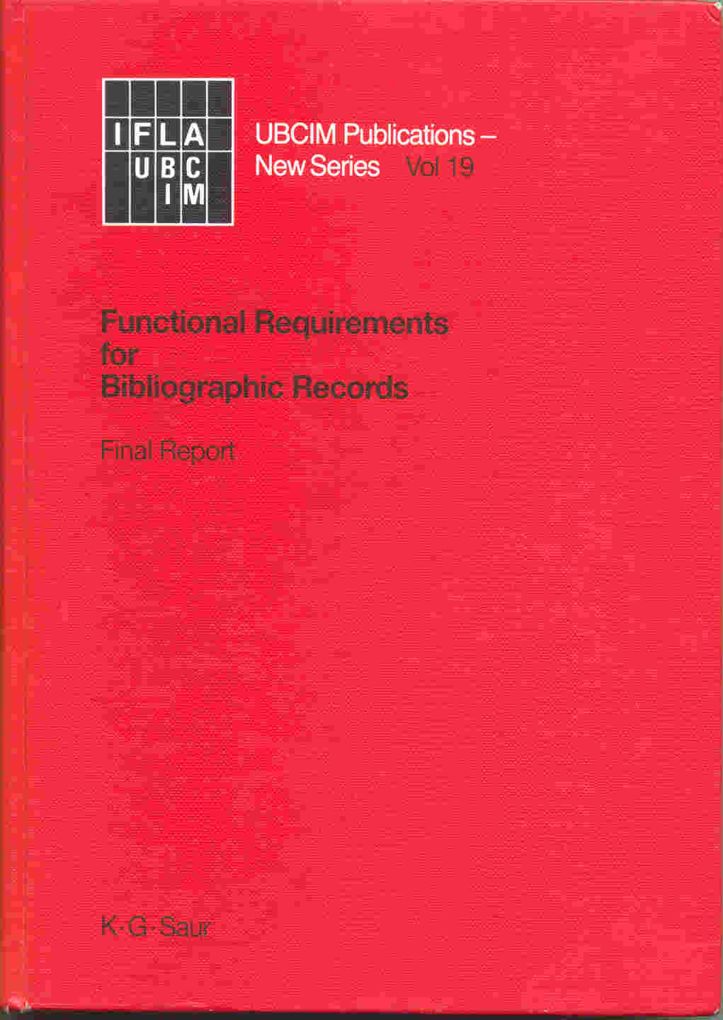
FRBR
Text available in print or at:
http://www.ifla.org/en/ publications/functional-requirements-for-bibliographic-records
Notes:
May 1, 2013
During the 1990s IFLA, the International Federation of Library Associations and Institutions, commissioned a new look at the bibliographic universe. The result was the document Functional Requirements for Bibliographic Records, or FRBR (published in 1998).

Slide 114
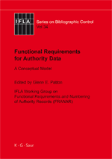
FRAD & FRSAD
Text available in print.
http://www.ifla.org/publications/ifla-series-on-bibliographic-control-34
FRSAD Final Report:
http://www.ifla.org/files/assets/classification-and-indexing/functional-requirements-for-subject-authority-data/frsad-final-report.pdf
Notes:
May 1, 2013
FRBR was joined by a companion volume, Functional Requirements for Authority data, or FRAD, published in 2009. FRAD is an expansion of FRBR and adds a number of entities not found in FRBR. There is also an extension of FRBR called Functional Requirements for Subject Authority Data. This training is be based on FRBR and FRAD, but I will refer to the model as a whole as FRBR.
FRBR analyzes the bibliographic universe and divides it into a set of entities, such as persons, corporate bodies, concepts, works, and so forth.

Slide 115
FRBR
A conceptual model of the bibliographic universe
Based on the entity-relationship model developed for databases
Notes:
May 1, 2013
FRBR is not a cataloging code. It is a conceptual model of the bibliographic universe based on a database modeling technique called ...

Slide 116
Entity-Relationship Model
Entity: Something that can be distinctly identified.
Relationship: An association between two or more entities.
Attribute: A characteristic that may identify instances of entities or relationships.
Notes:
May 1, 2013
... “entity-relationship,” first introduced in the 1970s. This model is widely used in database design, but until recently hasn’t been used extensively in library databases. In this model a specific database universe is defined, and this universe is divided into specific entities linked by specific relationships.
An entity is something that can be distinctly identified within the context of the database. For example, a genealogical database might define as entities “persons,” “places,” “events.”
A relationship is an association between two or more entities. A genealogical database might define a “father-child” relationship between a male person and his children.
In the model, entities and relationships are defined by attributes (called “elements” in RDA). An attribute is a characteristic that may identify instances of entities or relationships. For example, one of the attributes of a person is his or her birth date; other possible attributes for a person might be where he lives, his profession, his marital status, and so forth. Entity-relationship databases are designed with the entities, relationships, and attributes needed for the purpose of the database. A personnel database might need to define lots of attributes and relationships for persons (e.g., SSN, sex, marital status, position in the company, salary, etc.). A bibliographic database would not define all possible attributes and relationships for “person”, just those needed for the purposes of the database, such as name, possibly birth and death dates, relationship to works he/she created, etc. RDA, based on FRBR, defines entities, relationships, and attributes. Most of our cataloging under RDA will consist of describing the attributes of the different FRBR entities.

Slide 117
Entity-Relationship Diagramming
Entities
Relationships
Attributes
Entity
Relationship
Attribute
Notes:
May 1, 2013
There are many different conventions of diagramming the entity-relationship model. One of the most basic methods is to use a rectangle for an entity, a diamond for a relationship, and an oval for an attribute. This is the diagramming technique used during most of this presentation. FRBR’s diagramming model is a little different; I will show FRBR diagramming in a moment.

Slide 118
Entity-Relationship Diagramming
Attribute 1
Entity 1
Attribute 2
Relationship
Attribute 1
Entity 2
Attribute 2
Notes:
May 1, 2013
In this diagramming method entities, relationships, and attributes are linked by lines. The simplest version uses single lines, as shown here. To illustrate more complex situations other types of lines may be used, including lines with arrows at either end to show whether the relationship is reciprocal or not. In this presentation most of the diagrams will have the simple lines shown here. In the basic model both entities and relationships can have attributes, but in FRBR attributes have only been defined for entities, so no attributes for relationships will be shown in this presentation.

Slide 119
FRBR Diagramming
Work
is realized through
Expression
is embodied in
Manifestation
is exemplified by
Item
Notes:
May 1, 2013
FRBR has two diagramming techniques, one for entity-relationship sets (i.e., the abstract model), and another for specific instances of entity-relationship. This slide illustrates the entity-relationship set diagramming technique. Entities are shown in rectangles as in the classic model, but relationships are simply shown by words next to the lines. In this illustration, “work”, “expression”, “manifestation”, and “item” are entities; “is realized through”, “is embodied in” and “is exemplified by” are relationships. Single arrows mean that only one instance of an entity can occur in the relationship; double arrows mean that more than one instance can occur. For example, look at the relationship between item and manifestation. In the FRBR model, a manifestation can be related to more than one item, but an item can be related to only one manifestation.

Slide 120
FRBR Diagramming
cb₁ Kelmscott Press
is the producer of →
← has a producer
    m₁ the 1891 publication of Poems by the Way by William Morris
    m₂ the 1892 publication of The Recuyell of the Historyes of Troye by Raoul Lefevre.
    m₃ the 1896 publication of The Works of Geoffrey Chaucer
Notes:
May 1, 2013
This slide illustrates FRBR’s diagramming technique when it wants to show specific instances of an entity. In this illustration, the corporate body entity “Kelmscott Press” has a specific relationship (producer) to three manifestation entities, Poems by the way, The Recuyell of the Historyes of Troye, and The works of Geoffrey Chaucer.
The two FRBR diagramming techniques are illustrated here in order to help you understand FRBR itself when you have a look at it. However, as mentioned, the traditional Entity-Relationship diagramming will be used in the rest of this presentation.

Slide 121
FRBR Entities
Group 1: The products of intellectual or artistic endeavor. Sometimes called “the primary entities.”
  Work: a distinct intellectual or artistic creation
  Expression: the intellectual or artistic realization of a work in some form (e.g. alpha-numeric, musical notation)
  Manifestation: the physical embodiment of an expression (e.g. a print publication)
  Item: a copy of a manifestation
Notes:
May 1, 2013
To create a good entity-relationship database, careful planning is required. When you begin to design an entity-relationship database, one of the first things you need to do is define the entities and relationships. You need to define every entity and every relationship that is important to your particular database. On the other hand, one type of entity should not overlap with another. This careful planning process is exactly what the authors of FRBR, FRAD, and FRSAD have done, and it has taken years. The authors of FRBR thought about what types of things should be defined as entities in our bibliographic universe, and this is the result.
The entities in the FRBR model are divided into three groups. The first is defined as “the products of intellectual or artistic endeavor,” and the entities in this group are listed on this slide.
Work: “a distinct intellectual or artistic creation”
Expression: “intellectual or artistic realization of a work in the form of alpha-numeric, musical, or choreographic notation, sound, image,” etc.
Manifestation: “the physical embodiment of an expression of a work”
Item: “a single instance of a manifestation”--in other words, a copy
HERE ASK PEOPLE TO THINK OF EXAMPLES OF EACH. The next slide also has examples.

Slide 122
FRBR Entities
Group 1 (“Primary entities”)
  Work
  Expression
  Manifestation
  Item
Gone with the wind
Original English text of Gone with the wind
German translation of Gone with the wind
1936 publication by Macmillan
1937 publication of German translation by Bertelsmann
2006 publication by Scribner
Library copy of 1937 publication (barcode 31197222656115)
1 of five Library copies of 1936 publication (barcode 31197011774061)
Library copy of 2006 publication (barcode 31197226590575)
Notes:
March 27, 2017: revised speaker notes—physical form is an attribute of the manifestation not the expression.
Here are some specific examples of these abstract entities. All of these entities have attributes. Attributes are characteristics that would be necessary to describe each entity, to distinguish it from other entities of the same type.
AS YOU GO THROUGH, ASK PEOPLE TO SAY WHAT THEY THINK THE ATTRIBUTES OF EACH ENTITY WOULD BE BEFORE TELLING THEM THE FRBR/RDA ATTRIBUTES.
Work: (what distinguishes it from other works?) title (“Gone with the wind”), form (novel), date of composition (pre-1936), etc. (music attributes include key, medium of performance)
Expression: (what distinguishes it from other expressions?) form (not literary form—form of expression, e.g., alpha-numeric notation, musical notation, spoken word, musical sound, photographic image, dance); date (in the case of the German translation, the date it was composed); language (1st expression = English; there may be other English expressions; language of the German translation is German, etc.); extent (e.g., the number of words, the duration of a recording, etc.)
Manifestation: (what distinguishes it from other manifestations?) title (i.e. exactly what is printed on the title page), statement of resp. (ditto), edition/issue designation, place of publication, publisher, date of publication, etc., form of carrier (i.e., physical form, e.g., text on paper, cassette, compact disc, electronic)
Item: (what distinguishes it from other items?) item identifier (e.g. barcode, possibly call number); provenance (who has owned the item?); marks/inscriptions; condition (missing its cover, etc.); access restrictions; location of the item (where is it vs. others?)
NOTE: Much of RDA consists of instructions for naming and describing the attributes of the entities. It looks to a situation where we might have a separate record or description for each entity, and so tells us what we should include in the descriptions of those entities—i.e., we’ll need to enter the attributes of the entities into our records.

Slide 123
FRBR Relationships (Group 1)
Work
realized through
Expression
embodied in
Manifestation
exemplified by
Item
Notes:
May 1, 2013
This is how the primary entities are related to each other (read from slide)

Slide 124
FRBR Relationships
Work-to-work relationships
Derivative relationship
adapted as / adaptation of
Work: Gone with the wind (Novel)
Work: Gone with the wind (Movie)
described in / description of
described in / description of
Work: Vanity Fair
Descriptive relationships
Work: Gone with the wind on film: a complete reference
described in / description of
Work: Vanity fair and Gone with the wind: a critical comparison
Notes:
June 6, 2014
To get more concrete, here are some specific instances of the FRBR work entity with various types of relationships. In this slide the novel is shown to have a relationship to two other works: a derivative relationship with the movie, and a descriptive relationship with the work Vanity fair and Gone with the wind: a critical comparison. In a real database the work Gone with the wind (the novel) would have relationships with many other works; and it would also potentially have relationships with instances of all the other types of FRBR entities. The database becomes like a web, with dozens, hundreds, or even thousands of relationship links between any one entity and other entities. In this slide you can see further relationships between the movie and a work that describes it, and the work Vanity Fair and the work that also describes Gone with the wind. In a FRBR/RDA based database each of these work entities would have separate descriptions that the user could examine.

Slide 125
FRBR/FRAD Entities
Group 2: entities responsible for Group 1 entities
  Person
  Family
  Corporate body
Notes:
May 1, 2013
The second group of entities are those responsible for creating intellectual or artistic content in Group 1 entities. FRBR/FRAD have defined three: Person, Family, Corporate body. Note “family” is new to descriptive cataloging rules, and was added to the FRBR model through FRAD. RDA incorporates guidelines for describing instances of the family entity. This should be helpful to us as we move forward.
The three entities here are defined much as we would expect
Person: “an individual or persona established or adopted by an individual or group”
Family: “Two or more persons related by birth, marriage, adoption, or similar legal status, or who otherwise present themselves as a family.”
Corporate body: “an organization or group of individuals and/or organizations acting as a unit”

Slide 126
FRBR Entities
Group 2
  Person
  Corporate body
  Family
Margaret Mitchell
Claude Debussy
George W. Bush
British Library
Ikea A/S
Jin (Dynasty : 265-420)
Peale (Family : Peale, Norman Vincent, 1898-1993)
Yan (Family : China)
Yan (Family : Philippines)
Notes:
January 23, 2023: remove gender
Here are some concrete instances of these abstract entities. Attributes have been defined for each of these entities.
BEFORE LISTING THE ATTRIBUTES ASK CLASS PARTICIPANTS TO SAY WHAT THEY THINK THE ATTRIBUTES OF THESE ENTITIES SHOULD BE.
For person, these include: name, dates, title, other designation, place of birth, place of residence, language of person, field of activity. For example, Margaret Mitchell has a name, associated dates, and so on, as do Claude Debussy and George W. Bush. The fact that the attributes of each of these are different is what distinguishes them from one another.
For corporate body, attributes include: name, number (e.g. for meetings), place associated with the corporate body, date associated with the corporate body, type of corporate body, language of the corporate body, its field of activity
For family, attributes include: name, type of family (e.g. clan, dynasty, etc.), dates of family, places associated with family, history of family
The RDA chapters dealing with these entities tell us how to record the attributes of the entities and we’ll be looking at them in detail in upcoming modules. Again, RDA is looking toward a database structure where we would have a separate entity record or description for each person, corporate body, or family, and within that entity record we would describe the entity, or in other words, record its attributes. We would create such a record only once for each entity rather than our current practice in MARC of repeating much information every time we create a new bibliographic record. Entity records would be linked to other FRBR entity records, e.g., the entity record for Margaret Mitchell would be linked to the work record for Gone with the wind via a “creator” relationship link. Any entity record can be linked to any other entity record as appropriate.
Our current authority database structure is similar to this: we only create a single authority record for Margaret Mitchell and we use that for all instances of Mitchell in the database. Upcoming modules will tell how we incorporate the attributes of each entity into the description of the entity (a.k.a. the authority record for the entity).

Slide 127
FRBR Relationships (Groups 1-2)
Work: Gone with the wind
created by
Person: Margaret Mitchell
realized through
Expression: 1st German expression
Expression: 1st English Expression
has a translation
Person: Martin Beheim-Schwarzbach
translated by
Notes:
May 1, 2013
Here we have various relationships between entities. Margaret Mitchell has a creator relationship with Gone with the Wind. The work has a “realized through” relationship with the two expressions; and notice the expression entities also have a relationship to each other. Finally, the German expression has a “translated by” relationship with another person entity, Martin Beheim-Schwarzbach.

Slide 128
FRBR Entities
Group 3: entities that can be subjects of works
  Any group 1 or group 2 entity, and
  Concept
  Object
  Event
  Place
Notes:
May 1, 2013
Group 3 entities are entities that can be subjects of works, expressions, manifestations, or items. Any of the entities can be the subject of a work—for example a person entity, from group 2, could be the subject of a biography.
The “new” entities in Group 3 are:
Concept: “an abstract notion or idea”
Object: “a material thing”
Event: “an action or occurrence”
Place: “a location”

Slide 129
FRBR Entities
Group 3 (subjects)
  All entities in Groups 1 and 2
  +
  Concept
  Object
  Event
  Place
Stone age
French language
Granite
Horses
Vesuvius (Italy)—Eruption, 79
Olympic Games (29th : 2008 : Beijing, China)
Salt Lake City (Utah)
Biscay, Bay of (France and Spain)
Notes:
May 1, 2013
Here are some concrete examples of Group 3 entities. All the examples are LCSH or currently formed name access points.
Attributes of concept include: term of concept, type of concept
Attributes of object include: type of object, date of production, physical medium, place of production, etc.
Attributes of event include: Date associated with event, place associated with event
Attributes of place include: term for the place
The RDA guidelines for recording attributes of concept and objects are not yet written and do not appear with the first publication. Guidelines for recording attributes of some events and jurisdictional places are in the current publication.
NOTE: Concepts and objects are not currently described in NACO authority records. They are described in LCSH authority records. Some events and places are described in NACO authority records; others are described in LCSH authority records. The distinction is covered elsewhere in this training.

Slide 130
FRBR Group 3 Relationships
Work: Gone with the wind
Concept: Georgia—History—Civil War, 1861-1865—Fiction
created by
has a subject
Person: O'Hara, Scarlett —Fiction
Person: Margaret Mitchell
has a genre
Concept: War stories
Concept: Historical fiction
Notes:
May 1, 2013
Here are a few group three relationships to the work Gone with the wind. In order to keep on familiar ground I’ve used LCSH style subject strings. However, note that with current LCSH practice there is a mixture of FRBR entities when a subject string is subdivided. For example, Georgia is a FRBR place entity, History and fiction are concept entities, and Civil war is an event entity. When combined as a string the whole thing would probably be regarded as a concept. If the strings were broken up (faceted) it would be possible to be more precise about the entity. This needs thinking out. Another point to note: in RDA fictitious characters are grouped within the person entity, not the concept entity, so Scarlett O’Hara is labeled a “person” in this example. [Pause to look at the diagram.]

Slide 131
FRBR/RDA Attributes
FRBR, a model, defines attributes, but does not tell us how to record the data
RDA, a cataloging code, defines attributes and does tell us how to record the data
Notes:
May 1, 2013
FRBR defines a set of attributes for each entity in the model. Because it is not a cataloging code, FRBR does not define how the information is to be recorded. For example, “name of person” is one of the attributes of the “person” entity in FRBR. FRBR defines this attribute: “The name of a person is the word, character, or group of words and/or characters by which the person is known”, and points out that a person may be known by more than one name, and that libraries normally select one of the names as a uniform heading. But it does not tell us how to form the data to be recorded in this element, and if we are one of the libraries that wants to select one as a uniform heading, it does not tell us how to make that choice. That is the province of a cataloging code, such as RDA. RDA also defines attributes for entities, but because it is a cataloging code it also informs us how to record the data and in the case of the “name of person” attribute, it tells us how to choose between competing forms.

Slide 132
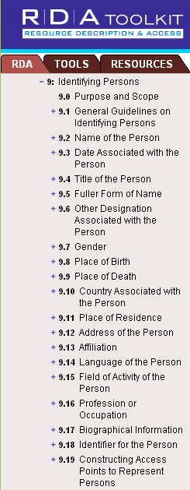
Attributes of
Person in RDA
Notes:
May 1, 2013
In this module we will examine the FRBR entity, “person”, and demonstrate how this works out in RDA. We will be looking at this entity in much more detail later.
FRBR and FRAD define several attributes of “person”. These are mostly taken directly into RDA, where they are worked out more fully, and in some cases refined with subelements. In RDA the act of recording attributes of an entity is referred to as “identifying” so RDA chapter 9 is called “Identifying Persons”. Chapter 9 is within a larger RDA section called “Recording attributes.” Within each “entity” chapter the guidelines begin with a scope note and general guidelines defining the entity, as you can see here. The central portion of each chapter consists of subsections detailing each attribute of the entity, including a definition of the attribute (also referred to as an “element” in RDA) and guidelines for recording the information. Finally, at the very end of each chapter, is a subsection detailing how to construct an access point to represent the entity. [Draw attention to 9.19.] It is extremely important that you understand this structure or you will get confused. The central subsections of the chapter do not necessarily have anything to do with the access point. They are intended to give guidance for recording attributes, not constructing an access point.

Slide 133
Person Entity Attributes
Person (Margaret Mitchell)
Preferred name: Mitchell, Margaret
Fuller form of (fore)name: Margaret Munnerlyn
Variant name: Marsh, John Robert, Mrs.
Date of birth: 1900 November 8
Date of death: 1949 August 16
Place of birth: Atlanta, Ga.
Language of the person: English
Notes:
Updated January 23, 2023 to remove gender
January 19, 2017: controlled form for gender
How might this work in the real world? “Margaret Mitchell” is an instance of the “person” entity. Many of the RDA-defined attributes apply to her. How would we work RDA out in a FRBR-based database?
The first RDA attribute is “name of person”. RDA works this out into two subelements, “preferred name” and “variant name.” RDA instructs us, for all of these forms, to invert; and it instructs us to choose the commonly known form as the preferred name. In this demonstration I will record the preferred name and one variant name. The preferred name is based on usage. Variant names can come from any source. Regarding Mrs. John Robert Marsh, in RDA, as in AACR2, if a married person is identified only by a partner’s name, the term of address is considered an integral part of the name, and hence is recorded as part of the name attribute, as here.
In RDA a fuller form of name is not required to “fill out” elements already found in a preferred or variant name. Because Mitchell had a middle name, the fuller form of her forename is “Margaret Munnerlyn”.
“Date associated with the person” is an element which RDA has subdivided into subelements: date of birth, date of death, and period of activity. Note the RDA element only calls for the year to be recorded in most cases. I am giving the format RDA prescribes if two persons with the same name are born or died in the same year. We will see that this data is recorded slightly differently in MARC.
Place of birth and language of the person are other possible attributes to record. RDA prescribes the forms shown.
There are many other elements and subelements called for in RDA. Note that only a few are core or required. Preferred name and dates are core. Remember this doesn’t mean the dates necessarily have to be part of the access point. It just means they need to be recorded as an element of the RDA record if known. There are a few other elements that are core if needed to distinguish one person from another.

Slide 134
Person Entity Attributes (MARC)
046 $f 1900-11-08 $g 1949-08-16 $2 edtf
100 1_ Mitchell, Margaret, $d 1900-1949
400 1_ Marsh, John Robert, $c Mrs., $d 1900-1949
370 Atlanta (Ga.) $2 naf
377 eng
378 $q Margaret Munnerlyn
Notes:
January 23, 2023: remove gender
March 27, 2017: recorded gender in plural
January 19, 2017: controlled form for gender
These same RDA elements translate into MARC in this way.
There is no discrete field in current MARC for recording the preferred name. The only place to record it is as a part of the authorized access point in 100. Subfield $a and $c (not present in this example) contains the preferred name prescribed by RDA.
Similarly there is no discrete place to record the variant name. Until MARC expands to allow this, it has to be recorded as part of a variant access point, in $a and $c of a 4XX field.
The fuller form of name element is recorded in field 378.
The date subelements are recorded in field 046; subfield f is date of birth, subfield g is date of death. Note the MARC formatting is different from the formatting called for in RDA.
Place elements associated with a person are recorded in 370; $a is the place of birth. The form in the 370 doesn't match identically the form found in the previous slide because PCC policy is to use the form of place found in the NAF rather than the form prescribed by RDA. A good illustration of LC-PCC/NACO policy trumping RDA instructions.
The language of the person element is recorded in 377. In current MARC practice, languages are recorded as the MARC language code in subfield $a, which is repeatable if the person used more than one language (we don’t record all languages the person knows, just the ones he or she actually produces works in).
To complete this record we would include notes for the sources we consulted to find the information. RDA instructions for this are in chapter 8; for the most part they would be recorded in 670 fields, just as NACO practice has been until now.

Slide 135
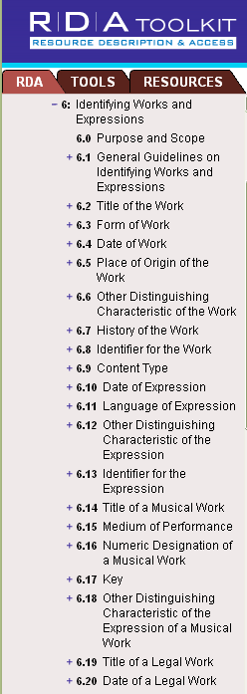
Attributes of
Work in RDA
Notes:
May 1, 2013
Now let’s create a record for a work. The attributes, or elements, of the work entity are found in RDA chapter 6, “Identifying works and expressions.” Elements or attributes of work include title, form, date of the work (date the work was created), other distinguishing characteristic, and special guidelines for particular kinds of works like musical works. There are more elements and subelements defining work in RDA than there were for person, so I can’t fit them all on the screen, but these are enough to get us started. Let’s create a record for Gone with the wind using some of these elements.
One thing to note before we start: “Author” or “Creator” is not an attribute of work in RDA or FRBR. The author is a person, family, or corporate body, and as such is a separate entity with a relationship to the work. In a pure RDA work record the author’s name would not appear in the record, but the record instead would be linked to the record for the author. This is a dramatic difference from current MARC practice.

Slide 136
Work Entity Attributes
Work (Gone with the wind)
Preferred title: Gone with the wind
Variant title: GWTW
Form of work: Novel; Romance fiction
Date of work: 1936
History of the work: Gone with the wind is a romance novel by Margaret Mitchell first published in May 1936; it won the Pulitzer Prize in 1937.
Notes:
March 27, 2017: removed “Summarization of the content: Scarlett O’Hara, the spoiled daughter of a well-to-do plantation owner, must overcome the challenges facing the South during and after the Civil War”. Summarization of content is an attribute of the expression not the work.
August 7, 2019: added a second form of work and rewrote History of the work in the way it would be recorded.
“The title of the work” element in RDA is subdivided into subelements “preferred title for the work” and “variant title for the work.” The preferred title is chosen as you would expect: choose the title by which the work is commonly known.
Gone with the wind does have a form. It is a novel. It is also romance fiction, historical fiction, and a war story.
We are instructed in RDA to record the date of the work, defined as the earliest date associated with the work. If we don’t know the complete history of the work, which we usually won’t, we can record the date of the first expression of the work; this date in turn may be the first time the expression was published in a manifestation. In this case that would be 1936.
History of the work is another possible element, which is totally free text. There isn’t a prescribed form.

Slide 137
Work Entity Attributes
(Current MARC Practice)
046 $k 1936 $2 edtf
100 1_ … . $t Gone with the wind
380 Novels $a Romance fiction $a Historical fiction $2 lcgft
678 Gone with the wind is a romance novel by Margaret Mitchell first published in May 1936; it won the Pulitzer Prize in 1937.
Notes:
February 26, 2019: updated speaker notes to clarify that more than one form can be recorded
This slide shows the elements of the entity “work” as currently recorded in the MARC authority format.
We’ve already noted that the creator is not one of the elements of “work.” The creator is a separate entity as we’ve already seen, and it is linked to the authority record for the work by recording the exact string found in the 1XX field of the creator’s own record at the beginning of the 1XX field in the authority record for the work. We will see this on the next slide.
Preferred title is recorded in $t of the 1XX field as part of the authorized access point because there is no discrete place to record the element outside the authorized access point.
Date of work is recorded in 046 subfield $k.
Form of work is recorded in 380 subfield $a. Could also have used 380 Novels $2 rbgenr OR 380 Novels $2 aat OR 380 Fiction $2 marcgt. NOTE: more than one form can be recorded, either as repeated subfields $a in 380 or in separate 380 fields. For example, War fiction, Historical fiction, Romance fiction all could have been included (from LCGFT).
An uncontrolled form could also be included as an additional 380.
History of the work is recorded in 678.

Slide 138
Entity-Relationship Linking
Person: Margaret Mitchell
created by
Work: Gone with the wind
Notes:
May 1, 2013
As a reminder, here is how the linking of the two entity descriptions we just created would appear in an entity-relationship diagram. The next slide shows how this same thing is done in MARC.

Slide 139
Linking in MARC
Authority Record for the Work Entity
046 $k 1936 $2 edtf
100 1_ Mitchell, Margaret, $d 1900-1949. $t Gone with the wind
380 Novels $a Romance fiction $a Historical fiction $2 lcgft
678 Gone with the wind is a romance novel by Margaret Mitchell first published in May 1936; it won the Pulitzer Prize in 1937.
Mitchell, Margaret, $d 1900-1949
Authority record for the Person Entity
046 $f 1900-11-08 $g 1949-08-16 $2 edtf
100 1_ Mitchell, Margaret, $d 1900-1949
400 1_ Marsh, John Robert, $c Mrs., $d 1900-1949
370 Atlanta (Ga.) $2 naf
377 eng
378 $q Margaret Munnerlyn
Notes:
January 23, 2023: remove gender
February 26, 2019: clarified that adding 500 to make the “author” relationship explicit is permitted under PCC policy
August 7, 2019: revised 678 to put it in form PCC best practices require (complete sentences)
We create links in MARC records by using text strings. In this case the work record for Gone with the wind is linked to the person record for Margaret Mitchell because an exactly-matching text string (the authorized access point for Margaret Mitchell) is in the appropriate fields in the linked records. The type of relationship seen on the previous slide, “created by”, is implied by the position of Mitchell’s authorized access point at the beginning of the 100 field in the work description. It would be possible to make this even more explicit in a MARC authority record by recording another link to Margaret Mitchell in a 500 field and recording with it the relationship designator “author”: 500 1_ $w r $i Author: $a Mitchell, Margaret, $d 1900-1949. This may, in fact, be done under current PCC policy (see PCC Guidelines for the Application of Relationship Designators in Authority Records, November 2018, Guideline 15a)
To repeat: “Mitchell, Margaret, $d 1900-1949” is not one of the elements of the work description. Its presence in the authority record for the work is only to create the link.
PAUSE HERE TO LET PEOPLE LOOK.

Slide 140
FRBR/FRAD User Tasks
Find
Identify
Select
Obtain
Contextualize
Justify
Notes:
May 1, 2013
So how does all this help our users? After all, that’s the main point of what we’re up to.
FRBR and FRAD define tasks that the user wants to accomplish when he or she approaches the library’s database. For FRBR these are:
1. The user needs to find materials relevant to his or her needs. A user begins this process by doing a search in the database.
2. Once a search is executed, users need to identify the resource, that is, they must confirm that the resource corresponds to what they were looking for.
3. If more than one resource corresponds to the search, they then need to select the resource most appropriate to their needs.
4. Finally, once the user has selected a resource he or she wants to obtain it.
FRAD adds the following tasks:
1. Contextualize. This means the user needs be able to place the entity he or she is seeing into context. This was apparently meant to apply mainly to creators and users of authority data, but it seems a useful task to keep in mind for all our users.
2. Justify means to document one’s reasons for choosing a name or term on which a controlled access point is based. This task is probably undertaken only by creators of authority data.

Slide 141
The MARC Authority Format
In NACO practice descriptions of persons, families, corporate bodies, works, and expressions are created in the MARC Authority Format.
Notes:
May 1, 2013
There will be separate modules for persons, families, corporate bodies, and works and expressions which will give description details. This module will cover MARC issues that are common to all authority records.

Slide 142
MARC Authority Structure
Fields
  Fields are divisions of the record
  Tag
    3-digit number naming the field
  Indicators
    Two characters giving handling instructions for the field
  Subfields
    Division of the field into different types of data
Notes:
May 1, 2013

Slide 143
MARC Authority Structure
0XX – control fields, standard numbers, etc.
1XX – the authorized access point (only one allowed)
3XX – where most of the RDA entity attributes are recorded
4XX – variant access points
5XX – links to related entities
6XX – notes and series treatment
Notes:
June 6, 2014
Presenter suggestion: you may want to compare and contrast the MARC authority tag structure with the MARC bibliographic tag structure.
The MARC authority structure contains a number of mnemonics that help us remember the tags and subfields. In this module “X” as a part of a tag number means any digit.
Note: in case someone wonders, 046 is in the 0XX block because it contains a standardized form of the date. In case anyone asks, we’re skipping 260 because it’s only rarely used if at all.
4XX. Variant access points recorded in 4XX fields are either supposed to direct the user to the authorized form he/she needs to use in searching, or to automatically redirect the user. This is where non-Latin script forms of names are recorded (another difference from the MARC bibliographic format)
5XX. We’ve traditionally called these “see also” references, but in fact they are links within the MARC structure to other entities.
In addition to the blocks shown on this slide are 7XX, linking fields, and 8XX. 7XX links are used to link to other authorized forms of the entity described in the record and could be used, as an example, to link the NACO form to the authorized form found in the German National Library’s authority file for the same entity. It is not generally used in this way in NACO practice (a few national libraries have exceptional permission to use the field, but most NACO catalogers will not), but during the transition between AACR2 and RDA it was briefly used to record the RDA authorized access point when that was different from the AACR2 authorized access point. This practice has been discontinued. An 8XX block also exists, but is not covered in this training workshop, and is rarely used in NACO authority records.

Slide 144
MARC Authority Structure
X00 – Persons and Families
    Also works or expressions with a person or family as creator
X10 – Corporate bodies
    Also works or expressions with a corporate body as creator
X11 – Meetings, events, expeditions, etc.
    Also works or expressions with a meeting (etc.) as creator
X30 – Works or expressions without an explicit creator
X51 – Geographic entities
Notes:
May 1, 2013

Slide 145
MARC Authority Structure: Quiz
___
  = authorized access point for a person
  = variant access point for a corporate body
  = link to a related meeting (etc.)
  = variant access point (lacking an explicit creator) for a work or expression
  = authorized access point for a geographic entity
___
___
___
___
Notes:
May 1, 2013
Combining the previous two slides: what are the MARC tags for these elements?
Note: the answers are in the next slide. You may want to encourage participants to look at the screen rather than at their manual when thinking about this exercise.

Slide 146
MARC Authority Structure: Quiz
100
  = authorized access point for a person
  = variant access point for a corporate body
  = link to a related meeting (etc.)
  = variant access point (lacking an explicit creator) for a work or expression
  = authorized access point for a geographic entity
410
511
430
151
Notes:
May 1, 2013
ANIMATED SLIDE: MARC tag comes in on each click

Slide 147
00X : Control Fields
008/09 (OCLC Auth/Ref) – “Kind of Record”
  a = “established heading”
  b and c = “reference record”
NACO catalogers will almost always code this “a”
Notes:
May 1, 2013
The leader is supplied automatically by the software and is not treated here.
Note to presenter: do not linger on most of these—most are automatically filled out when creating a record in OCLC.

Slide 148
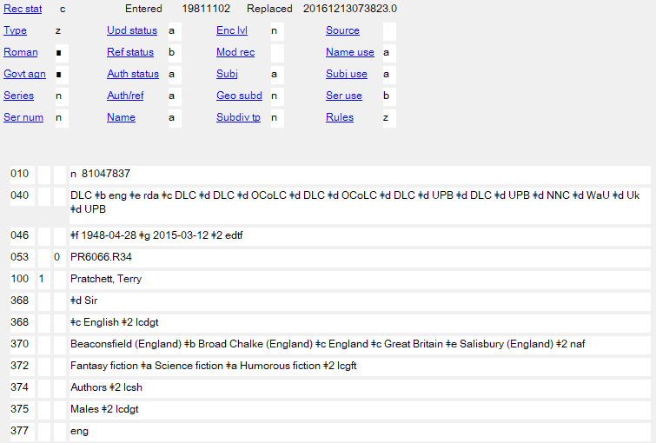
Notes:
October 14, 2024: added speaker note about the 375 field
February 4, 2019: updated authority record
This is a record containing an established authorized access point.
Note: you might want to mention that this and some other authority records that will be shown in slides include the 375 gender field, which was allowed by PCC in NACO record for the first 10 years of RDA implementation. The field should be deleted if a cataloger is revising a record for any other reason and is no longer a field added to new or existing authority records.

Slide 149
00X : Control Fields
008/10 (OCLC Rules) – “Descriptive Cataloging Rules”
  a-d = various former rules, including AACR2
    a - Earlier rules
    b - AACR 1
    c - AACR 2
    d - AACR 2 compatible heading
  z = “other”
Use “z”
Notes:
November 12, 2019: revised to give meanings of each code on the slide
Note: be careful when you encounter a record with anything other than “z”. “a”, “b”, and “d” are records formulated under earlier codes than AACR2 and there is a high likelihood that the authorized access point will not be appropriate for RDA. Even “c” (AACR2) formulated authorized access points might not be appropriate for RDA, though most are.
Codes for earlier rules:
a – earlier than AACR
b – AACR1
c – AACR2
d – AACR2 compatible

Slide 150
Notes:
February 4, 2019: updated authority record
This record is coded “other”, which is what we use for RDA

Slide 151
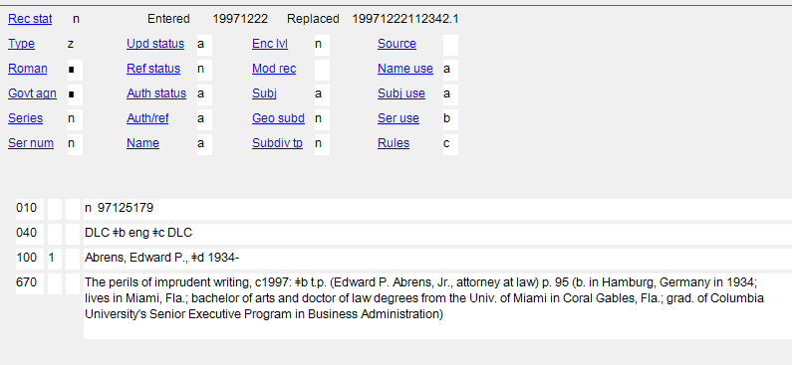
Notes:
June 6, 2014
This record is coded “c”, for AACR2. If anyone makes any changes to this record it should be evaluated and upgraded to RDA. Based on usage shown in the 670s, "Jr." should be included in the RDA access point.

Slide 152
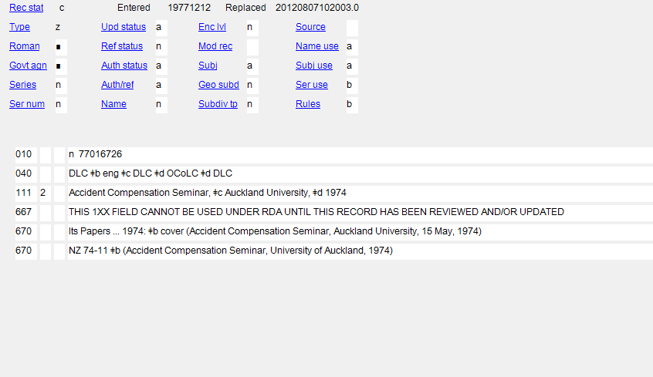
Notes:
October 14, 2024: added second paragraph to speaker notes
September 17, 2018
This record is coded “b” for AACR 1. The form in 111 should not be used in an RDA record; if needed the record needs to be updated to RDA (including revising the form in 111).
Notice the 667 note in this record, which was added programmatically to this type of record. Also notice that the form of the access point in the 111 field is not what would have been used either in AACR2 or RDA (qualifiers are enclosed in parentheses separated by space colon space, and date precedes location of conference).

Slide 153
00X : Control Fields
008/12 (OCLC Series) – “Type of series”
  a = Monographic series
  b = Multipart item
  c = Series-like phrase
  n = Not applicable
008/13 (OCLC Ser num) – “Numbered or unnumbered series”
  a = Numbered
  b = Unnumbered
  c = Numbering varies
  n = Not applicable
008/16 (OCLC Ser use) – “Heading use – series added entry”
  a = Appropriate
  b = Not appropriate
Notes:
May 1, 2013

Slide 154
Notes:
February 4, 2019: updated authority record
This authorized access point cannot be used as a series.

Slide 155
00X : Control Fields
008/14 (OCLC Name use) – “Heading use – main or added entry” (1XX/7XX in bib record)
  a = Appropriate
  b = Not appropriate
008/15 (OCLC Subj use) – “Heading use – subject added entry” (6XX in bib record)
  a = Appropriate
  b = Not appropriate
Notes:
May 1, 2013
All authorized access points created under the NACO authority program are appropriate for use in a 1XX or 7XX bibliographic field (so always code “a”); most are appropriate for use as a subject.

Slide 156
Notes:
February 4, 2019: updated authority record
This authorized access point may be used in 100 and 700 fields (“Name use”) and in 600 fields (“Subj use”)

Slide 157
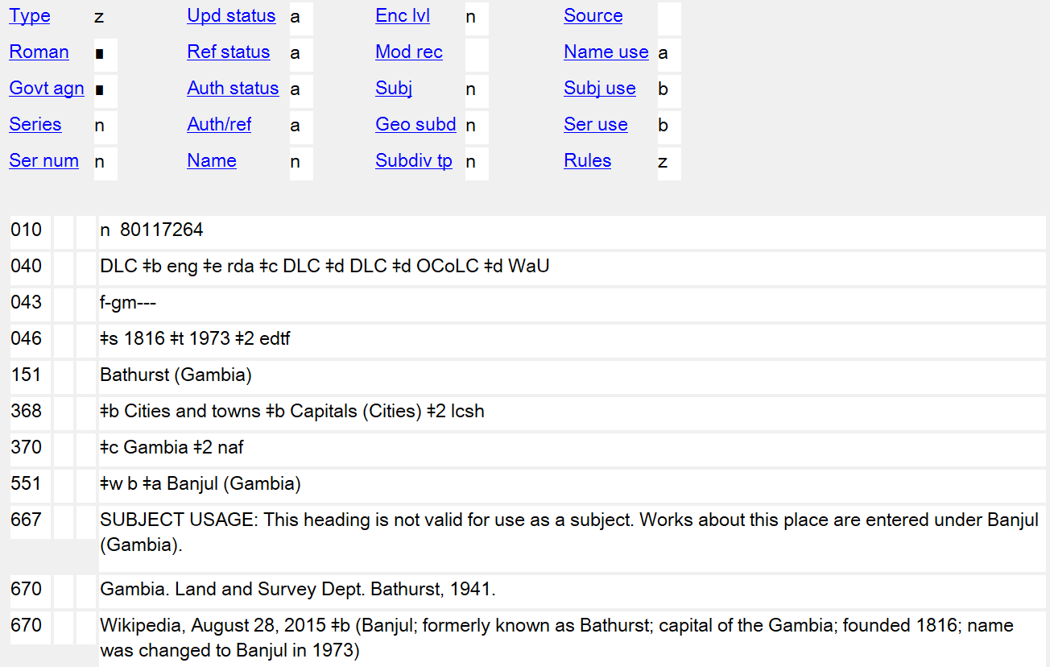
Notes:
November 12, 2019
This NAR for the earlier name of a place is valid for use as a name, but may not be used as a subject. In addition to a 667 note explaining this, the fixed fields Subj (008/11) and Subj use (008/15) are also coded to indicate this. With the correct coding in the fixed field, OCLC will not allow this heading to be controlled as a subject heading (either in 610 or 651). It can still be used as an access point in a 110 or 710 field (Name use is coded “a”).

Slide 158
00X : Control Fields
008/29 (OCLC Ref status) – “Reference evaluation”
  a = 4XX or 5XX fields present in the record
  b = Includes 4XX fields that are not “evaluated”
  n = no 4XX or 5XX fields present in the record
Because guidelines for evaluation of non-Roman script references have not yet been established, use “b” if non-Latin script 4XX fields are present
Notes:
May 1, 2013

Slide 159
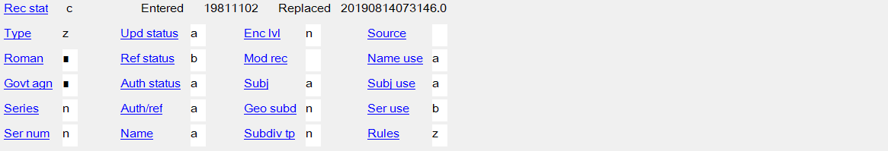
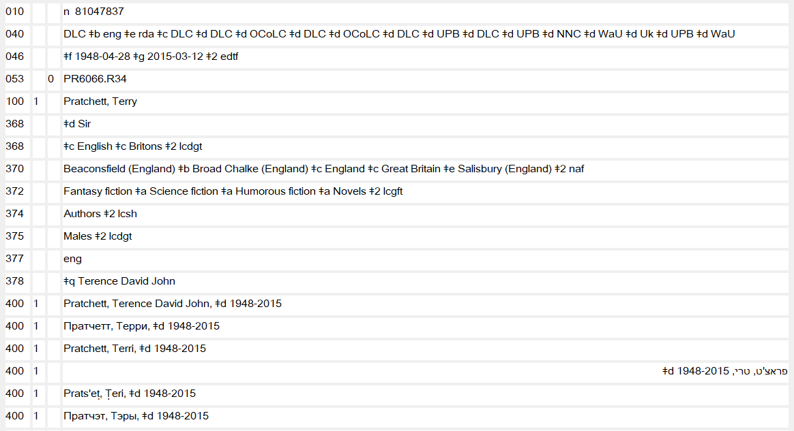
Notes:
November 12, 2019: replaced screen image and added arrows pointing to non-Latin script references
February 4, 2019: updated authority record
Coded “b” because of the non-Latin script (Hebrew and Cyrillic depicted in slide) 4XX fields

Slide 160
00X : Control Fields
008/32 (OCLC Name) – “Undifferentiated personal name”
  a = Differentiated personal name
  b = Undifferentiated personal name
  n = Not applicable
Notes:
February 24, 2014
A differentiated personal name is an authorized access point that is unique to the person described in the record. An undifferentiated personal name is an authorized access point that is used for more than one person (because they share the same name and nothing could be found to differentiate their authorized access points). More on this in the “Describing Persons” module.
Undifferentiated name records are no longer permitted under PCC policy, but you will still encounter undifferentiated name records in the LC/NACO authority file. We will learn what to do when we encounter these in the next module, Module 2.

Slide 161
Notes:
February 4, 2019: updated authority record
The authorized access point in this record is “differentiated”—it applies only to the science fiction/fantasy author Terry Pratchett.

Slide 162
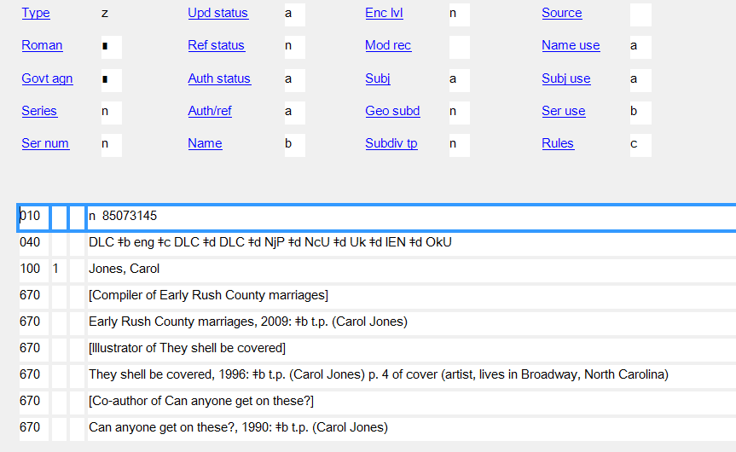
Notes:
February 27, 2020: updated speaker notes
The authorized access point in this record is “undifferentiated”—it applies to three different individuals named Carol Jones. One compiled Early Rush County marriages; one illustrated They shell be covered; and one is the co-author of Can anyone get on these?
Please note: this is an AACR2 record. Undifferentiated name authority records in RDA NACO authority records are no longer created under PCC policies. No additional individuals may be added to existing undifferentiated records either.

Slide 163
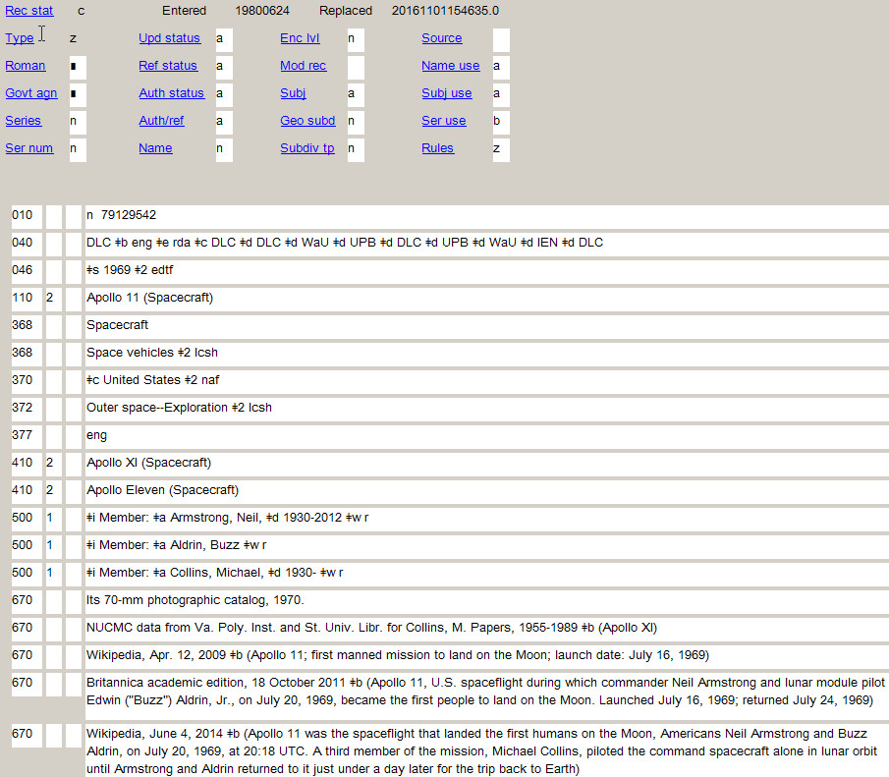
Notes:
November 2, 2016
The entity on this record is not a person, so the “Name” position is coded “not applicable.” Records describing families (X00 3_), corporate bodies (X10), meetings (X11), places (X51), and works/expressions without an explicit creator (X30) are coded “n”. Records describing works or expressions that have an explicit personal creator (authorized access point for the work/expression begins with the authorized access point for a person) are coded “a” or “b”, depending on how the record for the person is coded.

Slide 164
00X : Control Fields
008/33 (OCLC Auth status) – “Level of establishment”
  a = Fully established
  c = Provisional
Notes:
November 12, 2019: added list of all codes and their definitions and notes about the DCM Z1
There are a few other possible codes, but “a” or “c” are what NACO catalogers will use. “c” is rarely used, normally because the cataloger does not have enough information to decide what the preferred name of the entity is. This usually involves a language issue (e.g. for a corporate body the cataloger does not know the name of the body in its own language).
a - Fully established
The heading may be used without reservation in a bibliographic record.
b - Memorandum
The heading is fully established but it has not been used in a bibliographic record. The authority work was done before the decision was made to not use the heading in a bibliographic record; however, the information is retained for probable future use. When the heading is used in a bibliographic record, code b may be changed to code a or c.
c - Provisional
The heading cannot be formulated satisfactorily because of inadequate information. Further investigation should be made when the heading is next used in a bibliographic record. When the needed information is available, code c may be changed to code a.
d - Preliminary
The heading is taken from a bibliographic record because the bibliographic item is not available at the time the heading is established. When the heading is used in a bibliographic record created from cataloging with an item in hand, code d may be changed to code a.
n - Not applicable
1XX field contains an unestablished heading in a reference, subdivision, reference and subdivision, or node label record.
| - No attempt to code
The DCM Z1 008/33 contains further details on when code “c” for provisional should be used, and what to do when using a preliminary (code “d”) record. “Preliminary authority records (008/33 value ‘d’) generally are the result of retrospective projects. LC catalogers are expected to upgrade NARs coded preliminary when using the heading on a bibliographic record. PCC catalogers are expected to routinely upgrade NARs coded preliminary when making other modifications to the record.

Slide 165
Notes:
February 4, 2019: updated authority record
This record is “fully established”.

Slide 166
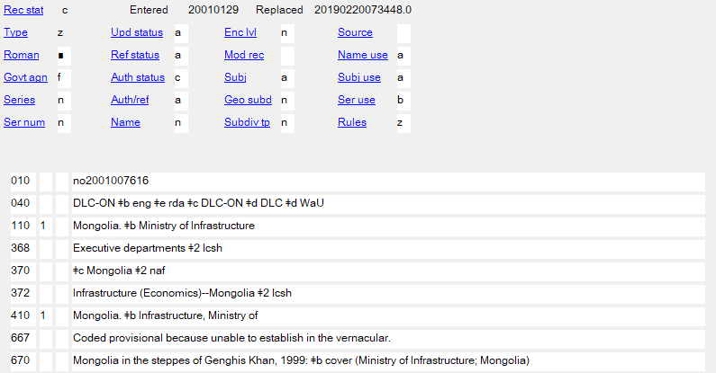
Notes:
October 14, 2024: added to speaker notes
February 26, 2019: replaced example
In this case the cataloger did not know the Mongolian name of the entity, so the code is “provisional”. If the name in Mongolian becomes available later, the 110 should be changed and the level of establishment changed from “c” to “a”.
When coding a record provisional, it’s also very helpful to add a 667 note explaining why.

Slide 167
00X : Control Fields
008/39 (OCLC Source) – “Cataloging source”
  blank = National bibliographic agency
  c = Cooperative cataloging program
Most NACO catalogers will code this “c”
Notes:
May 1, 2013

Slide 168
Notes:
February 4, 2019: updated authority record
Coded blank because initially created by LC. The “Source” code is automatically entered by the software and is based on the MARC organization code in 040 $a. NACO catalogers should not attempt to change the code.

Slide 169
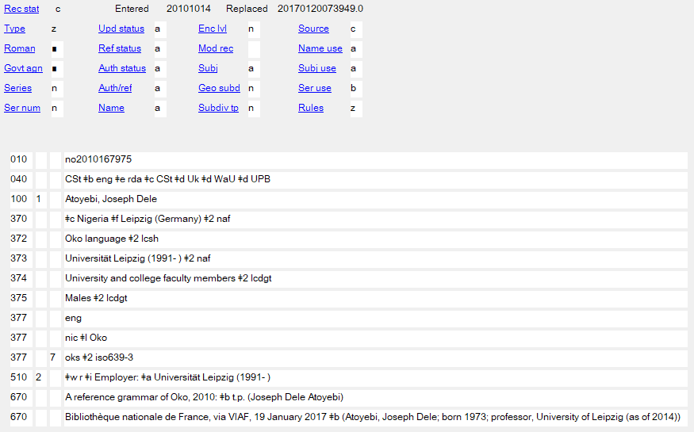
Notes:
March 8, 2019: replaced example with updated image
Coded “c” because initially cataloged by a PCC library (CSt = Stanford University).

Slide 170
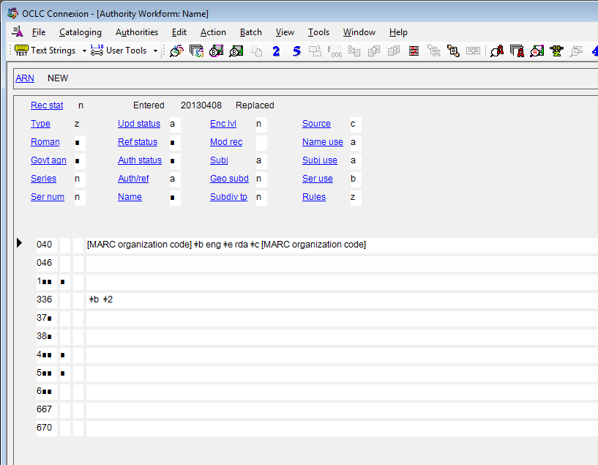
Notes:
May 1, 2013
We’ve just gone over most of the fixed field values in the MARC authority record, but most are filled out automatically by the software. There are three, however, that need special attention (whether they’ve been automatically filled out or not) because their values vary more than the others.
This is the OCLC RDA authorities workform, showing these three fixed fields. When creating or editing authority records, pay particular attention to “Ref status”, “Auth status”, and “Name.”

Slide 171
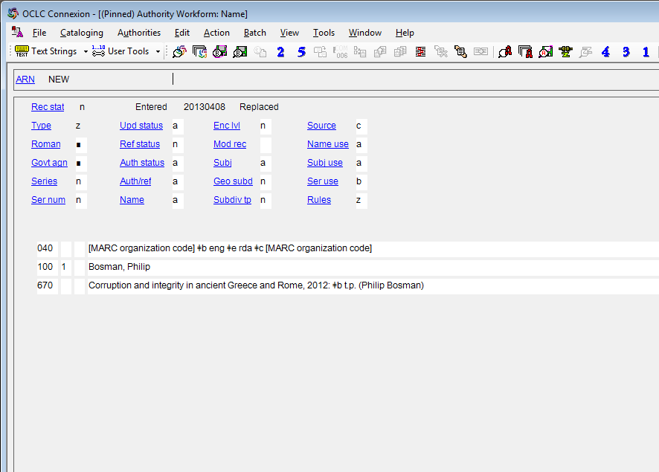
Notes:
May 1, 2013
This example shows the initial result of using the OCLC generate authorities macro. Even though “ref status”, “auth/ref”, and “name” are already filled out, you still need to check them and possibly change them. For example, if you add a 4XX or 5XX field, “ref status” must be changed to “a”.

Slide 172
01X-09X : Code Fields
010 – Library of Congress Control Number
  added automatically in OCLC
024 – Other standard identifier
  consult NACO 024 Best Practices Guidelines
040 – Cataloging source
  always include “$e rda” immediately after “$b eng”
Notes:
August 16, 2023: updated slide and notes to reflect that 024 URIs can be added to NACO records
February 27, 2020: added speaker note about the PCC URIs in MARC Pilot Project
August 8, 2019: added 024 to slide
024: In 2020 the PCC started a URIs in MARC Pilot Project. Participants in the project were permitted to revise or add URIs in the 024 field of new and existing authority records. A 667 note was added as well: “URIs added to this record for the PCC URI MARC Pilot. Please do not remove or edit the URIs.” The pilot project has concluded, and URIs may be added by NACO members to authority records following the guidelines in: NACO 024 Best Practices Guidelines. When updating a NACO record for another reason, and that record has URIs and the accompanying 667 note, the 667 note may optionally be deleted.
040: In new records, “$e rda” may be automatically added by default depending on your option settings. It needs to be added manually when upgrading pre-RDA records.

Slide 173
Notes:
February 4, 2019

Slide 174
01X-09X : Code Fields
024 – Other standard identifier
  First indicator:
  7 - Source specified in subfield $2
  8 - Unspecified type of standard number or code
  Subfields:
  $a - Standard number or code (NR)
  $0 - Authority record control number or standard number (NR)
  $1 - Real World Object URI (NR)
  $2 - Source (NR)
  Code $2 from Standard Identifier Source Codes
  Consult NACO 024 Best Practices Guidelines for guidance and instructions
Notes:
August 16, 2023: updated slide and notes to indicate that the 024 moratorium is over.
February 27, 2020: updated notes with information about the URIs in MARC Pilot Project
Field 024 can be used to record other standard identifiers, including URIs, for the entity described in the NAR. The NACO 024 Best Practices Guidelines include instructions for using this field.
In 2020 the PCC started a URIs in MARC Pilot Project. Participants in the project were permitted to revise or add this field in existing or new authority records. These records include a 667 note saying: “URIs added to this record for the PCC URI MARC Pilot. Please do not remove or edit the URIs.” The project has now concluded. NACO members may add URIs to the 024 field of authority records following the NACO 024 Best Practices Guidelines.
When updating a NACO record for another reason, and that record has URIs and the accompanying 667 note, the 667 note may optionally be deleted.

Slide 175
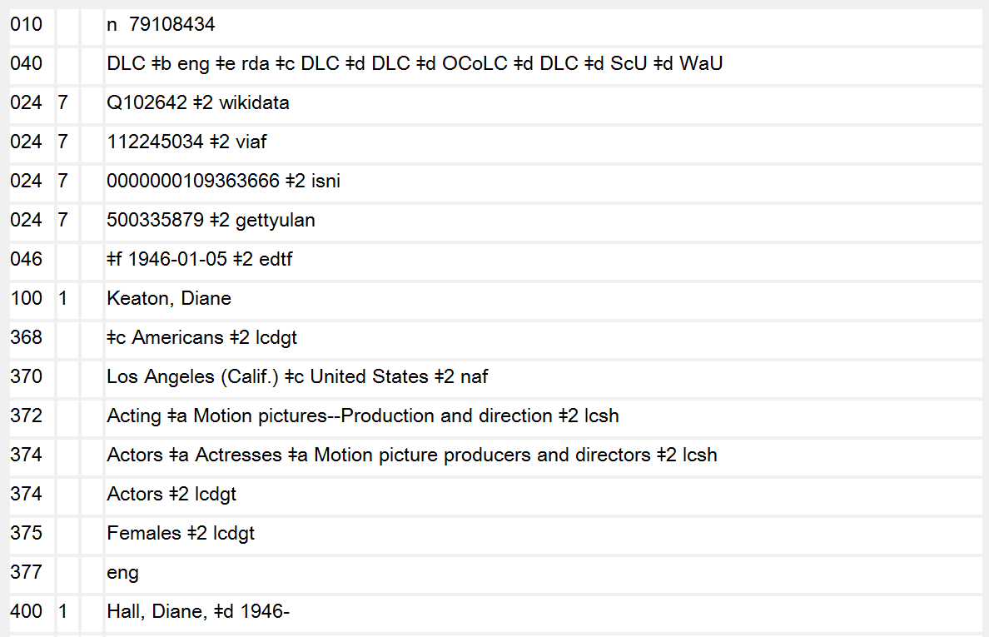
Notes:
August 16, 2023: Updates notes to indicate that URIs may be added and the 024 moratorium is over.
August 8, 2019: new slide
Example of an authority record with other standard identifiers (MARC 024) included. See NACO 024 Best Practices Guidelines.

Slide 176
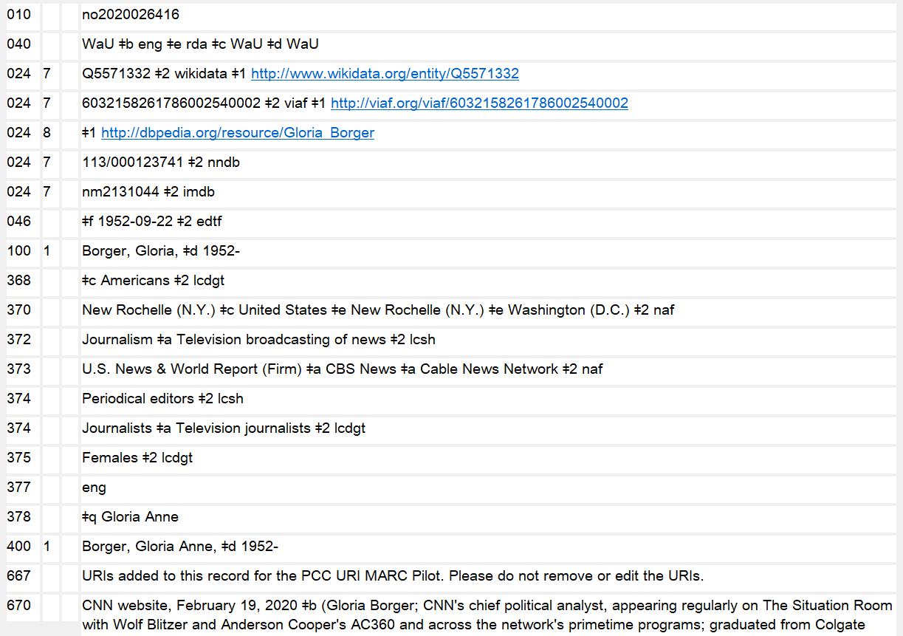
Notes:
August 16, 2023: Updates notes to indicate that when updating a record for another reason, the 667 field may may optionally be deleted.
February 27, 2020: new slide
An example of a record with URIs added as part of the PCC URIs in MARC Pilot Project. When updating a NACO record for another reason, and that record has URIs and the accompanying 667 note, the 667 note may optionally be deleted.

Slide 177
01X-09X : Code Fields
046 – Special Coded Dates
  $f Birth date
  $g Death date
  $k Beginning or single date created
  $l Ending date created
  $o Single or starting date for aggregated content
  $p Ending date for aggregated content
  $q Establishment date
  $r Termination date
  $s Start period [for period of activity]
  $t End period [for period of activity]
  $u Uniform Resource Identifier
  $v Source of information
  $2 Source of date scheme
Notes:
October 14, 2024: deleted “[PCC has not yet implemented]” in slide after $q and $r; deleted the speaker note that said not to use $q and $r until PCC implements them; added speaker notes telling catalogers to change $s and $t in existing NARs to $q and $r when they represent establishing and termination dates
August 7, 2019: added subfields $u and $v
February 26, 2019: added subfield $o and subfield $p
$q and $r were added to the MARC 21 Authority Format in 2015 and $s and $t were redefined at that time to be used only for start and end dates of periods of activity. Subfields $s and $t formerly included establishment/termination date of a corporate body. However, PCC did not implement $q and $r until August 2023, so there are still numerous NARs for corporate bodies that contain $s and $t that should be changed to $q and $r. The DCM Z1 046 contains additional information and instructions:
“Prior to August 2023, subfields $q and $r were not approved for use in name authority records; subfields $s and $t were used instead. Catalogers updating existing corporate body authority records containing 046 subfields $s and $t are encouraged to evaluate the subfields and recode them to subfields $q and $r if it is determined that the subfields represent the body’s dates of establishment and termination. If the subfields instead represent the start and end dates of a period of activity associated with the body, leave them coded $s and $t. For further guidance, see the NACO “At-a-Glance” Sheet for MARC 046 Subfields for Corporate Bodies and Conferences.” https://www.loc.gov/aba/pcc/naco/documents/MARC046-Conferences-CorporateBodies.pdf

Slide 178
01X-09X : Code Fields
046 – Special Coded Dates
  Record dates using Extended Date/Time Format (EDTF) in all cases except for century dates
  See: https://www.loc.gov/standards/datetime/
  Use pattern yyyy or yyyy-mm or yyyy-mm-dd
  Include $2 edtf
    2012 $2 edtf 2012
    2012-01 $2 edtf 2012 January
    2012-01-13 $2 edtf 2012 January 13
    1855? $2 edtf probably 1855
    [1930,1931] $2 edtf 1930 or 1931
    1957~ $2 edtf approximately 1957
Notes:
March 4, 2020: updated notes to show that EDTF provides for other kinds of coded dates
Note: Because PCC practice for formulating dates in the 046 field changed in 2015, you will encounter many older NACO records that do not have 046 field data formulated according to EDTF. If you are updating such a record, you must bring the 046 data up to current PCC standards.
The slides show the most commonly forms of EDTF-coded dates (exact dates, probable dates, and approximate dates). The EDTF standard provides for coding many other kinds of dates that could sometimes be needed in authority records. Examples:
201X = an unspecified year in the 2010s
2010-21 = spring of 2010 (independent of location)
2010-29 = spring of 2010 in the Southern Hemisphere
[2010..2014] = one of the years from 2010 to 2014
[..1760-12-03] = on or before 1760 December 3
[1985..] = in 1985 or a later year

Slide 179
01X-09X : Code Fields
046 – Special Coded Dates
  Dates earlier than 1000 A.D. (except for centuries):
    Record year as four digits (use leading zeros as needed)
    Precede B.C. dates with a minus sign and subtract one year (because there was no “Year Zero”)
    0951 $2 edtf 951 A.D.
    0031~ $2 edtf approximately 31 A.D.
    0006 $2 edtf 6 A.D.
    -0360 $2 edtf 361 B.C.
    -0035? $2 edtf probably 36 B.C.
Notes:
October 27, 2016

Slide 180
01X-09X : Code Fields
046 – Special Coded Dates
  Century dates:
    Follow the ISO 8601 standard (not EDTF)
    Record century as two digits following this pattern:
    19 = all “19XX” years = 20th century
    Use leading zeros as needed
    Precede a B.C. century date with a minus sign
    Do not include a $2 source code
    20 21st century
    09 10th century
    00 1st century
    -00 1st century B.C.
    -04 5th century B.C.
Notes:
November 2, 2016

Slide 181
Notes:
February 4, 2019
Dates of birth. Note that the presence of 046 does not necessarily mean that the dates will be part of the authorized access point. More on this in Module 2.

Slide 182
Notes:
February 4, 2019
Date of death

Slide 183
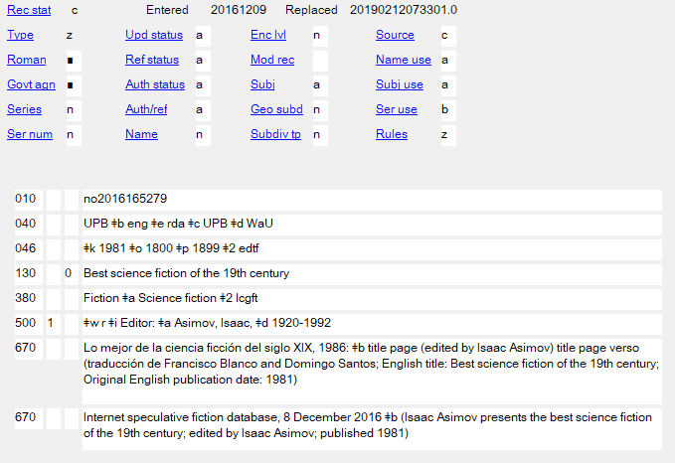
Notes:
August 7, 2019: added additional sentence in notes
February 26, 2019: added slide to show example of coded dates for work
Date of aggregating work (subfield $k); date of beginning and end of aggregated content (subfields $o and $p). An alternate way of recording 19th century here would be to use only subfield $o with a century date: $o 18, but then you would need two 046s:
046 $k 1981 $2 edtf
046 $o 18

Slide 184
053: Local Classification Number
NACO libraries may add local classification numbers for literary authors classified in PA-PT that do not use successive cutter numbers
May also be added for authors of juvenile literature in English classed in PZ
Notes:
October 2, 2024: updated to reflect change in policy to allow 053s for authors of juvenile literature in English
September 17, 2018: updated slide and speaker notes to reflect policy change; deleted slide with link to 053 (literary author number) request form.
053 is an optional field but NACO libraries may add field 053 for locally assigned LC classification numbers associated with a personal name heading for literary authors who have written works of the imagination, and for authors of works for children in English.
Previously, NACO members would suggest literary author numbers to the Library of Congress; the suggestions were reviewed by LC staff and added to the name authority record as “LC-verified” with second indicator value “0”. On July 1, 2018, LC announced that it was discontinuing the NACO Literary Author Number Program. Instead, NACO members may input locally assigned literary author numbers in name authority records.
To include a literary author number in a differentiated NAR, the author must be classified in PA-PT and must not use successive cutter numbers. In 2023, LC announced that PZ numbers for authors of children’s literature in English may also be included in NARs. Literary author numbers cannot be included in undifferentiated personal name authority records.

Slide 185
053: Local Classification Number
Do not add for literary authors:
  Whose name has changed significantly due to changes in cataloging rules, marital status, etc.
  Born before 1925
  Who have pseudonyms or joint pseudonyms, regardless of date of birth
Notes:
October 2, 2024: new slide created by splitting the previous slide into two
There are also four conditions under which literary author numbers should not be added by NACO members:
Literary authors whose name has changed significantly due to changes in cataloging rules, marital status, etc.
Literary authors born before 1925
Literary authors who have pseudonyms, regardless of date of birth
Literary authors who have joint pseudonyms, regardless of date of birth
In those cases, a proposal must be submitted through SACO to include the literary authors in the LC classification schedules. The LC Policy and Standards Division will add literary author numbers to the name authority records after the proposals are approved.

Slide 186
053: Local Classification Number
First indicator: undefined
Second indicator:
0 - Assigned by LC
4 - Assigned by agency other than LC
Subfields:
$a - Single number or beginning number of span
$b - Ending number of span
$c - Explanatory term
$5 - Institution to which field applies
Notes:
March 4, 2020: new slide showing indicator values and subfields that will be used

Slide 187
053: Local Classification Number
Use second indicator “4” with MARC institution code in subfield $5
053 _4 [number] $5 [MARC institution code]
Example:
053 _4 PS3556.O554 $5 NNC
100 1_ Fontenot, Scott Michael, $d 1968-
No limit to the number of local assigned numbers
Field 053 is repeatable for authors who write in more than one language; include $c with language term
Notes:
March 4, 2020: added $c to third bullet
To add a locally assigned literary author number in field 053, use second indicator “4” with your MARC institution code in subfield $5. At this time, there is no limit to the number of locally assigned numbers that may be present in a name authority record.

Slide 188
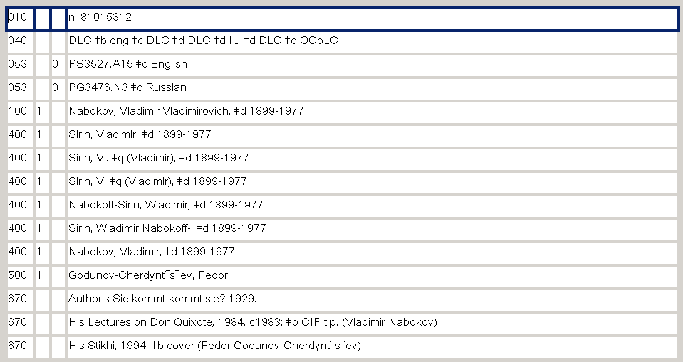
Record with 053s
Notes:
May 1, 2013

Slide 189
053: Local Classification Number
For authors of juvenile literature, add $c “Juvenile fiction, English” or one of the other terms listed in CSM F 632, section 6
Examples:
053 _0 PZ7.T378 $c Juvenile fiction, English
100 1_ Thomson, Sarah L.
Class number assigned by LC
053 _4 PZ7.1.A23945 $c Juvenile fiction, English $5 ViU
100 1_ Adekunle, Rosalyn
Class number assigned by University of Virginia
Notes:
October 2, 2024: new slide
Classification and Shelflisting Manual F 632, section 6, contains the instructions for adding literary author numbers for children’s literature in English.
PZ numbers found in LC bibliographic records may be included in an 053 field with second indicator value of 0.
PZ numbers devised by a NACO participant should have second indicator value of 4 and a subfield $5 with the library’s MARC organization code.
All PZ numbers given in 053 must have a subfield $c with one of the explanatory terms given in CSM F 632 section 6 (next slide)

Slide 190


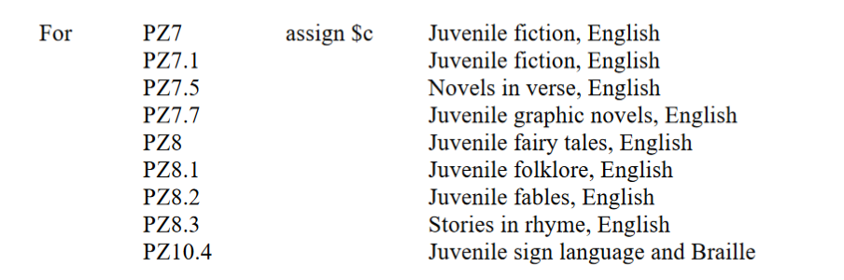
053: Local Classification Number
Notes:
October 2, 2024: new slide
Classification and Shelflisting Manual F 632, section 6, contains the instructions for adding literary author numbers for English children’s literature. It gives a list of explanatory terms to use in subfield $c.

Slide 191
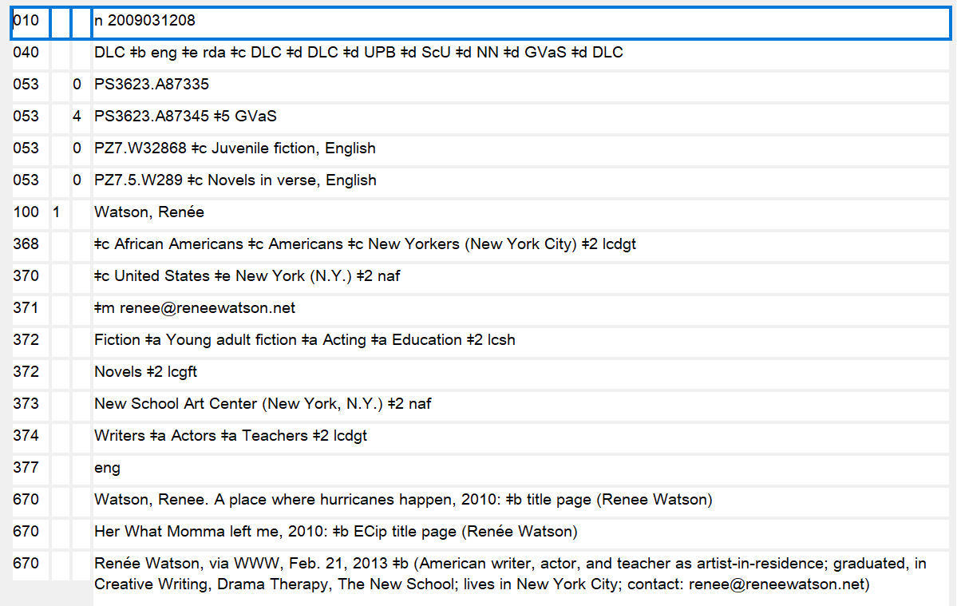
Notes:
October 2, 2024: new slide
Slide shows an authority record for an American author with multiple numbers for adult and children’s literature.

Slide 192
065: Other Classification Number
May be used by Canadian agencies for class PS8000 numbers for Canadian literary authors
http://epe.lac-bac.gc.ca/100/200/301/lac-bac/class_ps8000-e/index.html
Use $2 fcps to indicate the source of the number
Use $5 to indicate the institution to which the field applies
Example: 065 ## PS8603.A593 $2 fcps $5 CaQMG
NARs for Canadian literary authors may contain both 053 and 065 fields
Notes:
March 4, 2020: updated speaker notes with final sentence about updating 053s that really belong in 065
065: Other Classification Number
LC Guidelines Supplement
This field may be supplied in a personal name heading only by Canadian agencies in consultation with LC’s Cooperative Programs Section. Its use is limited to classification numbers in the PS8000 schedule for Canadian literature. Other NACO participants should not supply, update, or delete this field.
DCM Z1
The 065 field may be used by Canadian agencies in consultation with LC’s Cooperative Programs Section for class PS8000 numbers. Other NACO participants should not supply, modify, or delete this field. Subfield $2 with value “fcps” is used to indicate Class PS8000 : a classification for Canadian literature as the source of the number.
Example: 065 ## $a PS8576.U57 $2 fcps $5 [MARC institution code]
Note: 065 didn’t validate in OCLC Connexion until March 2020. Prior to then some Canadian libraries may have put PS8000 numbers in 053. Canadian agencies should move them to 065 when encountered.

Slide 193
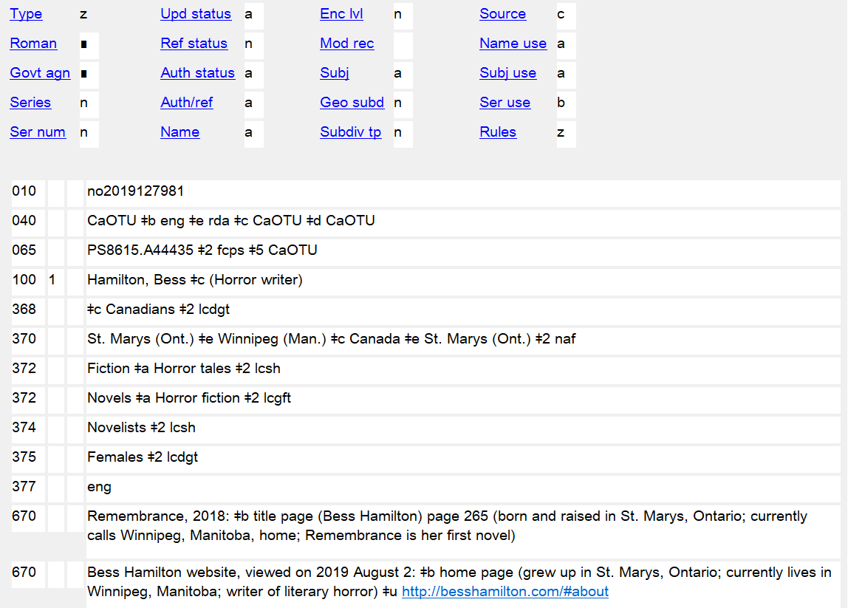
Notes:
February 27, 2020: new slide
An example of an authority created by a Canadian library (University of Toronto) for a Canadian literary author with an 065 field containing a class PS8000+ number. The class number was originally included in 053 and moved in March 2020 to 065.

Slide 194
1XX: Authorized Access Point
100 1_ = Surname formatted in inverted order (Surname, Forename) or a name without forename(s) which is known to be a surname
100 0_ = Forename or a name consisting of words, phrases, initials, separate letters, or numerals that are formatted in direct order
100 3_ = Family
110 1_ = Corporate body (jurisdiction)
110 2_ = Corporate body (non-jurisdiction)
111 2_ = Meeting (etc.)
130 _0 = Work/Expression with no explicit creator
151 = Geographical entity
Notes:
June 6, 2014

Slide 195
1XX: Authorized Access Point
At a minimum, includes the preferred name of the entity
May also include cataloger-added elements, such as dates, qualifiers
Notes:
May 1, 2013

Slide 196
Notes:
December 12, 2016

Slide 197
3XX: RDA Elements
370 – Associated Place
  $a – Place of birth $s – Start period
  $b – Place of death $t – End period
  $c – Associated country $u – Uniform Resource Identifier
  $e – Place of residence/ $v – Source of information
  headquarters $0 – Author record control
  $f – Other associated place number/standard identifier
  $g – Place of origin of work $1 – Real World Object URI
  or expression $2 – Source of term
  $i – Relationship information $3 – Materials specified
  $4 – Relationship
Notes:
August 16, 2023: Updated notes to indicate that URIs may be added for places in the 370 field.
February 27, 2020: updated slide with addition of $u, $v, $0, $1; added note about URIs in $0, $1, and $4
August 7, 2019: updated name of subfield $g; added $i, $3, and $4
Only RDA elements applicable to all kinds of entities are covered here. Those specific to particular kinds of entities are discussed in the following modules.
It is assumed that these places are or could be established in the NAF. If they have been, $2 naf may be added. If the place name comes from another thesaurus (e.g. LCSH), this needs to be indicated (“$2 lcsh”). If the name has not been established, omit $2, but formulate it the way it would be if it were established (e.g., include a larger place as a qualifier if appropriate).
URIs for places may be added to the 370 field in $0 and/or $1. Subfield $4 can hold a code and/or a URI for the relationship. Example:
370 $i Setting: $f Arizona $2 naf $4 http://id.loc.gov/vocabulary/relators/stg $0 http://id.loc.gov/authorities/names/n79034873

Slide 198
Recording the Place Attribute
(1XX, 4XX, 5XX)
The form of the place name is governed by RDA Chapter 16.
Authorized access points for jurisdictional place names are generally formed as in AACR2, e.g. “Paris (France)” However:
16.2.2.4. Precede the name of the larger place by a comma when the place name is used as a place associated with an entity -- e.g. “Paris, France”
But, following PCC policy, record the authorized access point in 370, not the 16.2.2.4 form
Notes:
September 17, 2018: 16.2.2.4 updated to reflect current RDA language.

Slide 199
Recording the Place Attribute (370)
Use authorized access point form if already exists
Do not use the abbreviated form for place names found in the Appendix B.11 (Names of Certain Countries, States, Provinces, Territories, Etc.)
370 $c United States $2 naf
not 370 $c U.S.
Retain terms of jurisdiction or other designations
      Russia (Federation) not Russia
      Korea (South) not Korea
      Buenos Aires (Argentina : Province) not Buenos Aires, Argentina
      Prussia (Duchy) not Prussia
      Prussia (Kingdom) not Prussia
Notes:
November 12, 2019: added example for second bullet
LOOK at B.11
In the 370 field attribute for the associated place, use the authorized access point form found in the authority record in the LC/NAF.
If no authorized access point exists in the LC/NACO Authority File for the place, it is not necessary to create a NAR in order to code the 370 field. Use the RDA preferred name for the place, but note that when there is no authorized source, a subfield $2 cannot be added.

Slide 200
Exercise:
Recording the Place Attribute (370)
These RDA forms are all found in the authority file. What form would you use to record the attribute?
London (England) Mexico City (Mexico)
Austin (Tex.) Ontario (Calif.)
Arizona Washington (D.C.)
United States Auckland (N.Z.)
France Puerto Rico
Brentwood (Los Angeles, Calif.)
Notes:
August 12, 2019: added a neighborhood example
Take time to look at Appendix B.11. Suggestion: Write forms on the board before going to the next slide.

Slide 201
Recording the Place Attribute (370): Jurisdictions
370 London (England) $2 naf [birthplace]
370 $b Mexico City (Mexico) $2 naf [death place]
370 $e Austin (Tex.) $2 naf [place of headquarters]
370 $f Ontario (Calif.) $2 naf [other associated place]
370 Arizona $2 naf [birthplace]
370 $b Washington (D.C.) $2 naf [death place]
370 $b United States $2 naf [death place]
370 Auckland (N.Z.) $b Puerto Rico $c France $2 naf
[birthplace, death place, associated country]
370 $e Brentwood (Los Angeles, Calif.) $2 naf [place of residence]
Notes:
May 28, 2024: added $2 naf to last example
August 12, 2019: added “jurisdictions” to caption. Added note about DCM Z1
Note that 370 can be repeated, or alternately subfields can be repeated within a single 370.
DCM Z1 370: For jurisdictions or other place names with authority records in the LC/NAF, use the authorized access point form as found, recording the source in subfield $2.

Slide 202
Recording the Place Attribute (370): Non-jurisdictions
For non-jurisdictions, prefer names from an authorized vocabulary such as LCSH. Record them exactly as established and include $2 for the source of the term(s).
  370 Cache Valley (Utah and Idaho) $2 lcsh [birthplace]
  370 $b Pompeii (Extinct city) $2 lcsh [death place]
  370 $f Tahoe, Lake (Calif. and Nev.) $2 lcsh [other associated place]
  370 $e Southeastern United States $2 mesh [place of residence]
  370 $e California--Santa Catalina Island $2 fast [place of residence]
Do not mix NAF terms and terms from other sources in the same 370 field. If you need to use both, record them in separate fields.
  370 Long Island (N.Y.) $2 lcsh [birthplace]
  370 $e New York (N.Y.) $2 naf [place of residence]
Notes:
August 12, 2019: changed caption by adding “Non-jurisdictions”; changed Lake Tahoe coding from $e to $f; added info on use of other vocabularies
September 17, 2018: replaced “NACO AF” with standard abbreviation “NAF”
For non-jurisdictions, other controlled vocabularies may be used in field 370.
DCM Z1 370: For non-jurisdictions, prefer names from an authorized vocabulary such as LCSH and identify the source in subfield $2. If the name is not found in an authorized vocabulary, record it in field 370 without giving a subfield $2 (it is not necessary for SACO participants to submit a subject heading proposal.)
Subfield $2 for the source of the term must be provided for controlled terms. Code from: Subject Heading and Term Source Codes.

Slide 203
Notes:
February 4, 2019

Slide 204
3XX: RDA Elements
377 – Associated language
  $a – Language code
  $l – Language term
  $2 – Source of code (not required if a MARC language code is used; required if a different code list is used)
NACO: Use the MARC language code
  http://www.loc.gov/marc/languages/langhome.html
  377 eng
  In addition, may supply an additional 377 field from another language code list (most useful when MARC only has a collective code for a language group and another list has a specific code)
Do not record a language term ($l) unless the code is a collective code
  377 nic $l Abidji
Notes:
October 14, 2024: updated notes about other code lists
August 16, 2023: updated notes to indicate that URIs may be added for the 377 field.
February 27, 2020: added speaker note about $0 and $1
August 8, 2019: added to speaker notes for instructions on what to choose when a language term is being recorded
February 26, 2019: added final paragraph about sign languages to speaker notes
DCM Z1: “Prefer language codes over language terms, using codes from the MARC Code List for Languages available at: http://www.loc.gov/marc/languages/langhome.html as the source for language codes. Use subfield $l (Language term) only to provide information not available in the MARC Code List for Languages. Encode multiple languages for a person or corporate body only if more than one language is used for publication, communication, etc.”
LC PCC-PS for 6.11.1.3: “When recording the language of expression, base the name of the language on the form found in the current edition of MARC Code List for Languages”. The language term for persons, families, and corporate bodies should also be based on the form found in the MARC code list.
Subfield $2 is not required when the MARC Code List for Languages is used as the language source code (second indicator value "#"). NACO institutions may supply an additional 377 field from another language code list by using second indicator value "7," with subfield $2 containing a code for a language source list taken from the list of MARC-registered language lists in Language Code and Term Source Codes (http://www.loc.gov/standards/sourcelist/language.html).
All entities except “work” can record an associated language. For persons, families, or corporate bodies, it is the language the entity USES to create works or expressions. For expressions, it is the language of the expression.
The last example shows the language Abidji, which hasn’t been assigned its own MARC language code. It has instead been assigned the collective code “nic” for Niger-Kordofanian languages. Note that ISO 639-3 and other language code lists such as Glottolog include codes for many individual languages that only have a collective code in the MARC code list. Catalogers are encouraged to add additional 377s with specific codes from other sources, particularly ISO 639-3.
Sign languages: In MARC, there is just a single collective code “sgn” for all sign languages. However, ISO 639-3 and other language code lists such as Glottolog include codes for individual sign languages.
.
Note: Subfields $0 (authority record control number or standard identifier) and $1 (Real World Object URI) are not shown on the slide, but are also defined for the 377 field, and may be added to authority records.
Example: 377 ## fre $0 http://id.loc.gov/vocabulary/languages/fre

Slide 205
Notes:
December 12, 2016

Slide 206
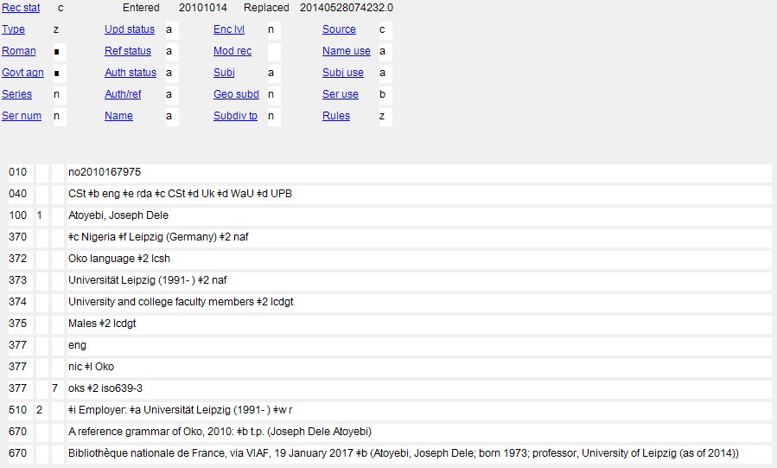
Notes:
October 14, 2024: added to speaker notes
February 26, 2019: added speaker notes
The associated languages of Joseph Atoyebi are English and Oko. The MARC code list of languages does not contain a code for Oko, only a collective language code for Niger-Kordofanian languages. $l is used in the second 377 to name the specific language. Because it wouldn’t be clear which $a the $l applies to if both codes were in a single 377, two 377 fields with MARC language codes are required.
However, ISO 639-3 does have a specific code for Oko, so the cataloger has optionally included an additional 377 field with it. Note again that for sources other than the MARC code list, second indicator 7 is used and the code for the source of the language code is recorded in $2.
Language Code and Term Source Codes: https://www.loc.gov/standards/sourcelist/language.html

Slide 207
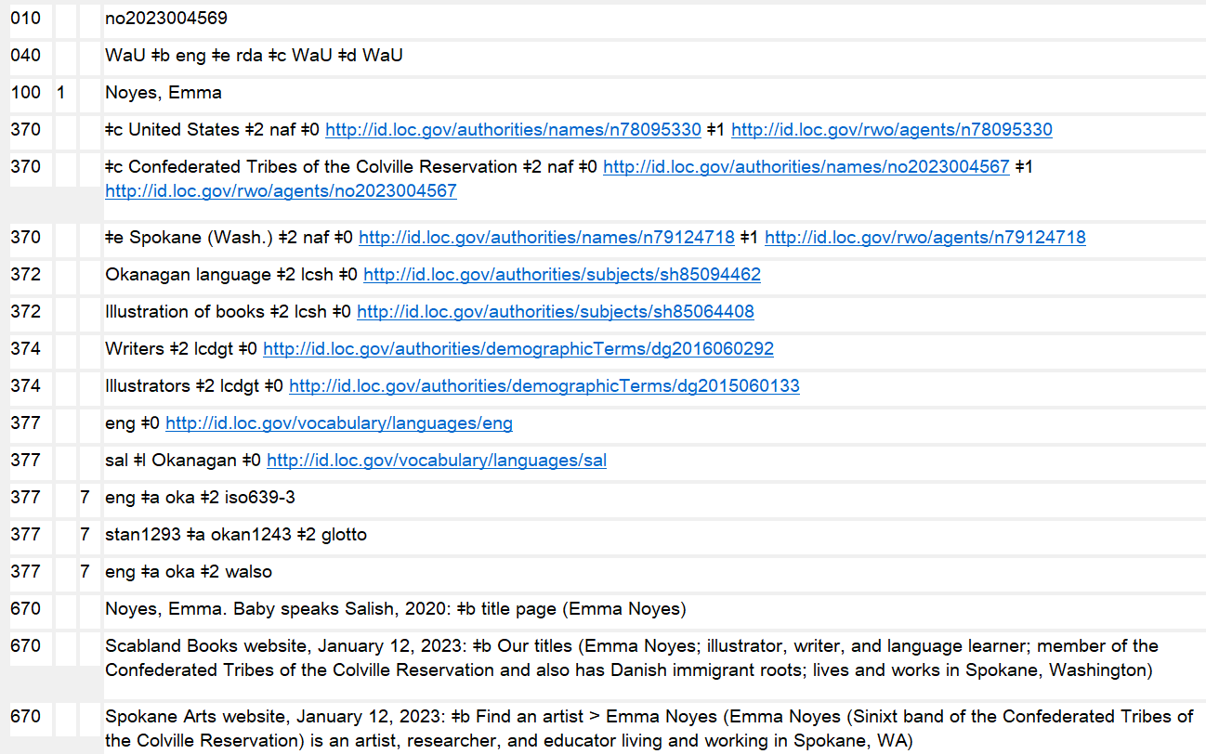
Notes:
October 14, 2024: new slide
Multiple 377s with language codes for English and Okanagan from different source code lists.
“sal” is the MARC collective language code for “Salishan languages”, including for Okanagan. Because $l is used in the second 377 (and also because URIs are also given), the MARC codes must be given in separate 377 fields.
“eng” and “oka” are the codes for English and Okanagan from ISO 639-3.
“stan1293” and “okan1243” are the codes from Glottolog.
“eng” and “oka” are the codes from The World Atlas of Language Structures Online.
Recording ISO 639-3 codes is highly recommended when there isn’t a specific MARC language code for a language. Including codes from other sources is up to cataloger judgment.

Slide 208
4XX: Variant Access Point
400 1_ = Surname formatted in inverted order (Surname, Forename) or a name without forename(s) which is known to be a surname
400 0_ = Forename or a name consisting of words, phrases, initials, separate letters, or numerals that are formatted in direct order
400 3_ = Family
410 1_ = Corporate body (jurisdiction)
410 2_ = Corporate body (non-jurisdiction)
411 2_ = Meeting (etc.)
430 _0 = Work/Expression with no explicit creator
451 = Geographical entity
Notes:
June 6. 2014

Slide 209
4XX: Variant Access Point
At a minimum, includes a name of the entity
May also include cataloger-added elements, such as dates, qualifiers
In NACO practice, variant access points may conflict with variant access points in other name authority records. They may not conflict with any authorized access point.
Notes:
February 26, 2019: revised bullet 3 to clarify that variant access points can only conflict with other variant access points in other NARs
In April 2017, RDA was revised so variant access points can be constructed using either a preferred name or a variant name.

Slide 210
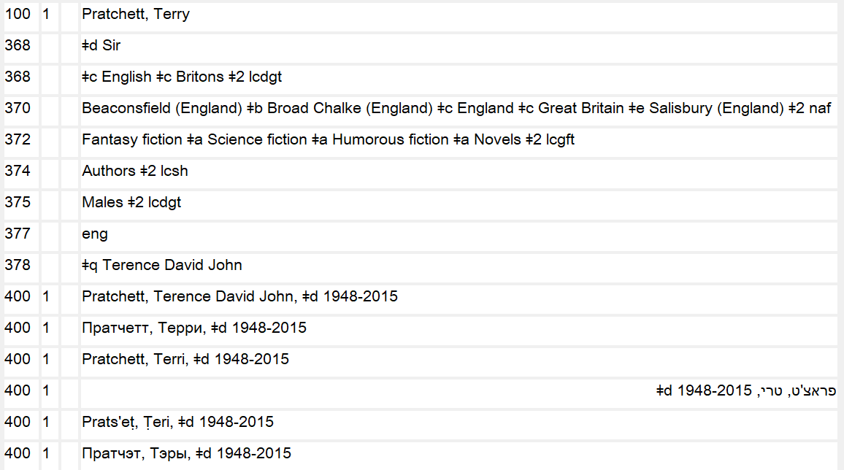
Notes:
November 12, 2019: new screenshot
Note: the Hebrew reference displays in OCLC either to the right or the left of the screen, depending on how the user’s preferences are set.

Slide 211
4XX or 5XX Subfield $w
Subfield $w is a control subfield that may be used with 4XX or 5XX to indicate some special instruction about the field
It includes four positions (numbered 0-3), each with a particular meaning and available codes
The meaning is dependent on character position. If a position is coded, all preceding positions must be coded as well (if only with “n” for not applicable). Succeeding positions, if not needed, do not need to be coded.
Subfield $w comes at the very beginning of the field.
Notes:
March 1, 2019

Slide 212
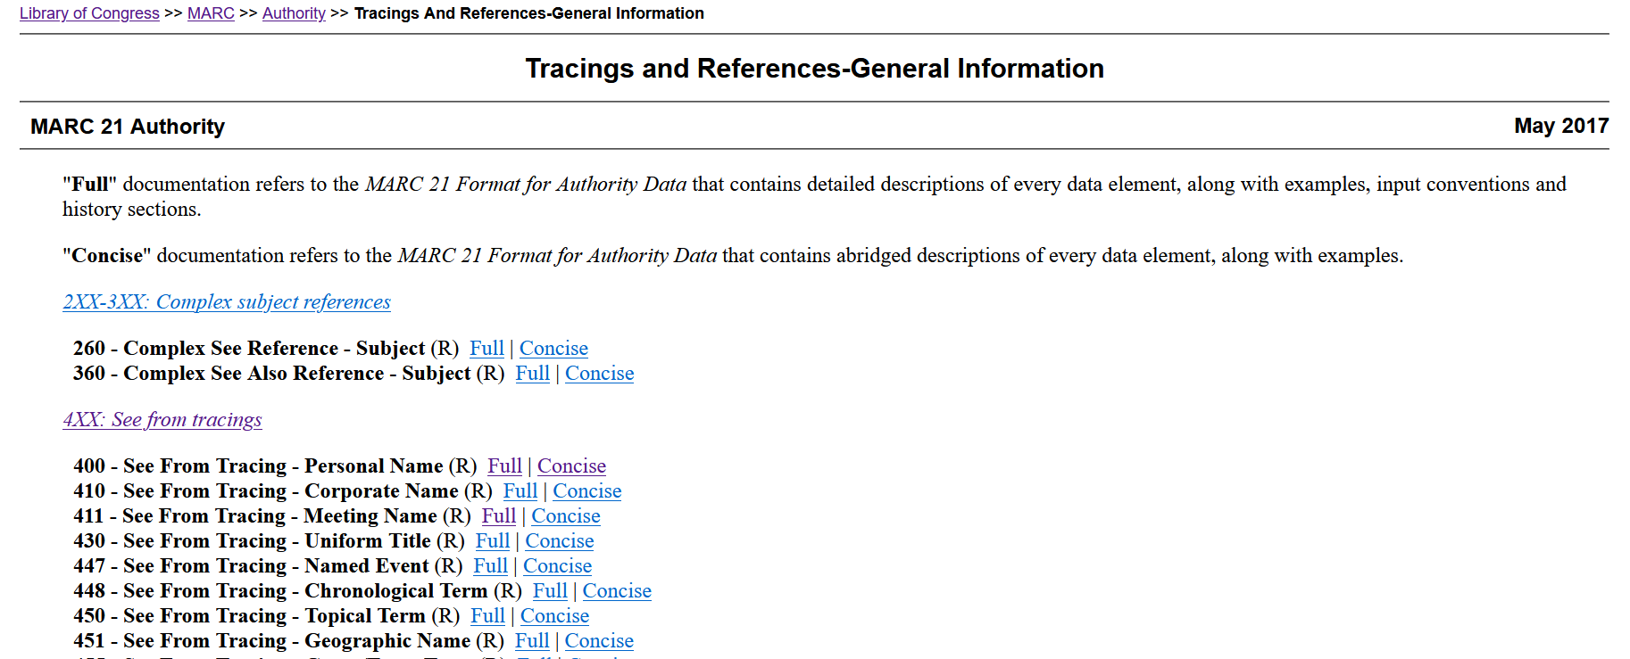
4XX or 5XX Subfield $w
Coding information is found in MARC 21 Format for Authority Data
Notes:
May 28, 2024: revised
March 1, 2019
Speaker note: To find this page, go to either 4XX or 5XX and click on “Tracings and References—General Information”

Slide 213
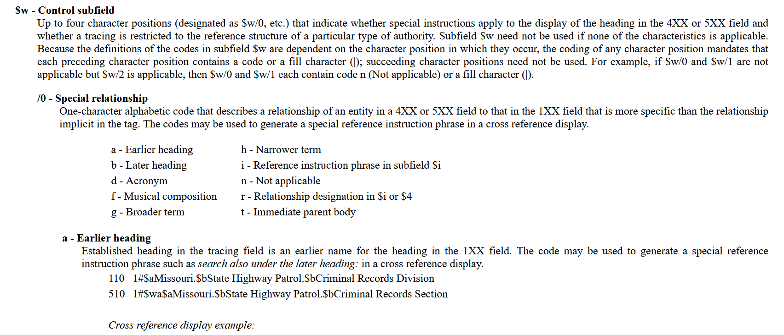
4XX or 5XX Subfield $w
Coding information is found in MARC 21 Format for Authority Data
Notes:
May 28, 2024: new slide
March 1, 2019
Scroll down and read through details of how $w and $i work with class.

Slide 214
4XX Subfield $w
The third and fourth positions (positions “2” and “3”) may be used with 4XX
Position 2 indicates that the form in 4XX is a previously authorized form, either pre-AACR2 (coded “a”) or AACR2 or RDA (coded “e”)
Because positions 0 and 1 are not used, they are coded “n”
Notes:
November 12, 2019: added notes
Instructor may wish to have trainees look at the MARC authority format for this, which is found in the Tracings and References-General Information section (https://www.loc.gov/marc/authority/adtracing.html).
$w - Control subfield
Up to four character positions (designated as $w/0, etc.) that indicate whether special instructions apply to the display of the heading in the 4XX or 5XX field and whether a tracing is restricted to the reference structure of a particular type of authority. Subfield $w need not be used if none of the characteristics is applicable. Because the definitions of the codes in subfield $w are dependent on the character position in which they occur, the coding of any character position mandates that each preceding character position contains a code or a fill character (|); succeeding character positions need not be used. For example, if $w/0 and $w/1 are not applicable but $w/2 is applicable, then $w/0 and $w/1 each contain code n (Not applicable) or a fill character (|).
/0 - Special relationship
/1 - Tracing use restriction
/2 - Earlier form of heading
One-character alphabetic code that indicates whether the heading in the 4XX field is an earlier form in which the name or subject was established either in the relevant national authority file or in an authority file other than the national authority file.
a - Pre-AACR 2 form of heading (national name authority file)
e - Earlier established form of heading (national authority file)
o - Earlier established form of heading (other authority file)
n - Not applicable
/3 - Reference display
One-character alphabetic code that enables the generation or suppression of a cross reference from a 4XX or 5XX field.
a - Reference not displayed
b - Reference not displayed, field 664 used
c - Reference not displayed, field 663 used
d - Reference not displayed, field 665 used
n - Not applicable

Slide 215
4XX Subfield $w
  100 1_ Jenner, Caitlyn, $d 1949-
  400 1_ $w nne $a Jenner, Bruce, $d 1949-
    Form previously authorized under RDA remains an appropriate variant access point
  100 1_ Joad, C. E. M. $q (Cyril Edwin Mitchinson), $d 1891-1953
  400 1_ $w nna $a Joad, Cyril Edwin Mitchinson, $d 1891-1953
    Form previously authorized before AACR2 based on 1949 ALA cataloging rules remains appropriate as an RDA variant access point.
Notes:
March 1, 2019
Joad example: 1949 ALA cataloging rules for author and title entries rule 37 called for forming the authorized access point based on the full form of the forenames rather than usage (as AACR2 and RDA require). Usage supports “Joad, C. E. M.”, not “Joad, Cyril Edwin Mitchinson” so the authorized access point was changed to reflect the current rules, but the previous form is appropriate as a variant access point.

Slide 216
4XX Subfield $w
Position 3 indicates that the form in 4XX should not display
      100 1_ Previn, André, $d 1929-2019. $t Quintets, $m clarinet, violins (2), viola, cello
      400 1_ $w nnea $a Previn, André, $d 1929- $t Quintet, $m clarinet, violins, viola, violoncello
  The previously-authorized AACR2 form (“nnea”) is coded not to display (“nnea”) because the medium of performance terms are not appropriate in RDA
  Note that the previous form is not changed in any way, including the addition of the death date to the authorized access point for Previn, which was not part of the access point when previously authorized.
Notes:
March 1, 2019
Note: this NACO training does not cover authorized access points for musical works, but this is an example of the type of 4XX field that might be coded not to display in an RDA database.
Here is the order of what happened to this record: The AACR2 authorized access point was revised because of RDA; a new authorized access point was recorded in 100, and the previous one was re-recorded in 400 with $w nnea. A few years later Previn died. The name form in the 100 field was changed to reflect his updated authorized access point, but the form that had already been recorded in 400 as a previously authorized form was not changed. Once a 4XX is coded with $w nne, $w nna, $w nnea, or $w nnaa, it is frozen and not changed again.

Slide 217
4XX Subfield $w
Position 3 indicates that the form in 4XX should not display
      110 2_ E.I. du Pont de Nemours & Company
      410 0_ $w nnaa $a Du Pont de Nemours (E. I.) and Company
    ̶ The previously-authorized pre-AACR2 form (“nna”) is coded not to display (“nnaa”) because the inverted form is not based on usage and is not appropriate in RDA.
    ̶ Note that the previous form is not changed in any way, including the coding of the first indicator 0 for inverted name, a coding that has never been used in AACR2 or RDA.
Notes:
March 1, 2019
Pre-AACR2 form was based on 1949 ALA Cataloging Rules 144A, which called for inversion if the corporate body name began with a forename or initials of a personal name.

Slide 218
5XX : Links to Related Entities
500 1_ = Surname formatted in inverted order (Surname, Forename) or a name without forename(s) which is known to be a surname
500 0_ = Forename or a name consisting of words, phrases, initials, separate letters, or numerals that are formatted in direct order
500 3_ = Family
510 1_ = Corporate body (jurisdiction)
510 2_ = Corporate body (non-jurisdiction)
511 2_ = Meeting (etc.)
530 _0 = Work/Expression with no explicit creator
551 = Geographical entity
Notes:
June 6, 2014

Slide 219
5XX Subfield $w
Subfield $w is used in 5XX in two situations
  To encode relationships (position 0)
  To suppress related entity access points (position 3)
Notes:
November 12, 2019: added notes
Instructor may want to have trainees look at the MARC authority format section Tracings and References-General Information section (https://www.loc.gov/marc/authority/adtracing.html).
$w - Control subfield
Up to four character positions (designated as $w/0, etc.) that indicate whether special instructions apply to the display of the heading in the 4XX or 5XX field and whether a tracing is restricted to the reference structure of a particular type of authority. Subfield $w need not be used if none of the characteristics is applicable. Because the definitions of the codes in subfield $w are dependent on the character position in which they occur, the coding of any character position mandates that each preceding character position contains a code or a fill character (|); succeeding character positions need not be used. For example, if $w/0 and $w/1 are not applicable but $w/2 is applicable, then $w/0 and $w/1 each contain code n (Not applicable) or a fill character (|).
/0 - Special relationship
One-character alphabetic code that describes a relationship of an entity in a 4XX or 5XX field to that in the 1XX field that is more specific than the relationship implicit in the tag. The codes may be used to generate a special reference instruction phrase in a cross reference display.
a - Earlier heading h - Narrower term
b - Later heading i - Reference instruction phrase in subfield $i
d - Acronym n - Not applicable
f - Musical composition r - Relationship designation in $i or $4
g - Broader term t - Immediate parent body
In NACO records, only codes “a”, “b”, and “r” are used in 5XX fields.
/1 - Tracing use restriction
/2 - Earlier form of heading
/3 - Reference display
One-character alphabetic code that enables the generation or suppression of a cross reference from a 4XX or 5XX field.
a - Reference not displayed
b - Reference not displayed, field 664 used
c - Reference not displayed, field 663 used
d - Reference not displayed, field 665 used
n - Not applicable

Slide 220
5XX Subfield $w (Relationships)
Subfield $w position 0
  a = earlier heading
  b = later heading
  r = relationship indicated in subfield $i
Most NACO authority work codes this position “r” but “a” or “b” will still be found in numerous records and may be changed to “r” with an appropriate $i relationship designator added
Notes:
October 14, 2024: revised slide because $w a and b are no longer to be used for places; removed speaker note about “a” and “b” still being used for jurisdictions
March 4, 2020: removed families from second bullet and notes; removed sentence “Subfield $4 is not used in NACO authority records” because it will be used in the future when URIs are added
/0 - Special relationship
One-character alphabetic code that describes a relationship of an entity in a 4XX or 5XX field to that in the 1XX field that is more specific than the relationship implicit in the tag. The codes may be used to generate a special reference instruction phrase in a cross reference display.
a - Earlier heading h - Narrower term
b - Later heading i - Reference instruction phrase in subfield $i
d - Acronym n - Not applicable
f - Musical composition r - Relationship designation in $i or $4
g - Broader term t - Immediate parent body
In NACO records, only codes “a”, “b”, and “r” are used in 5XX fields.
Code “r” means that the relationship is indicated in subfield $i (relationship designator) or subfield $4 (relationship code or URI).

Slide 221
5XX Subfield $w (Relationships)
Family – use simple see also references for earlier/later
    100 3_ Mountbatten (Family : $d 1917- : $c Great Britain)
    500 3_ Battenberg (Family : $d -1917 : $c Great Britain)
Place – until 2024 used codes “a” or “b” for earlier/later
    Eswatini 151 Swaziland
    551 $w a $a Swaziland 551 $w b $a Eswatini
Place – current practice: use code “r” with appropriate designators for corporate bodies in $i
    Eswatini 151 Swaziland
    $w r $i Predecessor: 551 $w r $i Successor: $a Eswatini
    $a Swaziland
Notes:
October 14, 2024: revised slide and notes discussing places; moved former third bullet to next slide
March 4, 2020: changed coding for families, added reciprocal place example, and replaced example in third bullet; updated speaker notes
Families: There are no relationship designators for earlier/later family names in RDA. “a” and “b” do not validate in OCLC Connection with family names, so simple see also references must be used (no $w at all). This will probably change after the “beta” RDA is implemented in 2021, since the “beta” RDA does include relationship elements for successor and predecessor families.
Places: “a” and “b” were used until 2024 for jurisdictions because there were no relationship designators in RDA for this relationship. However, in 2024 the PCC decided that catalogers may use appropriate designators for corporate bodies to express sequential relationships for places (e.g., “successor”, “predecessor”, “product of merger”). The old $w coding can be replaced with value “r” and subfield $i if revising a place name authority record for any reason.

Slide 222
5XX Subfield $w (Relationships)
All other entity relationships – use code “r” and a relationship designator in subfield $i
    100 1_ Atwood, Margaret, $d 1939- $t Handmaid's tale
    500 1_ $w r $i Author: $a Atwood, Margaret, $d 1939-
    500 1_ $w r $i Sequel: $a Atwood, Margaret, $d 1939- $t Testaments
    530 _0 $w r $i Adapted as television program (work): $a Handmaid's tale (Television program)
Notes:
October 14, 2024: new slide with former third bullet from the previous slide
Fuller information about relationships is coming up in a few slides.

Slide 223
5XX Subfield $w (Suppression)
Subfield $w position 3
  - Used when more than two bibliographic identities are linked
  - Code “c” = reference not displayed, field 663 used instead to explain the relationship. This is intended to suppress the 500 fields from display in the index.
    100 1_ Carr, John Dickson, $d 1906-1977
    500 1_ $w nnnc $a Dickson, Carter, $d 1906-1977
    500 1_ $w nnnc $a Dickson, Carr, $d 1906-1977
    500 1_ $w nnnc $a Fairbairn, Roger, $d 1906-1977
    663 For works of this author entered under other names, search also under $b Dickson, Carr, 1906-1977 $b Dickson, Carter, 1906-1977 $b Fairbairn, Roger, 1906-1977
  For full information about dealing with multiple bibliographic identities, see “Related Persons” in Module 2.
Notes:
August 8, 2019: revised 663 to have punctuation between $b subfields agree with instructions in the FAQ – LC/PCC Practice for Creating NARs for Persons Who Use Pseudonyms. No punctuation is given between separate instances of $b.
The coding here is intended to have systems display the note in field 663 instead of the see also references in the 500 fields.

Slide 224
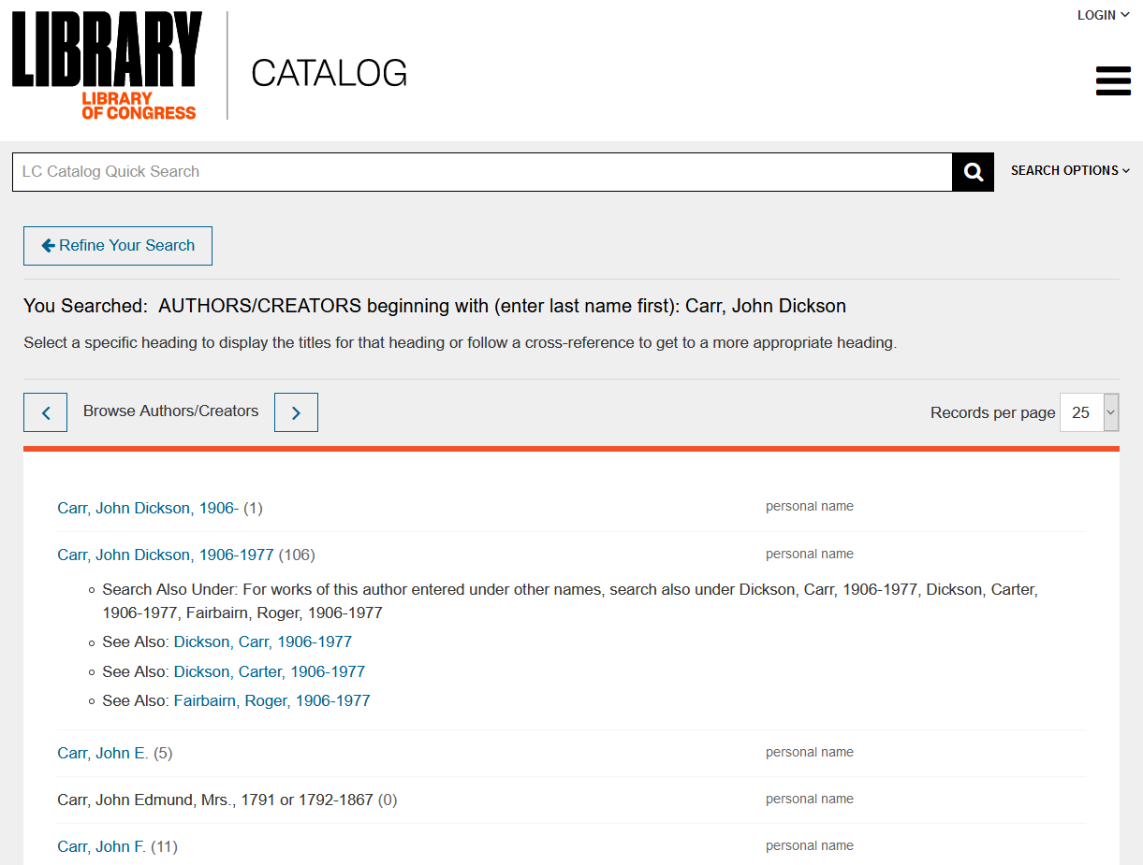
Notes:
November 12, 2019
Results of a browse author search for Carr, John Dickson in the LC Catalog. The system displays the note in the 663 field of the authority record, but it does not also suppress the see also references in the 500 fields.

Slide 225

PCC Guidelines
https://www.loc.gov/aba/pcc/rda/PCC%20RDA%20guidelines/Post-RDA-Implementation-Guidelines.html
Notes:
Follow the PCC Guidelines for the Application of Relationship Designators in NACO Authority Records. A summary of the more important guidelines follows in the next few slides.

Slide 226
5XX : Links to Related Entities
The link is created by recording the exact form of the authorized access point of another entity
An authority record for the other entity must exist in the LC/NACO Authority File
A corresponding link may or may not exist in the other record
Because there are many different kinds of possible relationships, the use of relationship designators to specify the nature of the relationship is encouraged
If the exact nature of the relationship is unknown or no relationship designator is available to describe it, a simple see also reference may be made (5XX with no $w or $i)
Notes:
February 26, 2019: added last bullet point, clarified second bullet point
First bullet: The easiest way to make sure you’re doing this correctly is to copy the 1XX field from the record for the related entity and paste it into your 5XX field.

Slide 227
5XX : Links to Related Entities
Relationship Designators
Record the designator in subfield $i, before the authorized access point
Include subfield $w r
Capitalize the designator and follow with a colon
  100 1_ Lewis, Meriwether, $d 1774-1809
  511 2_ $w r $i Corporate body: $a Lewis and Clark Expedition $d (1804-1806)
Notes:
November 12, 2019: added 100 field in example to explicitly show the relationship more clearly
March 1, 2019: added last line to speaker note
Second bullet: $w r is a MARC requirement. It has nothing to do with RDA.
NOTE: remember however the information a few slides ago about using the coding “a” or “b” for earlier/later forms of name for geographic places and families.

Slide 228
5XX : Links to Related Entities
Relationship Designators
Designators for relationships between persons/families/ corporate bodies and other persons/families/corporate bodies are drawn from RDA Appendix K
Designators for relationships between works/expressions and other works/expressions are drawn from RDA Appendix J
Designators for relationships between persons/families/ corporate bodies and works/expressions are drawn from RDA Appendix I
Designators for relationships between works and subjects are drawn from RDA Appendix M2.2-M 2.3.
PCC policy: relationships of any kind, including subject relationships, may only be made to entities within the LC/NACO Authority File
Notes:
February 26, 2019: revised in light of the PCC Guidelines for the Application of Relationship Designators in NACO Authority Records
The Joint Steering Committee welcomes suggestions for new relationship designators. PCC participants may send proposals/suggestions to the PCC Standing Committee on Standards, which will review them and forward them to the ALA Representative to the JSC for fast track consideration.

Slide 229
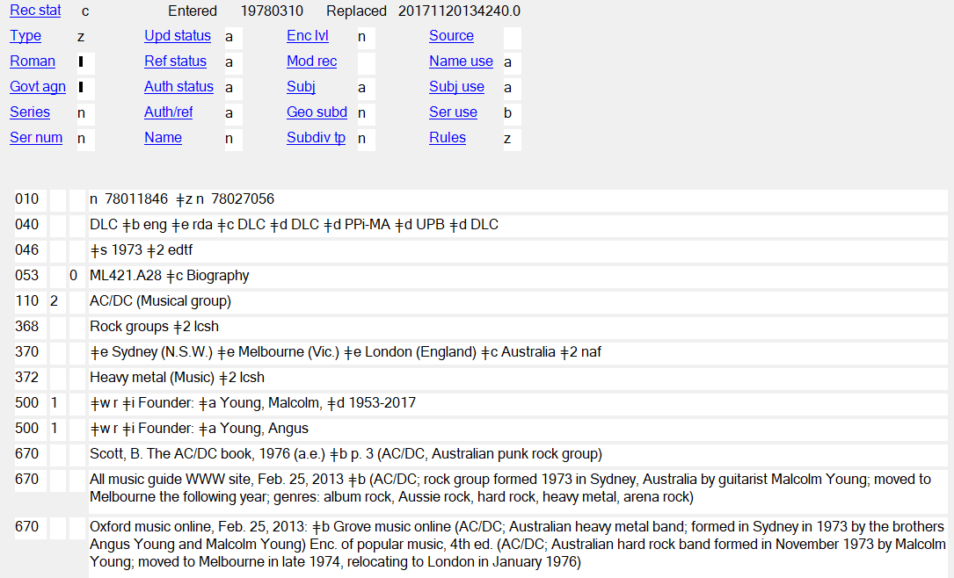
Notes:
September 17, 2018
Relationship between a corporate body and two persons (its founders) – Relationship designator from Appendix K.

Slide 230
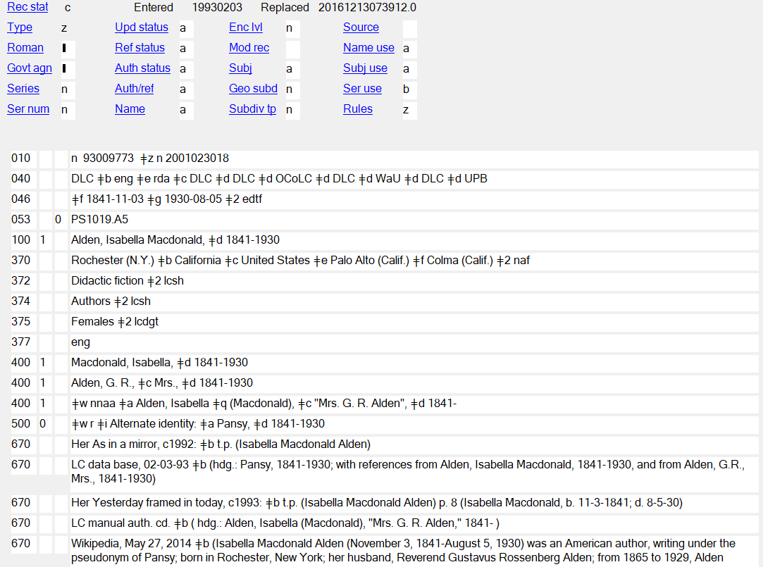
Notes:
November 12, 2019: revised notes
Relationship between a person and another person. Relationship designator from Appendix K.

Slide 231

Notes:
September 17, 2018
Reciprocal record for the same relationship between a person and another person. Relationship designator from Appendix K.

Slide 232

Notes:
September 17, 2018
Relationship between a person and a family. Relationship designator from Appendix K.

Slide 233

Notes:
September 17, 2018
Reciprocal record for the previous slide. Relationship between a family and a person. Relationship designator from Appendix K.

Slide 234

Notes:
November 13, 2019
Relationship between a person and a work. Relationship designator from Appendix I:
founder of work: An agent responsible for establishing a serial, integrating resource, or multipart monograph.
Reciprocal relationship: founder of work of.

Slide 235

Notes:
November 12, 2019: added blue box and second paragraph of notes
Circled in red: Relationship between a work (the film) and another work (the novel). Relationship designator from Appendix J.
Boxed in blue: Relationship between a work (the film) and three persons associated with the work (the director, screenwriter, and producer). Relationship designators from Appendix I.

Slide 236

Notes:
Updated November 12, 2019
Relationship between a work (the novel) and other works (the film adaptation, and sequels and prequels to the work). Relationship designator from Appendix J.
Note also that the NAR shows the relationship between the novel and the author of the novel: 500 1 $w r $i Author: $a Mitchell, Margaret, $d 1900-1949

Slide 237

Notes:
February 26, 2019: removed reference to the MARC relator terms list
Relationship between an expression and two persons (its translators). Relationship designator from Appendix I.

Slide 238

Notes:
September 17, 2018
Relationship between a work and its subject. Relationship designator from RDA Appendix M.

Slide 239

Notes:
August 16, 2023: updated notes to indicate that 5XX fields may include subfields $0 and/or $1.
February 27, 2020: new slide
URIs may be added to 5XX fields in subfields $0 and/or $1.

Slide 240


Notes:
March 5, 2020: new slide
Identifiers may also be added to 5XX fields in OCLC Record Manager when catalogers “validate” a field. The OCLC software adds a subfield $0 in with the authority record control number in these cases. The $0 then serves as a hotlink to the related record that catalogers may click on and view. $0’s added in Record Manager can also be viewed in OCLC Connexion (next slide).

Slide 241

Notes:
March 5, 2020: new slide
$0’s added in Record Manager can also be viewed in OCLC Connexion. Catalogers should not manually add or edit $0’s with LCCNs. Only catalogers working in Record Manager are permitted to use the access point validation function to automatically add these identifiers.

Slide 242
6XX: Notes
667: Cataloguer’s note (RDA 5.9, 8.13)
Intended for other catalogers, not for the public
Free text, no required format, although there are some commonly used phrases
DCM Z1 has a selection of representative examples
Notes:
February 26, 2019: added last bullet point, all speaker notes
Examples from DCM Z1:
667 ## $a Not same as: [name or title, LCCN].
667 ## $a Cannot identify with: [name or title, LCCN].
667 ## $a Reinvestigate before using again.
667 ## $a Formerly on undifferentiated name record: [LCCN of undifferentiated name record].
667 ## $a Coded provisional because [reason for coding].
667 ## $a Date of birth removed from all fields per author request, [date updated].
667 ## $a For works issued before/after [date]. (Used for official language changes)
667 ## $a See also related access points for individual instances of this conference which include specific information about the number, date, or place of the individual conference.
667 ## $a SUBJECT USAGE: This heading is not valid for use as a subject. Works about this person are entered under [personal name heading].
667 ## $a SUBJECT USAGE: This heading is not valid for use as a subject. Works about this place are entered under Sri Lanka.
667 ## $a SUBJECT USAGE: This heading is not valid for use as a subject; use a family name heading from LCSH.
667 ## $a SUBJECT USAGE: This heading is not valid for use as a geographic subdivision.
667 ## $a Non-Latin script references not evaluated.

Slide 243

Notes:
August 8, 2019
A common example. The 667 note here explains the reason why the cataloger has coded the record “provisional” in the 008/33 (Level of Establishment).

Slide 244

Notes:
October 26, 2016
Another common example. The second 667 note is required for NARs that contain non-Latin script 4XX fields.

Slide 245

Notes:
November 13, 2019
“Cannot identify with” is used in a 667 note to record another established name that may or may not represent the same entity, but the cataloger has not been able to identify them definitively as the same entity. As illustrated in this particular example, there are separate NARs for two playwrights named Elizabeth Hart who both published in the 1930s. Because it was not possible to definitively identify them as the same person, two authorities were created, each with a 667 note referring to the other one.

Slide 246
6XX: Notes
670: Source consulted (RDA 5.8, 8.12)
Records sources of information used to record other elements in the description
Use one 670 per source
In NACO practice the first is generally the resource being cataloged when the authority record is first created
Suggested format:
  670 Title proper, date: $b location within source (data found)
Notes:
May 1, 2013

Slide 247
For online sources, can use subfield $u to link to cited resource if it contains significant information that cannot be cited succinctly in the NAR
Does not take the place of requirement to cite relevant data in $a and $b of the 670 needed to support the 1XX or 4XXs
670 Heather Hiestand website, June 13, 2018: $b home page (Heather
Hiestand) about (born in Illinois; her family migrated west before
she started school. Since then she has claimed Washington State as
home, except for a few years in California; has written mystery,
romance, and historical fantasy; author of many novels, novellas,
and short stories; also writes as Heather Redmond and formerly,
Anh Leod) $u http://heatherhiestand.com/about-heather/
Notes:
February 28, 2020: new slide to show example with $u
DCM Z1 670:
Catalogers may optionally provide a uniform resource identifier (URI) in subfield $u of the 670 citation to link to the cited resource if it contains significant information related to the established entity that cannot be cited succinctly in the authority record. Note that use of a URI in the 670 $u does not take the place of the requirement to cite relevant data in subfields $a and $b of the 670 field needed to support the authorized access point (including additions) or variants (this information will continue to be available if the site changes or disappears). However, information found in online sources may be added to the 046 or 3XX fields with the appropriate citations in subfields $v and $u and not repeated in a 670 when that information is not used in the 1XX or a 4XX. If a URI is included in a 670, it must be given in subfield $u.

Slide 248

Notes:
November 13, 2019: new screenshot and revised instructor notes
Note: this is an older record and some of the 670s do not conform to current practices. The practice of beginning the field with “His” or “Her” (see first two 670s) is no longer followed. Also the first 670 in this record does not show any justifying information for other elements in the record. This is also an obsolete practice.
Abbreviations were used in 670 fields in AACR2. RDA does not prescribe. You may choose to abbreviate or not (e.g., t.p. vs. title page). However, abbreviating the title proper (as seen in the fourth 670) is no longer recommended.
Note that this gives several good examples of 670s for websites and other online resources. The last 670 illustrates that you may include a subfield $u with the URL for the website cited.
When adding a new 670 field in an NAR, add it at the end. There is no need to revise previous 670s to make them conform to current practice.

Slide 249

Notes:
December 12, 2016
The first and third 670 in this record show how to deal with non-Latin script data when recording non-Latin script references (see the 400 field). According to DCM Z1 670, give subfield $a in romanized form. In subfield $b give the information in both the non-Latin script form found in the resource followed by an equals sign and the systematically romanized form.

Slide 250
6XX: Notes
  Alternately, 046 or 3XX $v and $u can be used to record a Source Consulted element. However:
    In PCC practice, information used to create the authorized access point (1XX) or variant access points (4XX) must be recorded in 670s.
    $v may be used alone; $u must always be preceded by $v
    100 1_ Antonelli, Lou, $d 1957-
    370 __ Medford (Mass.) $e Mount Pleasant (Tex.) $2 naf $v Lou Antonelli website, viewed March 19, 2015 $u http://www.louantonelli.blogspot.com/
Notes:
February 28, 2020: added 046 to first bullet and text from DCM Z1 to speaker notes
August 8, 2019: revised $v, which should contain the title of the source consulted. Added note in instructor notes.
Note: that when using $v, you do not need to give the location that the information was found. Only the source title, and date of publication (or viewed on date) are necessary.
DCM Z1 670: Information found in online sources may be added to the 046 or 3XX fields with the appropriate citations in subfields $v and $u and not repeated in a 670 when that information is not used in the 1XX or a 4XX.

Slide 251
6XX: Notes
675 – Source data not found
  Citation for a consulted source in which no information is found related in any manner to the entity represented by the authority record or related entities
  Always cite the resource being cataloged if it provides no information related to the entity when the authority record is first created
  Use with discretion – it is not necessary to cite every source you searched. Use as a time saver for others by citing sources you think other catalogers might attempt to search
Notes:
September 17, 2018: In November 2013, DCM Z1 was updated to indicate that field 675 should be used if the item being cataloged provides no information related to the entity represented in the authority record. Previous practice was to use field 670 with the phrase “name not given” or “title not given” in $b. Deleted two slides covering the previous practice.
Note that the definition was recently changed to include “related entities” – previously 675 was used to justify 5XX fields. 670 will now be used for this. There is no need to correct the coding of older records, however, although you may if you like.

Slide 252
6XX: Notes
675 – Source data not found
  Not repeatable
  Only subfield $a available
  Repeat subfield $a for each source
  Separate each subfield $a by a semicolon
  675 $a GNIS, 2 February 2013; $a The Columbia gazetteer of the world, 1998
Notes:
May 1, 2013
Note that the definition was recently changed to include “related entities” – previously 675 was used to justify 5XX fields. 670 will now be used for this. However, there is no need to correct the coding of older records, although you may if you like.

Slide 253

Notes:
February 26, 2019: replaced NAR with updated version
This person has a common name that will likely need differentiating in the future. The cataloger listed likely sources checked for differentiating information such as a birth date so that future catalogers wouldn’t try the same sources again.

Slide 254
6XX: Notes
672 – Title Related to the Entity
673 – Title Not Related to the Entity
  Subfield $a = Title
  Subfield $b = Remainder of title
  Subfield $f = Date
  Subfield $w = Bibliographic record control number
Optional, but useful when there might be confusion about who is the creator of similar works by authors with the same name
See MARC 21 and DCM Z1 for detailed guidance
Notes:
March 7, 2019
672: The 672 field may be used to record a title that is related to the entity represented by the 100, 110, 111, or 151 in the name authority record. For example, the field may be used to record titles for which the entity is a creator, contributor, issuing body, or subject.
Use of the 672 field does not negate the need to use the 670 field for the title for which the authority record is being created, nor to use the 670 fields to justify information recorded in the 1XX and 4XX such as preferred and variant forms of name.
Apply the same instructions on non-filing characters in the 245 field to record the number of non-filing characters in the second indicator of the 672 field.
Subfield $f is used to record a date appropriate to the entity recorded in $a (e.g., use date of work for a preferred title and date of publication for a title proper). Do not use brackets in $f when recording a supplied date of publication or production. Do not give a date of distribution, date of manufacture, or copyright date in $f.
Subfield $w is used to record bibliographic record control number s (e.g., 001, 010, and 016 fields in bibliographic records). It is recommended that catalogers provide $w when readily available. Subfield $w should only be used with titles for the manifestation record control number.
673: The 673 field may be used to record a title that is not related to the entity represented by the 100, 110, 111, or 151 in the name authority record. For example, in an authority record for a person, the 673 may be used to record the titles of works written by a different person with a similar name.
Use of the 673 field does not negate the need to use the 675 field as described in the 675 section of DCM Z1.

Slide 255

Notes:
March 8, 2019
The 673 fields in this record inform us that the novels Good intentions and Seattle green, both by Jane Adams, are not by this Jane Adams, who is also a novelist and could have been writing in the 1980s.

Slide 256
6XX: Notes
678 – Biographical or Historical Data (RDA 6.7, 9.17, 10.8, 11.11)
  Record a brief statement about the person, family, corporate body, or work. This is entirely free text, in your own words, based on all the sources you have consulted
  Intended to be read by the public
  Recommended format
    [Entity’s name in direct order] ([dates if available]) was/is a … [describe the entity]
Notes:
May 1, 2013

Slide 257

Notes:
November 2, 2016

Slide 258

Notes:
November 2, 2016

Slide 259

Notes:
December 12, 2016

Slide 260
Module 1: NACO Foundations
Questions?
Notes:
May 1, 2013

